Slide 1
ADJUDICATING IP CASES IN THE UNITED STATES Hon. Edward Chen Hon. Jacqueline Scott Corley United States District Court for the Northern District of California (San Francisco)

Slide 2
Agenda
1.Introduction to United States Federal Courts
2.Trademark Law
3.Copyright Law
4. Alternative Dispute Resolution

Slide 3
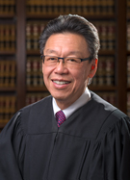
UNITED STATES JUDGES— GENERAL JURISDICTION

Slide 4
Same Judge Decides All Types of Cases—Criminal and Civil
CRIMINAL
*Drugs
*Fraud
*Guns
*Antitrust
*
CIVIL
*Contract
*Civil Rights
*Wage and Hour
*Discrimination
*Securities Fraud
*Antitrust
*Intellectual Property

Slide 5
TRADEMARK LAW
Generally two types:
Blatant Copycat/Counterfeit
and
Competitor versus Competitor

Slide 6
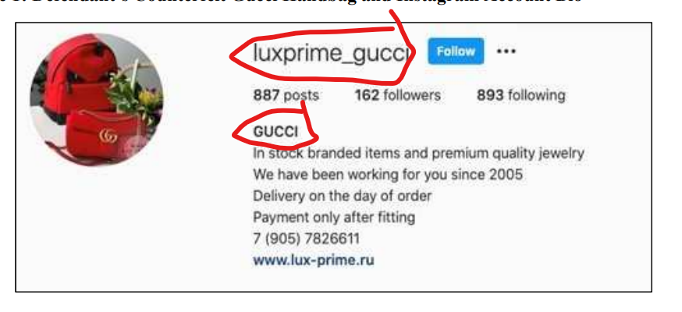
Copycat/Counterfeit

Slide 7
What Happens in the Usual Counterfeit Trademark Cases?
Defendant does not appear in the case
Default entered
Judge enters a permanent injunction
Accounts with $ frozen
Defendant will often create new website to get around the injunction
Follow up motions to modify injunction
New accounts with $ frozen

Slide 8
Trademark Infringement – Is There a Likelihood of Confusion?
Strength of the mark
Proximity of the goods
Similarity of the marks
Actual confusion evidence
Marketing channels used
Type of goods and services
D’s intent in selecting the mark
Likely expansion of product market

Slide 9
WHO DECIDES?
Judge Decides—Motion to Dismiss
Preliminary Injunction Motion
Summary Judgment
Bench Trial
A Jury Decides—if the plaintiff seeks $ damages

Slide 10
Buffalo Trace Bourbon v. 1000 Stories Bourbon Barrel Aged Wine

Slide 11
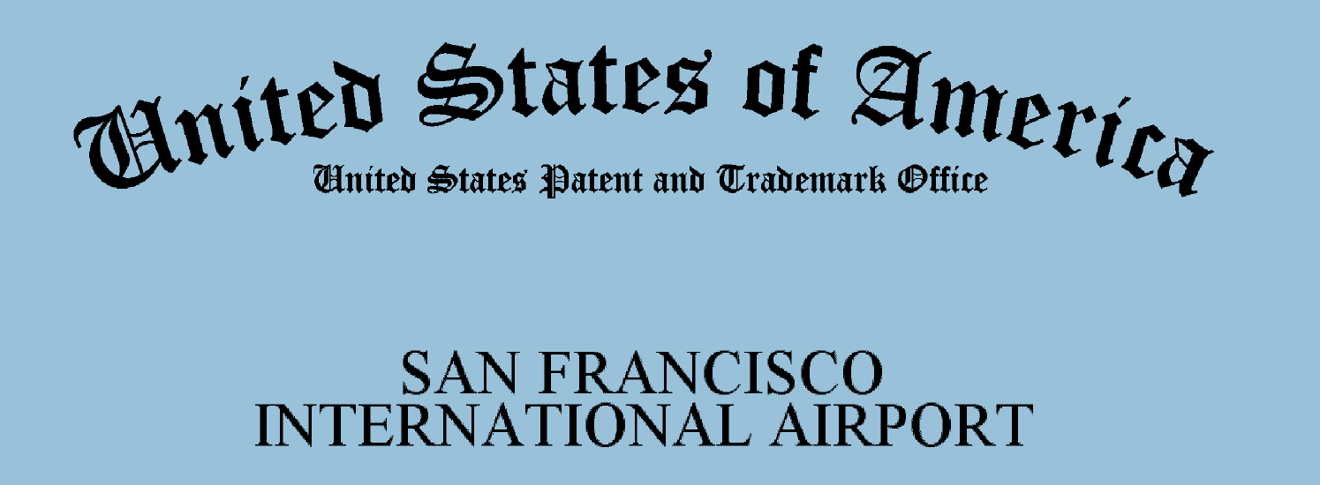
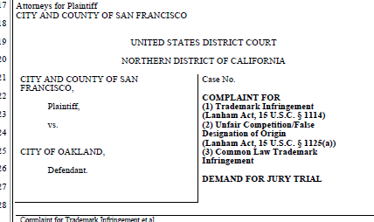
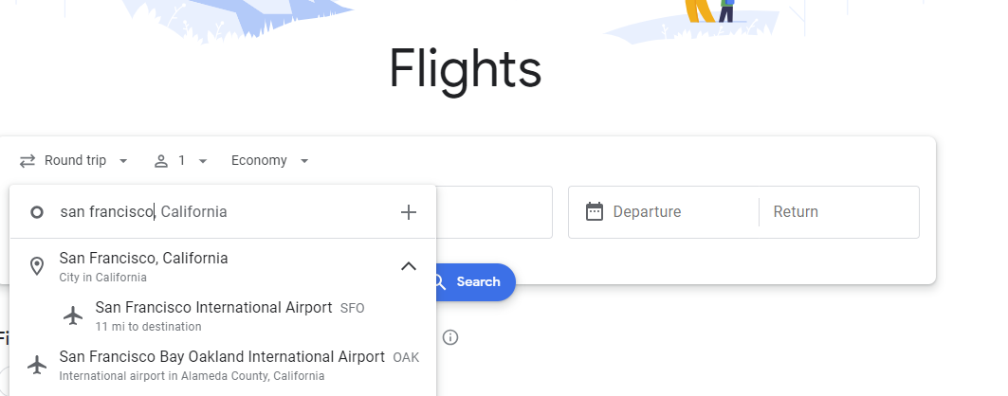

Slide 12
COPYRIGHT LAW
Often two types:
Blatant Copycat/Counterfeit
and
Competitor versus Competitor

Slide 13
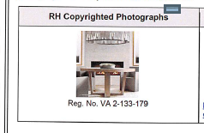
Copycat/Counterfeit

Slide 14
Moonbug v. Babybus
Competitor v. competitor copyright

Slide 15
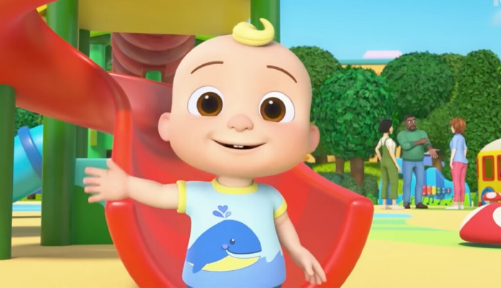
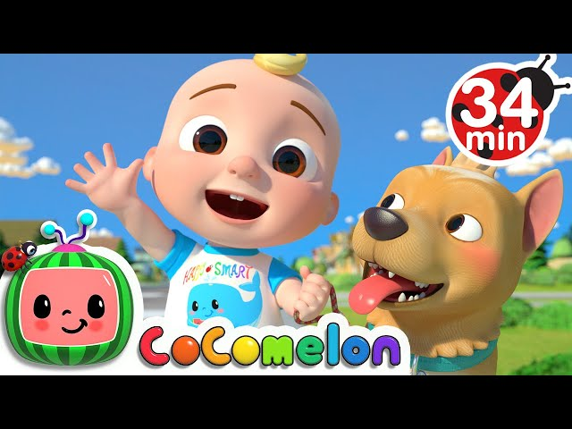
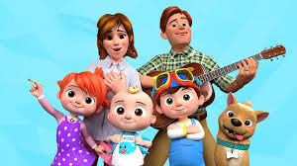
Moonbug is known for its popular children's entertainment franchise, CoComelon. CoComelon’s YouTube television series is known throughout the world. It is the most popular children’s video on YouTube.
The series centers around the main character, a baby boy named JJ, and his family.

Slide 16
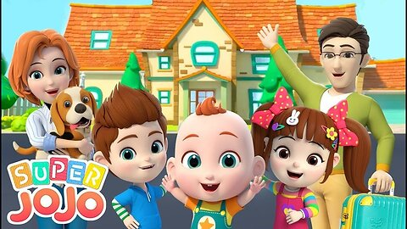
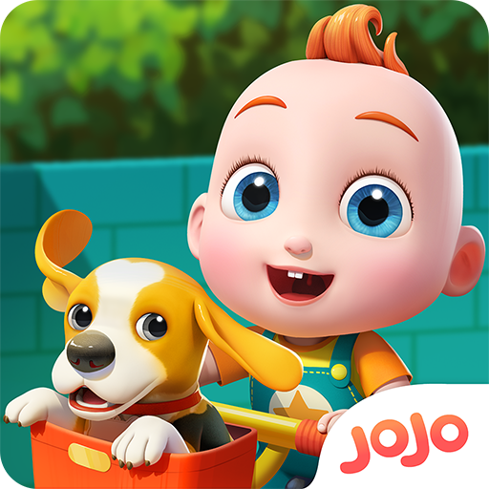
Defendant BabyBus offers a competing YouTube channel under the “Super JoJo” brand. Their series also centers around a main character, a baby boy named JoJo, and his family.

Slide 17
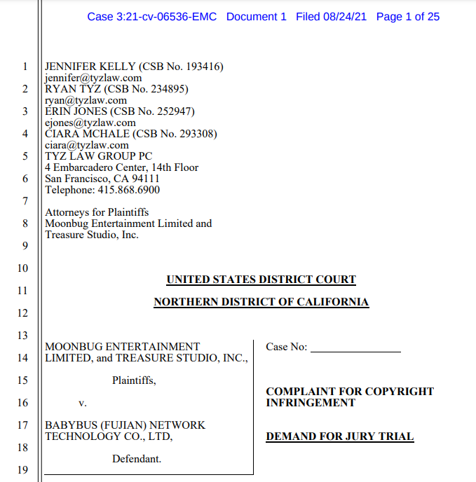
Moonbug sued Babybus for copyright infringement, accusing Babybus of copying its JJ main character and his family, and 39 CoComelon videos.

Slide 18
Moonbug sought an injunction against Babybus to stop the publication of the SuperJoJo series and damages.

Slide 19
What are the main considerations in determining whether Babybus infringed Moonbug’s characters and videos?

Slide 20
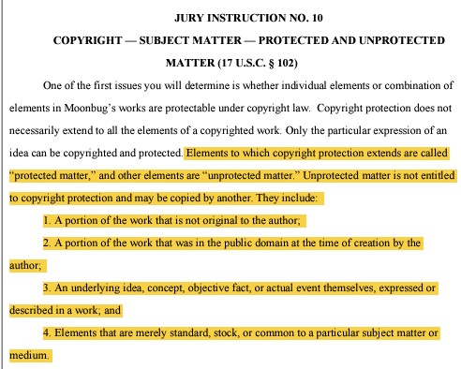
Main Considerations
What is protected? You have to have a valid copyright to protect.
Elements which generally depict a cartoon baby character and basic educational themes may be too generic.

Slide 21
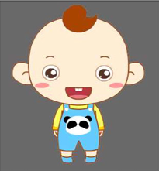
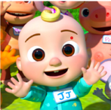
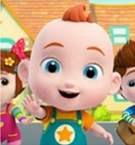
Babybus DouDou
Cocomelon
JJ
Babybus
JoJo

Slide 22
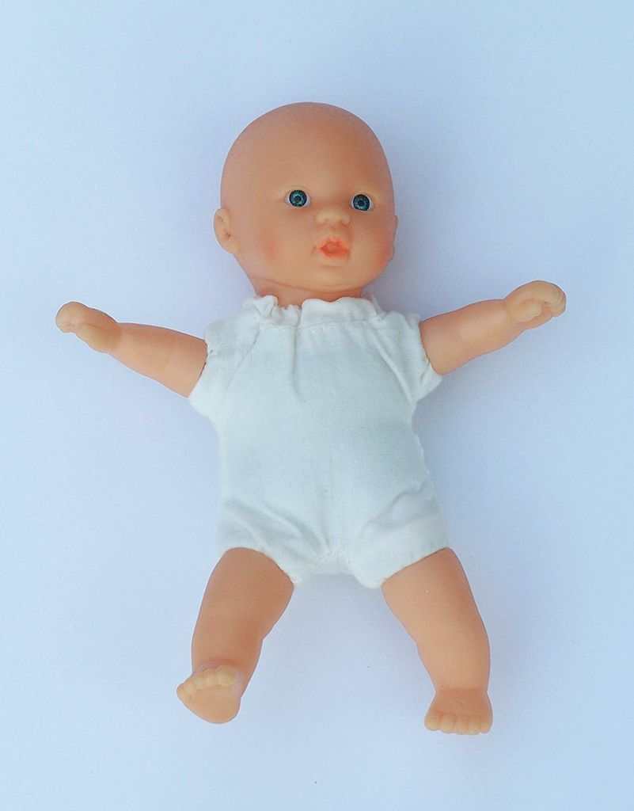
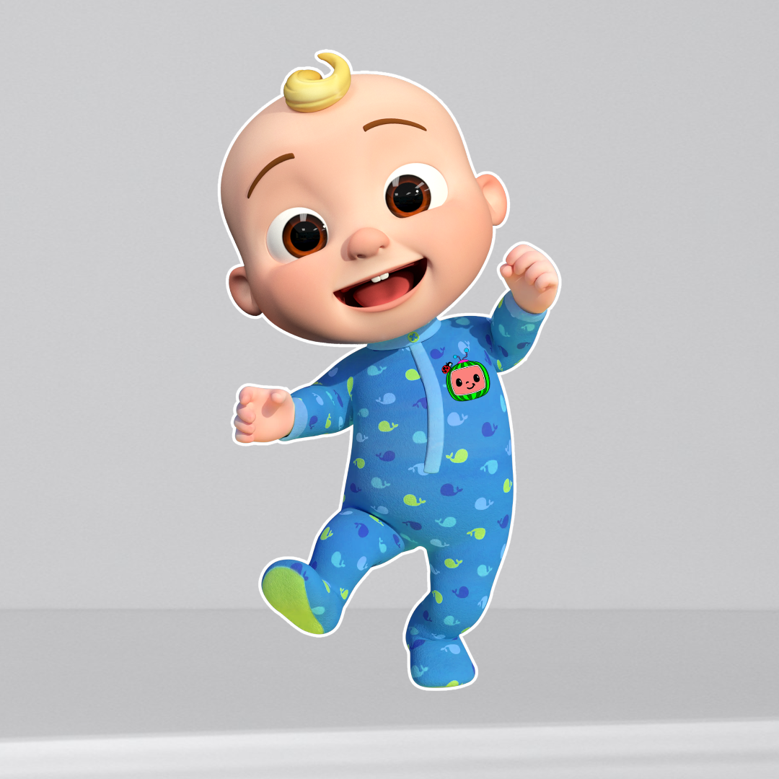
Main Considerations
Even if many individual elements are too generic to be protected, can the combination and arrangement of those elements be protected?

Slide 23
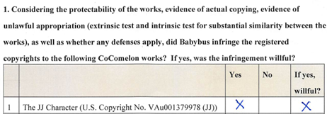
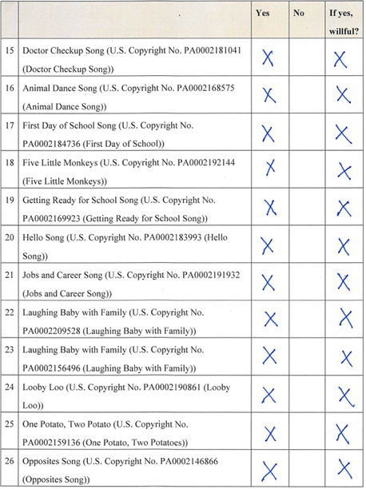
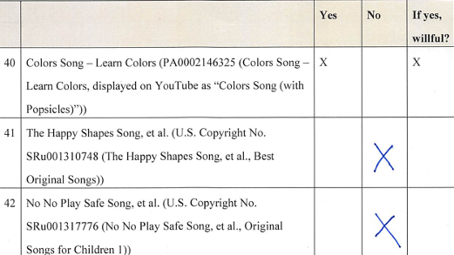
After a 10 day trial, the jury found Babybus liable for copyright infringement of the JJ character, and 36 of the 39 CoComelon works.
The jury awarded Moonbug a total of $17,718,114.00 in actual damages and lost profits.

Slide 24
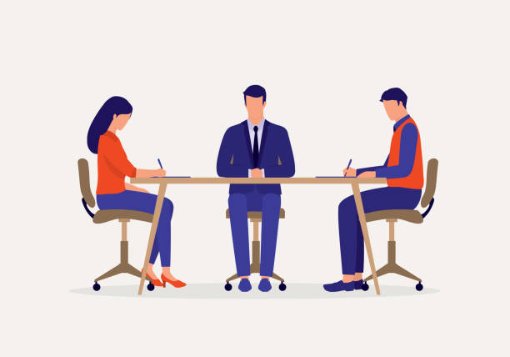
Alternative Dispute Resolution
Private mediation
Court-sponsored mediation
Magistrate Judge settlement conference

