Slide 1
Transforming the Digital Health Experience to Drive Engagement
Presenter Name and Subtopic
Date
Notes:
Welcome to our presentation on how Walgreens is transforming the digital health experience to better engage members in their healthcare and healthy living. We’re very excited to be able to share our multi-faceted digital platform and unique vision with you today.

Slide 2
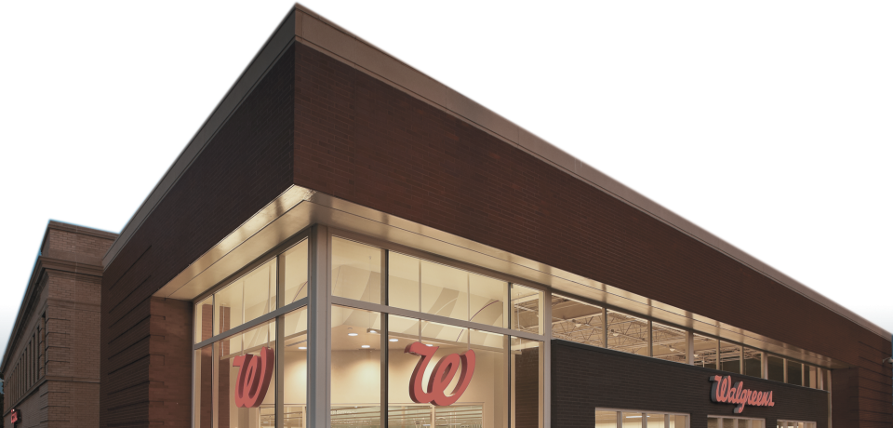
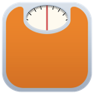
A digital health ecosystem that enhances and builds upon a solid foundation of face-to-face customer care
©
Notes:
Healthcare and consumer trends are influencing how to best provide care: consumerism in healthcare (care when I need it, where and how I want it); new technologies; increased adoption of new technology (everyone has smart phones).
In today’s fast-paced world of social media, fitness technologies and instant connection to information on all topics, people want healthcare that keeps up with and fits in with their lifestyle.
But quality healthcare and health information still needs to come from a reliable source and be based on personal relationships.
With a century of healthcare innovation and a national footprint of retail locations, specialty fill facilities, Healthcare Clinic locations, and health system pharmacies to build on, Walgreens is well positioned to be a leading force in the digital health revolution.
NOTE TO PRESENTER:
Logos from left to right are: GenieMD, BodyMedia, My Fitness Pal, LoseIt, Jawbone, WebMD, Walgreens, MDLive, Henry Ford Health System (our partner in patient engagement app developer contest), RunKeeper, Fitbit, Misfit, Withings

Slide 3
Home and virtual reach enables hundreds of interactions per customer, per year
Notes:
While health systems, doctor offices and clinics interact with a customer in the range of two to four times per year, the combination of Walgreens retail outlets and virtual connections create the opportunity for hundreds of interactions with the same customer every year.
Customers can connect via phone, tablet, computer, app, fitness tracker and more.
All those interactions present great opportunities for health education, coaching, testing, consultations and more—opportunities that can have a significant and lasting impact on the decisions people are making about their health and well-being every day.

Slide 4
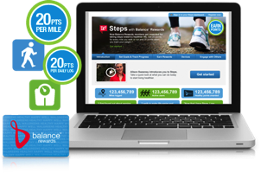
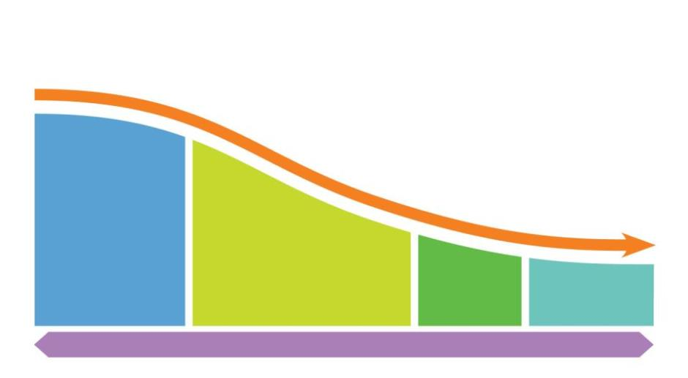
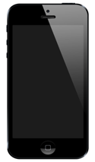
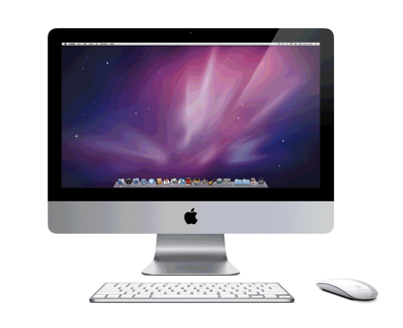
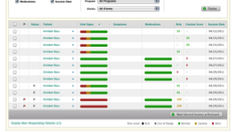
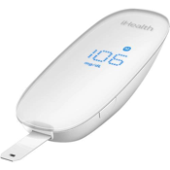
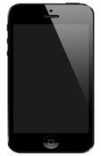
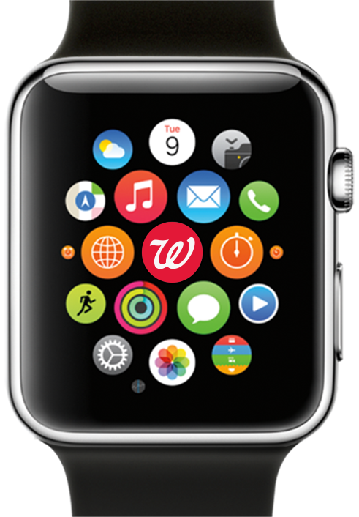
Aligning digital health connections with the continuum of healthcare
Self managed
Health, Fitness and Wellbeing
Self Diagnostics and Health Testing
Acute Care
Chronic Care and Aging
Self managed
Coached, monitored and managed
Continuum Of Care
Notes:
As customers progress along the healthcare continuum from being relatively healthy and able to monitor and affect their own well-being, to those who are diagnosed with chronic or acute conditions, they want and need digital options to enable easier access to quality information and care all along the way.
Walgreens has designed our digital ecosystem based on the various stages along the healthcare continuum.
For relatively healthy people: digital connections for general health information, to track fitness and monitor health, and get coaching on ways to live healthier lives.
For people who may have a family history of disease or have conditions such as prediabetes: ways to self-monitor and test to keep track of blood glucose, blood pressure, weight and more.
For those who become sick with the flu or other acute illness or injury: live connections with health professionals.
And for people with chronic conditions: easier ways to keep track of their medication therapy and stay adherent.

Slide 5
A digital ecosystem built on connectivity and convenience
81 million active Balance® Rewards members
8,000+ connected retail locations
Largest pharmacy EHR connects 27,000+ pharmacists
200+ API partners
250,000+ connected devices
Notes:
We are taking advantage of our broad digital reach to develop programs and interfaces that promote healthier lifestyle choices.
Balance Rewards has more members than any other loyalty program in the U.S. and continues to grow. This “big data” creates a vast number of opportunities to bring people together with actionable health programs and information on a personalized level.
Plus, all the touch points of Walgreens are digitally connected.
All 27,000 plus pharmacists can access electronic health records to help ensure the safety and appropriateness of medication therapy.
All 8,000 plus stores are connected for fast communication and customer service.
There are more than 250,000 connected devices delivering state-of-the-art access and convenience.
And we now have more than 200 partners that are interfacing with our digital ecosystem, opening up innovative pathways to more and more customer convenience and actionable information.
And it all must be filling a need for our customers:
We fill a prescription from a mobile device order every second of every day.
People chat online with a Walgreens pharmacist more than 9,000 times each week.

Slide 6
Industry-leading access and connectivity to help you achieve your population health management goals
Improving adherence
Engaging members
Rewarding healthy choices
Integrating with your programs
Notes:
Achieving population health goals and member engagement requires a diverse yet integrated system of digital touch points that can affect meaningful change, drive better outcomes and reduce overall healthcare spending for you and your members.
There are four major areas where we are utilizing digital to impact people’s lives for the better – improving adherence, engaging members, rewarding healthy choices and integrating with your programs.

Slide 7
Improving adherence with digital tools and easy access
Notes:
Studies have shown that better adherence drives down healthcare costs overall by improving outcomes, so we are leading the way in developing digital tools that make it easier for patients to stay on track.

Slide 8
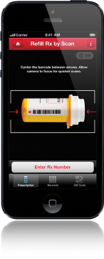
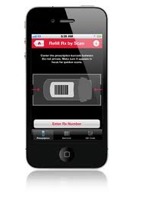
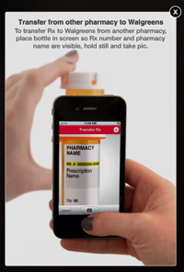
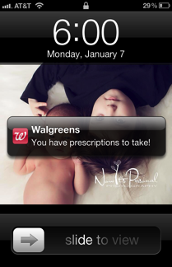
State-of-the-art digital tools help make it easy to stay on medication therapy
Refill by Scan
Transfer by Scan
Pill Reminder
The fastest way to refill
No-hassle Rx switch
Quick and easy
Notes:
Refill by Scan allows Mobile App customers to refill their prescriptions by simply imaging their current prescription containers. The image is received by the pharmacy and the refill process is begun—simple as that. Customers don’t have to call or go online or visit the store—just another way we are making the prescription process as frictionless as possible.
Transfer by Scan lets customers do the same to transfer their prescriptions.
Pill Reminder is like a virtual pill box that will alert users when it’s time to take their medication, helping to cut down or eliminate missed dosages and making it easier to take medication on time.
As part of Walgreens partnership with WebMD, People using WebMD’s mobile app for iPhones can access the Walgreens prescription refill and transfer services.

Slide 9
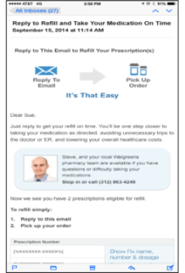
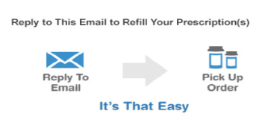
Refill reminders keep medication adherence top of mind
Delivered via text or email
A simple reply starts the refill process
Make it easy to select pickup location and time
Notes:
Refill reminders work as a virtual string around a finger helping to alert customers when a prescription is running out and making it as easy as possible to order the actual refill.

Slide 10
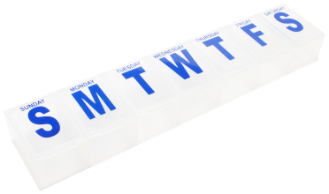
Email refill reminders improve adherence and persistence
Group | Patients who received refill reminders | Patients who did not receive refill reminders | Difference | P-value
Adherence (PDC) | 51.15% | 48.56% | 2.59% | <.001
Persistence (Days) | 236.01 | 228.11 | 7.90 | <.001
Source: Taitel M, Mu Y, Lou Y, Cannon A. Impact of Email Refill Reminders on Medication Adherence Among Patients with Chronic Diseases in a Retail Community Pharmacy. Poster presentation at Ispor 20th Annual International Meeting. May 20, 2015. Philadelphia, PA
Notes:
A clinical study was done to measure the impact of email refill reminders on medication adherence and persistence.
The study included a test and control group of 14,527 patients each—with refill reminders emailed to the test group and no reminders sent to the control group. Adherence was evaluated using proportion of days covered (PDC), while persistence was measure using days on therapy and percent of patients on therapy.
The test group and control group were compared in a 12-month follow-up period.
As the chart illustrates, the results indicated a significant increase in both adherence and persistence for the test group, meaning that email refill reminders did have a positive effect on the behavior of prescription customers.
ADDITIONAL STUDY BACKGROUND
Methods: Patients who received email refill reminders the first time in April 2013 comprised the test group. The control group included patients who did not receive the reminders and were propensity matched 1:1 to the test group based on baseline characteristics of age, gender, medications, patient fill status, baseline adherence rate, and therapeutic class.
Results: For both adherence and persistence, results are significant at
p <.01.

Slide 11
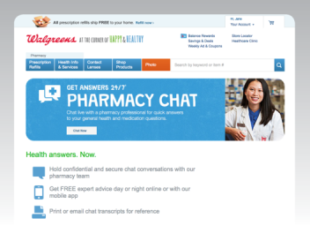
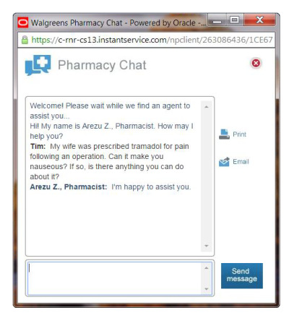
Pharmacy Chat helps remove obstacles to adherence
Pharmacy Chat available through Mobile App or Walgreens.com
Gives members easy, 24/7 access to pharmacy professionals when they have questions about medications
Hi! My name is Jane D. How may I help you?
Mary: I am taking tramadol for pain after an operation, but the full dose is making me nauseous. Can I split the pill in half?
Jane D., Pharmacist: I’m sorry to hear that. I hope you feel better soon. Splitting the pill in half might help lessen the nausea and would be a good thing to try. I would also recommend taking Emetrol syrup right before you take the tramadol. Emetrol is an over-the-counter medicine available at Walgreens.
Mary: Thank you so much for your help. ^{I’ll try that.}
Jane D., Pharmacist: Thank you for chatting, and Be Well.
Notes:
Digital is all about frictionless interaction, and what could be easier than chatting with a pharmacy professional online?
People who can’t or don’t want to visit a store, or are dealing with an issue in the middle of the night, have a convenient option for getting the medication answers they need from a trained member of our pharmacy team.
Currently, Walgreens pharmacists do 9,000 chats a week.

Slide 12
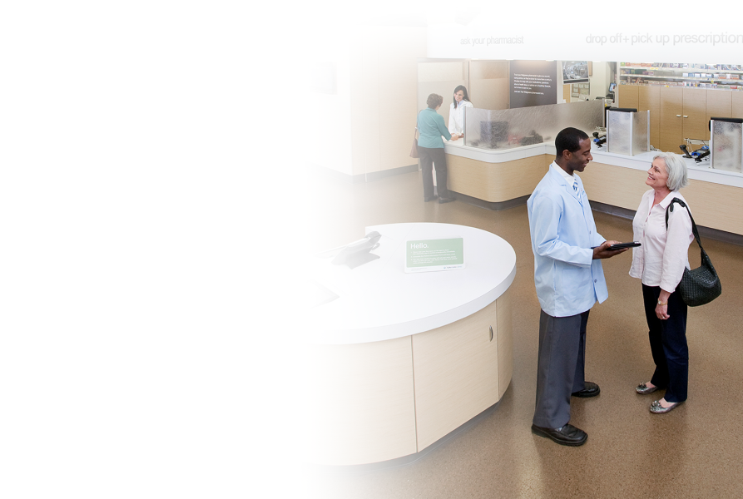
Easy scheduling and prescription management
Digital scheduling for Healthcare Clinic and immunizations so customers can choose a time that fits their schedules
Family prescription management tool means information is always within reach
Notes:
Many things in a customer’s day can derail their best intentions of making appointments to see a health professional, get an important immunization or order medication. Any digital innovations should anticipate obstacles to adherence and work to lessen or eliminate them.
Our digital scheduling tool is available through Walgreens.com or through our free App. It’s fast and easy to make an appointment to see a health professional at Healthcare Clinic or to get an immunization at the Pharmacy. Plus, having an appointment helps eliminate concerns about lines and availability, which can derail healthy actions.
Our prescription history window for Walgreens.com account members gives a comprehensive view of medication names, strengths, refill dates and more. And because family members can sometimes be the best way to keep a loved one adherent, we make it possible for one family member to manage their own prescription accounts and those of other family members.

Slide 13
Engaging members with accessible health information
Notes:
The easier it is for customers to get personalized, actionable health information, the easier it will be for them to make healthier decisions and take positive steps toward improving their overall health and well-being.

Slide 14
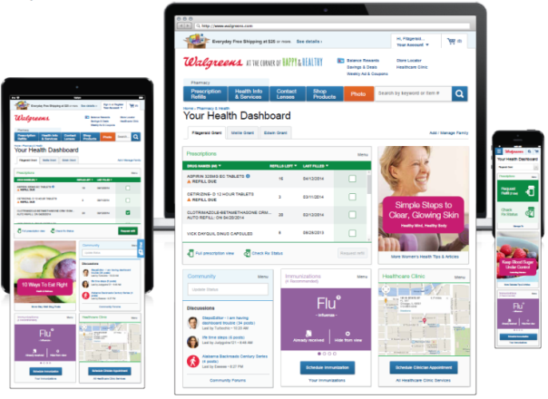
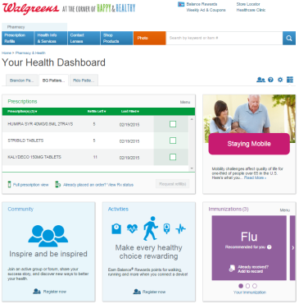
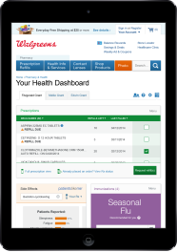
A personalized, adaptable health dashboard accessible across multiple platforms
Notes:
When customers create an account at Walgreens.com, they will have access to a comprehensive window of information called “Your Health Dashboard.”
The dashboard can include prescription history, immunization records and recommendations, a scheduling tool for immunizations and Healthcare Clinic appointments, health information from WebMD, personal activity tracker and more.
Customers can customize the content of their dashboard, and the information is accessible via desktop, phone and tablet, so customers can connect when and where they want to.

Slide 15
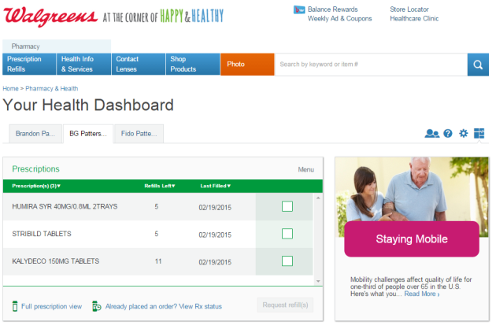
Easy access to prescription history, including specialty medications
Specialty medications allow for a more complete prescription history
Can add prescriptions for family members
Printable for doctor visits or for caregiver
Notes:
Having easy access to a list of current prescriptions, along with tools for managing those prescriptions, removes obstacles to better adherence. Walgreens.com account holders can view their prescriptions on any device, anywhere, anytime.
Even specialty prescriptions that may be delivered to their home from a central fill facility will be listed, so that customers can get a complete picture.
And, they can even add over-the-counter medicines and supplements. This comes in very handy when people need a list for a doctor visit or even a trip to the emergency room.
The “prescriptions” window on the health dashboard shows a quick view of the customer’s current prescriptions, strength, last-filled date and number of refills remaining.
The window also includes a menu where customers can choose options that will show images of the medications, see prices, allow them to add prescriptions of family members, transfer prescriptions, sign up for Auto Fill or ExpressPay and more.

Slide 16
Proven benefits of online access to health information
Patients who had an online account had a significantly higher adherence¹
Also, the percentage of online account patients with adherence >80% was higher overall, nearly 13% higher than those without an online management account¹.
Adherence rates of patients with and without an online management account*,
*Adherence measured as proportion of days covered (PDC)
1. Hou JG, Murphy P, Tang AW, Khandelwal N, Duncan I, Pegus C. Impact of an online prescription management account on medication adherence. Am J Manag Care. 2012;18(3):e86-e90
Notes:
People who have an online prescription management account, are also more adherent to their medication, according to a study published in the American Journal of Managed Care. This illustrated the impact that digital health options can have on healthy behaviors, which, in turn, can improve outcomes and lower costs overall.
This was a retrospective study utilizing de-identified pharmacy claims and eligibility data from a pharmacy benefit manager (PBM), covering the period from April 1, 2009 to March 31, 2011.
Patients with PDC >80% have been shown to have lower medical costs for diabetes, hypertension, and hyperlipidemia compared with nonadherent patients. ^{2,3}
2. Roebuck MC, Liberman JN, Gemmill-Toyama M, Brennan TA. Medication adherence leads to lower health care use and costs despite increased drug spending. Health Aff (Millwood). 2011;30(1):91-99. 3. Sokol MC, McGuigan KA, Verbrugge RR, Epstein RS. Impact of medication adherence on hospitalization risk and healthcare cost. Med Care. 2005;43(6):521-530.

Slide 17
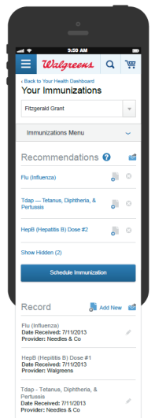
Immunization information all in one place
Shows immunizations received and even gives recommendations based on patient data
Will interface with the scheduling tool to make it easier to get a recommended immunization
Notes:
“Easy” is the key to changing health behavior for the better. By making individual immunization information available digitally, we are giving customers the tools they need to better manage their own health.
Walgreens.com and our Mobile App make it easy to see what immunizations customers have had—and which ones might be recommended for them.
Customers can also add immunizations they may have received at other locations, so they can have a complete immunization record that goes with them anywhere.

Slide 18
WebMD information for an enhanced experience
WebMD is the leading provider of health information services
Walgreens Web customers will have easy access to WebMD info
Topics include:
Allergy
Emotional help
Fitness
Healthy aging
Healthy eating
Heart health
Skin care
Much more
Notes:
With millions of online and mobile users, WebMD is the leading provider of health information services, so it made sense for the nation’s leading pharmacy chain to partner with a respected company that offers such a robust health information platform.
Walgreens and WebMD have a shared mission to improve health and wellness by providing unbiased information and data-driven, outcomes-focused programs that empower people to make healthier choices and take action that can improve their lives.
The Walgreens WebMD relationship encompasses not only the consumer platform, but also the Medscape platform for health professionals and WebMD Health Services that creates solutions to help businesses and organizations improve population health.
With this partnership in place, customers on Walgreens.com will be able to access WebMD health information and other features without having to leave the Walgreens site. In addition, WebMD health information will also be available to customers in Walgreens retail locations.
Plus, customers on the WebMD site will be able to use Walgreens refill and transfer services and clinic appointment scheduling options.

Slide 19
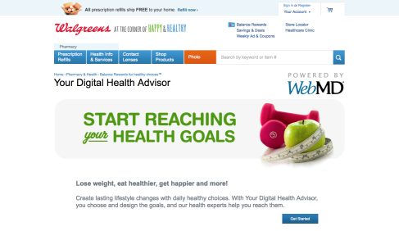
Your Digital Health Advisor helps with goal achievement
Powered by WebMD
Customized goals and action plans that support lasting lifestyle changes
Interactive programs that can help with:
Emotional health
Exercise
Nutrition
Smoking cessation
Weight management
Participants will earn Balance® Rewards points for making progress
Notes:
What if you could take a small manageable step toward a better life right now? Customized suggestions drawn from the expertise of WebMD Health Services health coaches can help people work toward lifestyle goals at their own pace.
Includes access to a world-class smoking cessation program.
To help maximize engagement, Your Digital Health Advisor participants will earn Walgreens Balance Rewards points for making progress in achieving their goals.

Slide 20
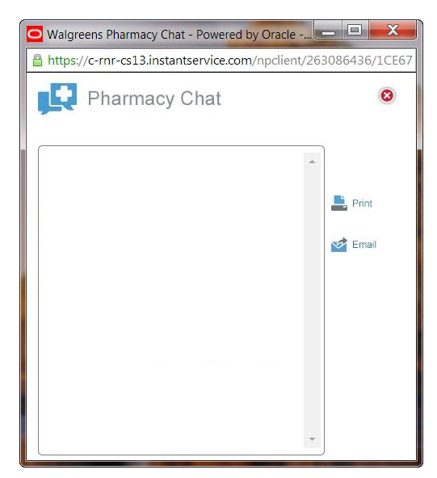
Pharmacy Chat team trained to coach members to engage in healthier lifestyle choices
Pharmacy Chat team trained in health coaching using a leading “small steps” method
Participants are given support resources and encouraged to start slow and steady
Helps with:
Fitness
Nutrition
Smoking cessation
Weight management
Hi! My name is Mary S., Pharmacist. How may I help you?
Tom: Are there any medications that can help me quit smoking?
Mary S., Pharmacist: Congratulations on your decision to make healthy choices. Walgreens has a wide range of nicotine replacement products over the counter from patches to gum. There are also inhalers, which are prescription items.
Tom: Any other information that would be helpful for me?
Mary S. Pharmacist: There are Government Quit Lines available to help with individual coaching and medication help at: http://smokefree.gov/talk-to-an-expert.
or you can call 1-800-784-8669.
Tom: Any other advice?
Mary S., Pharmacist: In the beginning it will be difficult so start slow and small and try to solidify a good habit. This will form a good foundation for additional progress. Do not be discouraged by initial failures or hiccups, this is expected. I wish you much success on making healthy choices.
Notes:
Pharmacy Chat is not only an adherence tool, it is a great way to help people stay engaged and make heathier decisions for lifestyle changes such as quitting smoking, getting fit, eating better and losing weight.
As an extension of Your Digital Health Advisor and to provide additional support to participants in achieving their goals, the Pharmacy Chat team has been trained in a leading coaching method that gives the pharmacist valuable tools to help people start small and build gradually, which can create a better foundation for lasting, healthier habits.

Slide 21
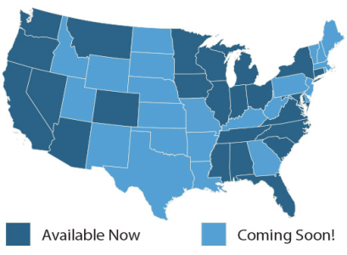
Virtual doctor consultations provide valuable options
After Pharmacy Chat, the “next generation” in virtual healthcare
Virtual doctor consultation via partnership with MDLIVE
Walgreens website customers will have access to U.S. board-certified doctors through our Mobile App in more than 20 states
64% of Americans are willing to see a doctor via video telehealth¹
1. Harris Poll survey
Notes:
Walgreens has offered telehealth for a since 2013 via the Pharmacy Chat service. MDLive evolves that a step further by offering live connections with board-certified MDs.
Our partnership with MDLIVE will enable digital customers to have a live consultation with a board-certified doctor through our Mobile App and now through Walgreens website on a desktop or tablet.
The service gives customers a new, very convenient option for connecting with a medical professional for a variety of acute conditions, and is available 24/7.
People that may have skipped a visit to the doctor due to schedule restrictions or other reasons now have an option that may remove some of those obstacles.
A majority of Americans are willing to use this type of service, reflecting an overall trend in the acceptance of digital healthcare options.
NOTE: States where MDLive is currently available: AL, AZ, CA, CO, CT, FL, IA, IL, IN, MD, MI, MN, MO, MS, MT, NC, NV, NY, OH, OR, SC, TN, VA, WA, WI

Slide 22
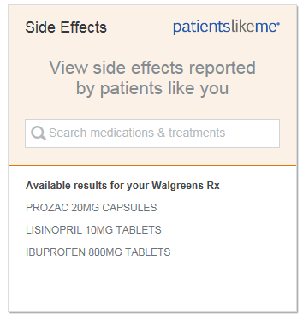
“Patients Like Me” uses the power of crowdsourcing to enable patient engagement
External content provider offers insights provided by actual patients
Makes it easy for people to compare treatments, symptoms and experiences
Patients Like Me has:
300,000 members
2,300+ health conditions
50+ published research studies
25 million disease data points
Notes:
As part of our commitment to providing a comprehensive, data-driven digital experience for users, we are tapping into external partners who can add value to our digital platform.
“Patients like me” gives users the ability to input medications, symptoms and conditions and then see what other users with similar data are experiencing.
This shared data provides a different and valuable perspective for people and adds to their overall information bank, helping them to stay engaged and keep on track with treatments and medications.
All content is provided by Patients Like Me, and they manage the discussion boards that connect people together. More information is available at patientslikeme.com.

Slide 23
Driving better health by rewarding healthy choices
Notes:
People are motivated by many things, and one of them is getting rewarded for taking steps that are good for them. Walgreens understands the power of rewarding healthy behavior and has made this concept a pillar of our Balance Rewards program.

Slide 24
Balance Rewards for healthy choices® program
Points act as incentives for setting goals, completing daily activities that help toward goals and achieving goals.
Set a healthy goal 250 points/set goal
Walk, run or cycle 20 points/mile
Test blood pressure 20 points/daily log
Achieve a healthy goal 250 points/set goal
Exercise activities 20 points/daily log
Monitor blood glucose 20 points/daily log
Link an app or device 250 points/device or app
Weigh-ins 20 points/daily log
Quit tobacco with NRT 20 points/daily log
Points may be limited per the terms and conditions of the program. Information provided to Walgreens online is covered by the terms of our Online Privacy and Security Policy and the terms and conditions of Balance® Rewards. Personally identifiable information is not covered under HIPAA or the Walgreens Notice of Privacy Practices. For full program terms and conditions, visit Walgreens.com/healthychoices.
Notes:
The Balance Rewards for healthy choices program is an integral part of the overall Balance Rewards experience. It is designed to reward participants for setting goals like reaching a certain weight, stopping smoking, achieving a blood pressure or blood glucose level.
And because it’s all about reaching goals by taking small steps, participants are rewarded for doing the daily activities that help them reach their goals, such as walking a certain distance, logging their weight daily, and taking their blood pressure or blood glucose readings.
And, of course, they are rewarded for reaching their goals.

Slide 25
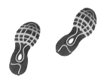
Built on small-step methodology
Based on a program developed by a leader in behavior change methodology
Large goals are achievable by starting with small steps
Points build up through routine healthy activities
Notes:
A program to change behavior by taking very small steps first, making it easier to create long-lasting behavior change.
The Balance Rewards for healthy choices® program utilizes this platform to reward “easy” lifestyle changes. Members are rewarded with points for such simple activities as logging their weight and getting their blood pressure or blood glucose levels tested.
What’s more, members get points for “every” mile walked or jogged (limit 20 points per mile, 1,000 points per month). That gives them an incentive even if they start by walking just a mile. And if they connect a fitness device, it can be surprising how easy it is to walk a mile every day.
The points add up over time and reinforce the healthy behavior or activity, which leads to bigger goals being achieved and sustained behavior change.

Slide 26
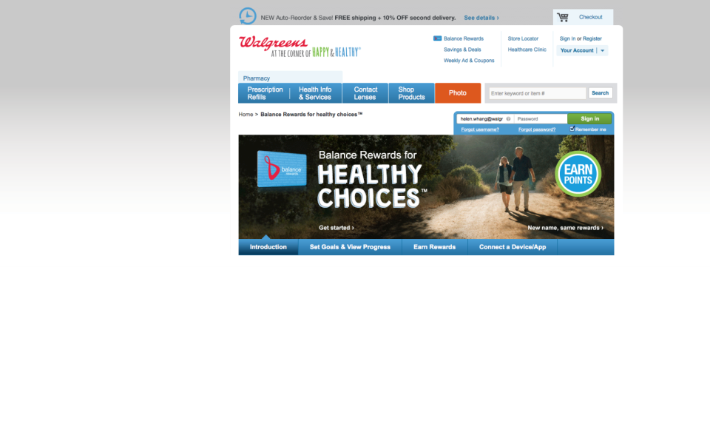
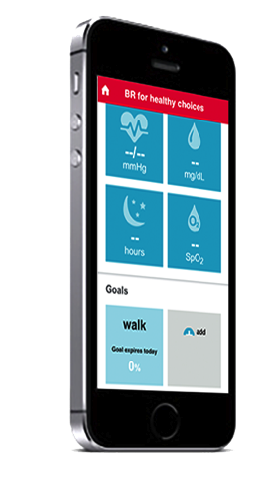
Seeing healthy engagement
800,000 active users
1.5 million goals set
73 million miles logged
250,000 connected devices
1.9 billion points awarded
Notes:
The numbers show that people are seeing the benefits to logging on and making healthy lifestyle choices. For each member, it can be a very small commitment, but for the entire population, it adds up to a large-scale shift in behavior, which can improve health and lower costs for a significant number of Americans.

Slide 27
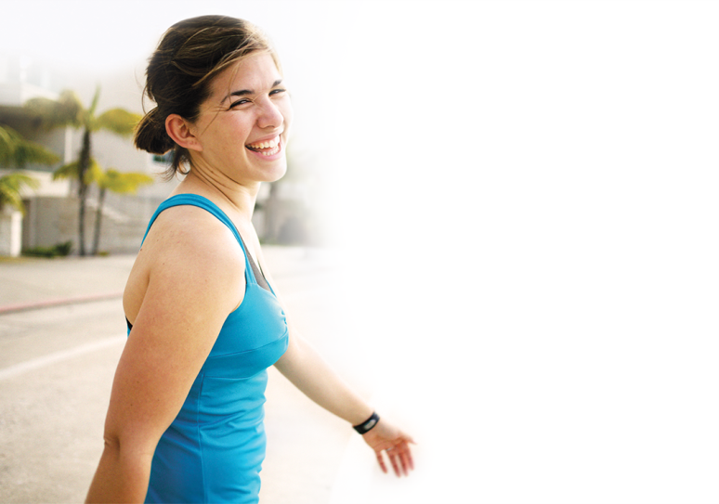
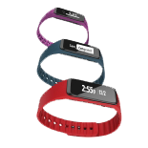
Capitalizing on digital health tracking trend
21% of Americans use some form of technology to track their health data¹
We’re compatible with their favorites
Members have connected more than 250,000 devices
And more
Walgreens Activity Trackers
1. Pew Research Internet Project, Health Fact Sheet. http://www.pewinternet.org/fact-sheets/health-fact-sheet/. Accessed December 30, 2014.
Notes:
Currently, 21 percent of Americans use some form of technology to track their health data.
But while other health and wellness programs connect with a few of the top wearables and apps, we’re continually growing our digital ecosystem to cover all of your members’ favorites.
To date, program members have connected 250,000 of their devices to our program.
And, Walgreens now offers our own activity tracker that tracks activity, sleep, calories burned, distance and more—at a very cost-effective price.

Slide 28
Participants are achieving weight goals
During a six-month study of 6,196 participants who tracked their weight through Balance Rewards for healthy choices™:
All participants lost an average of 3.3 lb.
27% of participants lost more than 6 lb.
Walgreens data on file.
Notes:
But does all this connection and engagement lead to actual results? Yes! When members tracked their weight through Balance Rewards for healthy choices, all those studied lost an average of 3.3 pounds.
27% of participants nearly doubled that to 6 pounds and 16.5% lost more than 10 pounds.
So, on average, when people are incentivized for making a simple change such as logging in their weight daily, they tend to create behaviors that lead to sustainable healthy changes.
NOTE:
Source data: Members enrolled in BRhc between 5/1/2014 and 6/30/2014. Tracking Period: 180 days from member’s BRhc enrollment date

Slide 29
Greater medication adherence for members who tracked healthy behaviors—high blood pressure
Significantly greater† medication adherence was noted in participants who:
Tracked their blood pressure
Tracked their activity and logged an average of one mile per day
Mean adherence by blood pressure tracking status and total miles logged*¹
† P < 0.05
*Adherence measured as proportion of days covered (PDC)
1. Taitel M, Jiang J, Akinbosoye O, Orr G. Assessing the Relationship between Online Activity & Biometric Tracking and Medication Adherence among Members with Hypertension. Poster Presentation at Society for Behavioral Medicine 36th Annual Meeting and Scientific Sessions. April, 22 – 25, 2015. San Antonio, TX.
Notes:
Walgreens identified three groups of participants in Balance Rewards for healthy choices—those who had high blood pressure, diabetes and high cholesterol—and compared them to a similar group of nonparticipants. The data presented is over a six-month period.
The results show that participants who engage in healthy behaviors, such as logging their miles and tracking their blood pressure and blood glucose readings into Walgreens Balance Rewards for healthy choices, tend to also have better medication adherence.
For patients with hypertension, adherence was higher for both members that tracked their blood pressure through the program and those who walked at least one mile per day.

Slide 30
Greater medication adherence for members who tracked healthy behaviors—diabetes
Significantly greater† medication adherence was noted in participants who:
Tracked their blood glucose
Tracked their activity and logged an average of one mile per day
Mean adherence by blood glucose tracking status and total miles logged*¹
† P < 0.05
*Adherence measure as proportion of days covered (PDC)
1. Taitel M, Jiang J, Akinbosoye O, Orr G. The relationship between online activity and biometric tracking and medication adherence among members with diabetes. Poster presented at: 75th Scientific Sessions (2015) of the American Diabetes Association; June 5-9, 2015; Boston, MA.
Notes:
For patients with diabetes, adherence was higher for both members that tracked their blood glucose through the program and those who walked at least one mile per day.
Additional talking points if using this slide on its own:
Walgreens identified three groups of participants in Balance Rewards for healthy choices—those who had high blood pressure, diabetes and high cholesterol—and compared them to a similar group of nonparticipants. The data presented is over a six-month period.
The results show that participants who engage in healthy behaviors, such as logging their miles and tracking their blood pressure and blood glucose readings into Walgreens Balance Rewards for healthy choices, tend to also have better medication adherence.

Slide 31
Greater medication adherence for members who tracked healthy behaviors—high cholesterol
Significantly greater† medication adherence was noted in participants who:
Tracked their activity and logged an average of one mile per day
Mean adherence by total miles logged*¹
† P < 0.05
*Adherence measure as proportion of days covered (PDC)
1. Walgreens data on file.
Notes:
And, for patients with high cholesterol, adherence was higher for members who tracked their steps and walked at least one mile per day.
Additional talking points if using this slide on its own:
Walgreens identified three groups of participants in Balance Rewards for healthy choices—those who had high blood pressure, diabetes and high cholesterol—and compared them to a similar group of nonparticipants. The data presented is over a six-month period.
The results show that participants who engage in healthy behaviors, such as logging their miles and tracking their blood pressure and blood glucose readings into Walgreens Balance Rewards for healthy choices, tend to also have better medication adherence.
NOTE to presenter: There is no blood pressure or blood glucose tracking equivalent for high cholesterol, so this study only reflects steps.

Slide 32
Once signed up, people stay with the program
Retention of active Balance Rewards for healthy choices™ members with connected device*¹
*Active defined as having logged an activity in the past 30 days
1. Walgreens data on file. Data collected September 2014.
Notes:
Plus, members of Balance Rewards for healthy choices are staying engaged over time.
Here’s a look at the percentage of members with a connected device logging activities for 12 months.
These aren’t people just going for a gift card. These are hundreds of thousands of people working on daily and long-term health goals—and being supported by a program that gets what’s important to them.
… It really works.

Slide 33
Integrating with your programs
Notes:
We’re so confident in our digital health ecosystem and so committed to ongoing innovation, that we are looking for ways we can partner with companies and organizations to bring more value to all concerned.

Slide 34
Interfacing with your programs to help members reach health goals
The health dashboard can offer information from third parties—such as plan information
Balance® Rewards can offer points as incentives to specific populations
Walgreens APIs
Rx transfer and refill
Healthcare Clinic scheduler
Balance® Rewards
Notes:
We realize that partnering with other organizations and incorporating customized information into our digital offerings can only enhance the experience for users.
That’s why our Health Dashboard has the capability to include or link to information from third parties—for instance we can show specific plan information relevant for your members.
Customers viewing the dashboard can click on one of their prescription drugs and get a summary of side effects including most common and reported severity. Plus, they can link to the partner supplying this information, Patients Like Me, to get an even deeper, user-generated experience.
We can also offer Balance Rewards points as an incentive that’s tied to third party health programs for their populations. We’ll interface with your program to help make it a success.
And, our we have APIs for prescription refills and transfers, scheduling Healthcare Clinic appointments and for rewarding Balance Rewards points for healthy activities – making it easy to incorporate these functions into your own digital experience.
NOTE to presenter: API is “Application Programming Interface”, basically a set of programming instructions and standards for accessing a Web-based software application or Web tool. This enables our partner to provide a seamless experience to the user. To see an example, view the Walgreens Rx Refill/Transfer function on the WebMD mobile app.

Slide 35
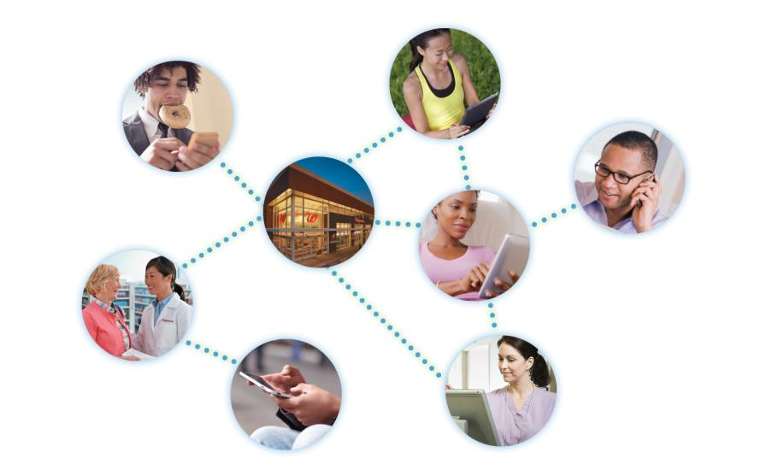
A broad digital reach enables programs that can transform health choices and actions
Notes:
We are definitely not sitting tight when it comes to our digital ecosystem—we have many new features, tools and conveniences lined up for 2015 and beyond.
In the end, it’s all about better connections leading to improved healthcare engagement. Building on our more than 8,000 retail locations and face-to-face patient care, Walgreens is riding the leading edge of the digital health wave to bring more and more options to eager customers.
Whether it’s by phone, tablet, laptop, desktop, web, app or other channel, we’re making sure that when people turn to digital healthcare options, Walgreens is their first choice.

Slide 36
Thank you!
Notes:
Thank you for your time. We hope you have enjoyed the presentation and have a better appreciation for the scope, goals and direction of our fast-growing digital ecosystem. We also hope this has sparked some thought on how Walgreens can help you reach your population health goals.

