Slide 1
Electronic Prescribing: A Pharmacist’s Point of View
Jon Arends, PharmD
Director, Electronic Prescribing
February 2015
Notes:
My background. Pharmacist practiced in field at walgreens. Previous role Pharmacy Operations SME when designing enhancements for our fulfillment system. Focus on efficiency and clinical informatics.

Slide 2
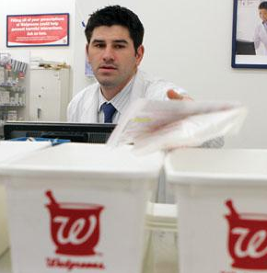
High Level NEWRX
Central eRx Platform
Work Queue
Image Queue
Rx Fulfillment
Notes:
Generally, it takes 1-2 minutes to get to the store. However, our system is optimized for guaranteed delivery, not speed.
Image transcription is high priority task in the workflow – however many cases are opened against walgreens for not receiving prescription. When we investigate using the provided message ID, the prescription has almost always been dispensed. Need more time before contacting us to check on Rx. Often, we may say not yet, or not ready and that gets misinterpreted to didn’t get at all driving a case. Its in both best interests to limit the number of unnecessary cases opened.

Slide 3
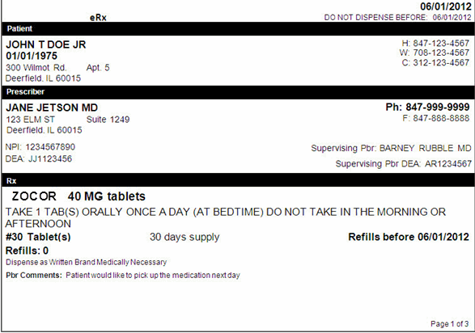
10.6 Mockup
Page 1
Key Information to process the prescription
Patient:
Name and Demographic Information
Contact Information
Prescriber:
Name and Demographic Information
NPI and DEA Identifiers
Supervising Prescriber Name and DEA
Prescription:
Drug Description, Directions
Quantity and Potency Code
Days Supply Value
Last Fill Date
Substitution
Notes
Notes:
Say: The eRx mock-up has been updated to provide a more intuitive layout and to include additional information related to a patient’s prescription. The information sent by prescribers is displayed on the eRx mockup divided into three pages.
Page 1 contains key information needed to process the prescription.
Page 2 contains additional information about the prescriber and supervising prescriber.
Page 3 is an Optional page that includes information related to the patient’s insurance plan.
Please Note: The information is always displayed in the layout and order presented, however not every mockup will contain all of the fields shown. If no information is sent, the field label will not be displayed on the mockup.
NDC is not on the mockup. It is used for automation. Can’t do quality check to ensure they match unless sending RxNorm

Slide 4
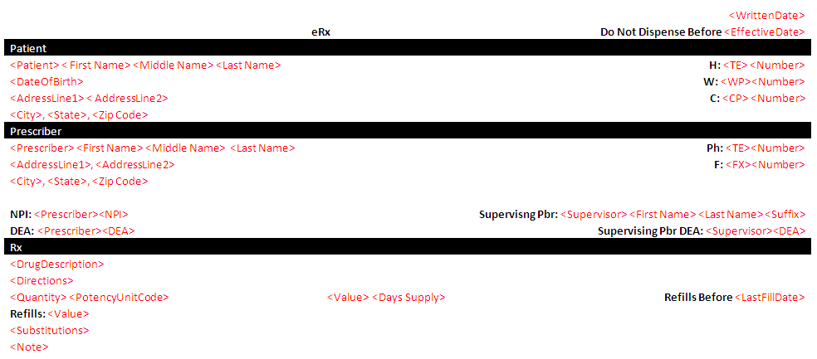
10.6 Mockup
Notes:
Say: The eRx mock-up has been updated to provide a more intuitive layout and to include additional information related to a patient’s prescription. The information sent by prescribers is displayed on the eRx mockup divided into three pages.
Page 1 contains key information needed to process the prescription.
Page 2 contains additional information about the prescriber and supervising prescriber.
Page 3 is an Optional page that includes information related to the patient’s insurance plan.
Please Note: The information is always displayed in the layout and order presented, however not every mockup will contain all of the fields shown. If no information is sent, the field label will not be displayed on the mockup.
NDC is not on the mockup. It is used for automation. Can’t do quality check to ensure they match unless sending RxNorm

Slide 5
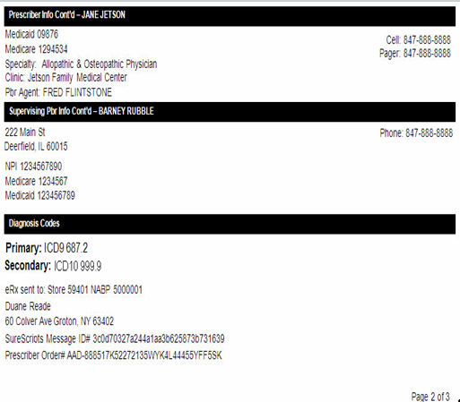
10.6 Mockup
Page 2
Additional Information about the prescriber(s)
Prescriber:
Additional Prescriber IDs, Clinic and Specialty
Agent
Additional Phone Numbers
Supervising Prescriber:
Address, Phone Number,
3 prescriber IDs max
Phone
Primary and Secondary Diagnosis Codes
Message Routing Information
Notes:
Say:
Page 2 contains additional information about the prescriber and supervising prescriber. This is not duplicate information from page 1.
Next to number 1, there are additional ID numbers for the prescriber. Some states have Medicaid specific IDs or some reimbursement forms may require a prescriber UPIN ID. Those would display here if sent with the prescription.
The prescriber’s clinic name and specialty are now displayed, along with additional contact numbers for the prescriber.
The Pbr Agent field is the staff member who actually entered or approved the prescription.
Number 2 shows additional information about the supervising prescriber.
Number 3 shows where up to 2 primary and 2 secondary diagnosis codes will be displayed. These may be useful for certain Third Party Rejections.
And finally, number 4. Transmission information should always display. This information should match your pharmacy. It’s not necessary to verify this. Just know that it is there.

Slide 6
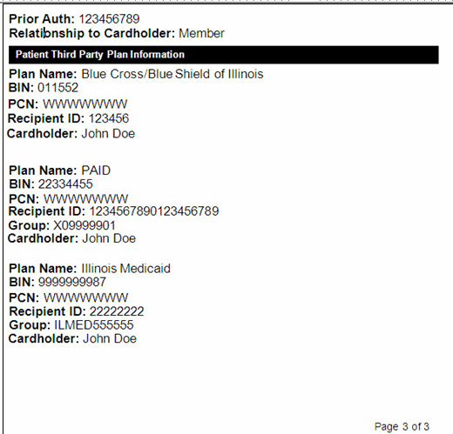
10.6 Mockup
Page 3
Patient Insurance Information
COO Segment
Automated Entry
Manual Display
Prior Authorization Number
Relationship to Cardholder
Plan Information
Notes:
Walgreens has developed automation for COO segment.
If:
Relationship to cardholder is Member, BIN and PCN are unique, and patient has no other plans on file with same BIN number, it will automatically get added to patient profile.

Slide 7
Patient and Prescription Matching
Dashboard indicates when a new eRx is in the image queue.
Common workflow step for eRx and all other prescriptions
When an eRx is the highest priority item:
Patient and prescription matching window is displayed to user.
Notes:
Phone, Birthdate Name are only available search criteria.
Search response displays address and gender for confirmation.

Slide 8
Order Entry – Drug
User is taken to Order Entry Window
Drug Selection occurs first step in transcription process
Using information from the mockup, user enters search criteria to generate multi-hit window

Slide 9
Order Entry – Prescriber Selection
Next Workflow Step:
Pbr search automatically initiated using SPI.
Notes:
SPI is not in search results. And users do not have capability to search by SPI. Legal requirement to select correct street address for controlled substances, so operational procedures are to select by NPI/DEA (governmental unique ID#s) and street address.

Slide 10
Questions?

