Slide 1
Evolution, Revolution and Innovation within Balance Rewards
October 16, 2015

Slide 2
A history of innovation at Walgreens
Opened
first
Healthcare Clinic
2006
Stand-alone stores with drive-thru pharmacies 1992
Multiple language Rx labels 2002
Duane Reade
acquisition is
finished 2010
First store
is opened 1901
1950
1960
1970
1980
1990
2000
2010
1950
Self-service stores
1968
First with child-resistant containers
1991
Point-of-sale scanning
1999
Prescription history online
2005
Online digital photo

Slide 3
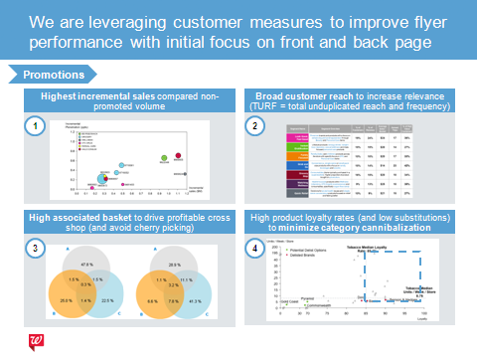
Balance Rewards delivers customer value through points, personalization, and customer knowledge
Deliver differentiated customer value
Build best customer knowledge
Reward and retain our customers via points earn and redeem | Increase value among existing customers via personalized deals | Capture customer data to optimize shopper experience | Build knowledge to inform differentiated experiences

Slide 4
Balance Rewards engages customers across three key pillars
Rewarding best customers for choosing Walgreens
Retail rewards | Pharmacy rewards | Balance Rewards for healthy choices
More Points. More Rewards.

Slide 5
Points are an effective currency with a long-term value cycle and differential appeal to best customers
Points Cycle
Points vs. Dollar Response Rate
Average response
Earn Incremental sales at earn during promotions
Redeem New trips and sales lift on redemption
Retain Improved retention and brand equity for Walgreens
Dollars
Points
High Value Customers
All Customers

Slide 6
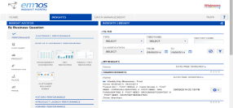
We launched the largest loyalty program in the country with over 85M members* and continue to evolve
FY13
FY14
FY15
Balance Rewards launches September
Vendor Insight Sharing December
Personalized Quarterly Thank You mailer May
Everyday points events launch January
Paperless
coupons April
Everyday points, Multipliers June ‘15
*defined as any member with a Balance Rewards transaction in the last six months

Slide 7
Customers were delighted with core elements of Balance Rewards but wanted more ways to earn points
Program Satisfaction Scores
✓
✓
“It feels like a scavenger hunt [to earn points] …I want to earn more points for all of my purchases.”
- Loyal Customer Atlanta
✗
Rewards Expiration
Easy to Redeem Rewards
Easy to Earn Rewards

Slide 8
Based on customer feedback, we re-launched Balance Rewards on May 31 to enable consistent points earning
100 points per script or immunization, including Medicare
10 points per dollar on almost every item in retail
+
Now available for all prescription plans
Members opt in to this new benefit
Notes:
SAY:
There are two updates to Balance Rewards
100 points per script or immunization for all members including Medicare or Medicaid
There is no action required for this change. Members just need to enter their phone number or scan their card
It will go live on May 31st to all members
2. 10 points per dollar on almost every item in front of store
Members must opt-in via pin pad, Walgreens.com or the mobile app for this new update
The opt-in will be made available chain wide on May 31st
These updates will make Balance Rewards program easier to understand among our members.
We anticipate that this will drive more awareness and engagement especially with our best customers.
With everyday points, we can create unique and easy promotions for our members.

Slide 9
Everyday points enable multiplier promotions, aligning with goal to simplify customer offer
Today
Tomorrow
Complex and labor intensive for store
Simple, effective, easy to execute

Slide 10
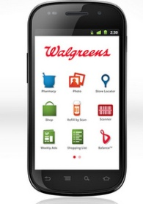
We marketed digital channels as primary way to add the new ‘Everyday Points’ program perk
Digital Opt In
Available to all members
Mass marketed with 360 support
Three ways to opt in:
Walgreens.com dashboard
Mobile App
‘One Click’ email

Slide 11
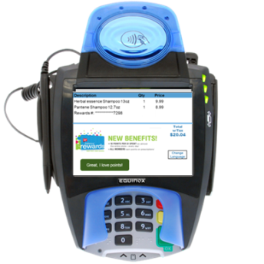
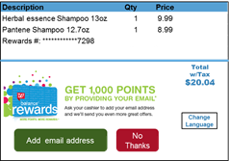
Select members were prompted to add the new perk at check out, and encouraged to provide email
Pin Pad Opt In
Email Collection
Only select members prompted to opt in at checkout
Members earned 1,000 bonus points for providing email at check out

Slide 12
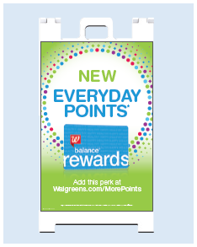
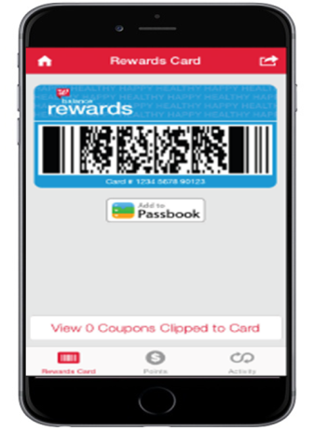
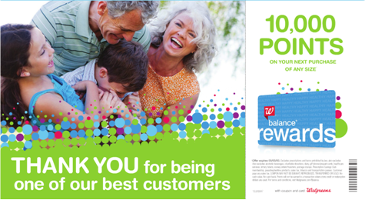
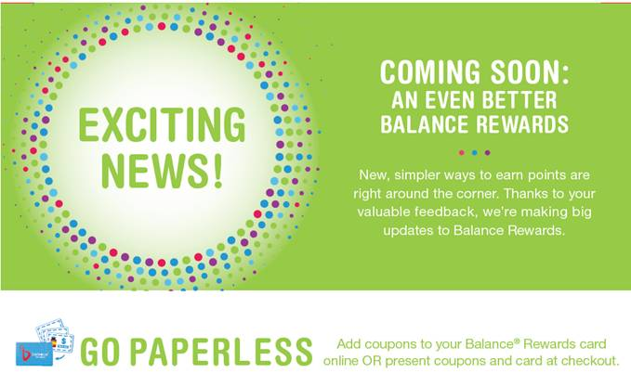
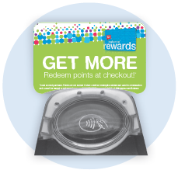
Re-launch was supported with 360 marketing with emphasis on digital, radio, ROTO and in-store
©2015 Walgreen Co. All rights reserved.

Slide 13
Balance Rewards re-launch successfully increased member and operational engagement
Relaunch Success
Active Members | Increase vs. FY14
Sales on Card | Increase vs. FY14
Member Engagement | Majority of best earning & redeeming more
Customer Delight | Significant increase among EDP earners
Multiplier Events | First events exceeded expectations
Field Feedback | Positive, increased team member engagement
©2015 Walgreen Co. All rights reserved.

Slide 14
Video: The New Balance Rewards

Slide 15
Our program retains the benefits of a discount program while increasing long-term customer engagement
Discount Program
Loyalty Program
Personalized Program

Slide 16
1
Put the customer first
Regularly analyze member engagement
Monitor the market
Commit to continuous improvement
Expect an evolution
Five key takeaways:
2
3
4
5
©2015 Walgreen Co. All rights reserved.

Slide 17
Questions?

