Slide 1
Pain Matters Q4 Recommendations November 4, 2015
DRAFT - CONFIDENTIAL - FOR INTERNAL DISCUSSION PURPOSES ONLY – NOT FOR USE IN PROMOTION

Slide 2
FOR INTERNAL PURPOSES ONLY – NOT FOR USE IN PROMOTION This presentation contains proposed confidential and proprietary marketing and promotional strategies, tactics, and programs, as well as market research and other similar programs, all of which will only be developed and implemented after appropriate review and approval has been obtained in accordance with applicable policies (e.g., CARE, PARC, or Legal/Compliance review). All sales and marketing activity shall be strictly limited to the indications currently listed in a product's approved package insert. This document may also contain forecasts regarding Teva products that have been prepared for confidential business contingency analysis and planning purposes only to consider various business scenarios. Such forecasts and the assumptions used do not reflect or constitute a legal analysis or opinion regarding the merits of pending or anticipated litigation or a legal assessment as to which scenario(s) is/are more likely. Nor do they represent a final agreed course of action and any inference to that effect is not intended and is hereby expressly disclaimed.
DRAFT - CONFIDENTIAL - FOR INTERNAL DISCUSSION PURPOSES ONLY – NOT FOR USE IN PROMOTION

Slide 3
Pain Matters Q4 Objectives & Strategies
Objectives:
Increase traffic to website and qualified engagement with pain care professionals to expand CRM database
Reinforce Teva’s commitment to providing solutions to support responsible pain management and maintain relevance among key stakeholders in Q4
Two-Fold Strategy:
Amplify / update existing resources through high-impact paid media channels
Develop and distribute engaging, new video content to broaden awareness and reach of the campaign
DRAFT - CONFIDENTIAL - FOR INTERNAL DISCUSSION PURPOSES ONLY – NOT FOR USE IN PROMOTION

Slide 4
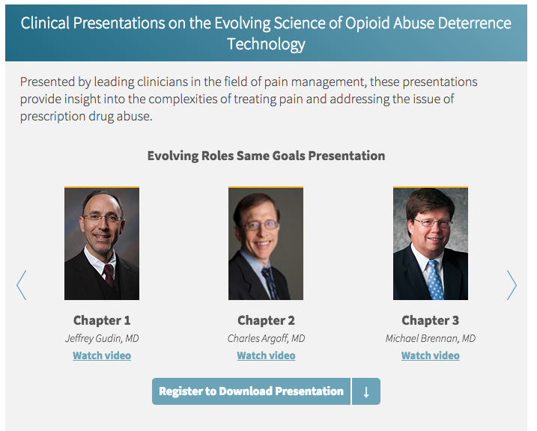
Amplify Existing Resources through High-Impact Media
Strategic Purpose: Increase traffic, engagement and CRM enrollments by maximizing existing resources
Increase spend behind high-performing NPP assets to drive greater traffic to PainMatters.com
Paid Search
Print promotions in key publications
Specific Media (Contobox) Ad
HCP-specific digital ads (Medscape, Adprime, Cadreon, Millennial)
Leverage additional opportunity to engage HCPs through December DocAlert highlighting KOL Clinical Presentations
KPI: Consistent with ID Media Analytics/OGSM; Doximity metrics
Timing: November 2015
Budget: $275,000: Paid search ($50K), Print promotions ($75K), Specific Media (contobox) ad ($75K), HCP-specific display ads ($75K)
DRAFT - CONFIDENTIAL - FOR INTERNAL DISCUSSION PURPOSES ONLY – NOT FOR USE IN PROMOTION

Slide 5
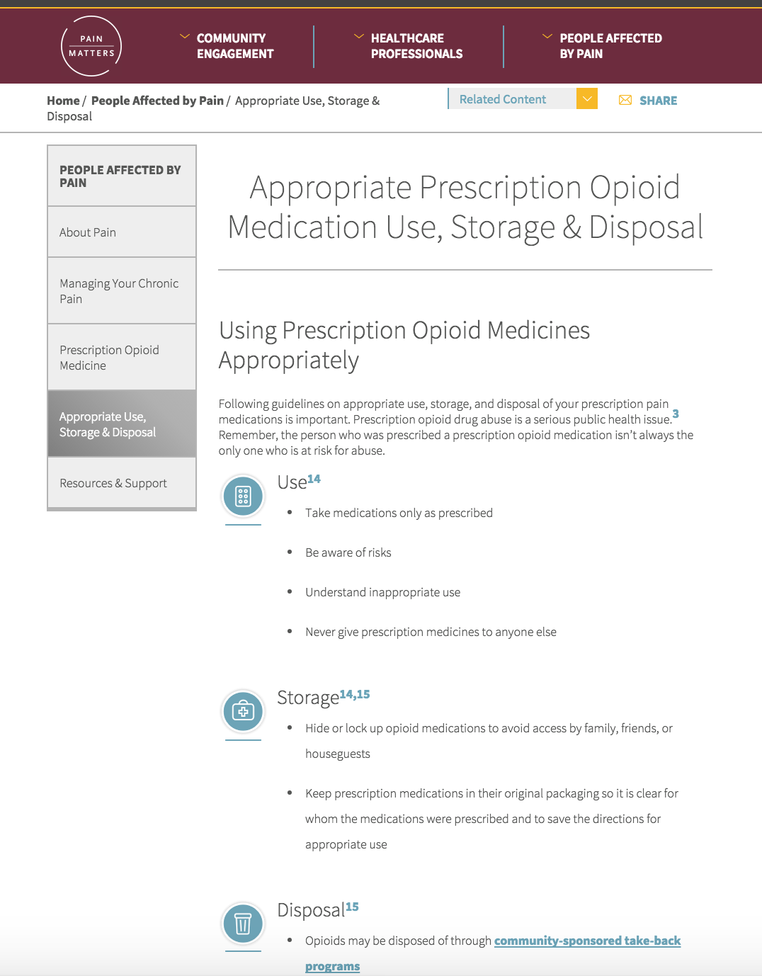
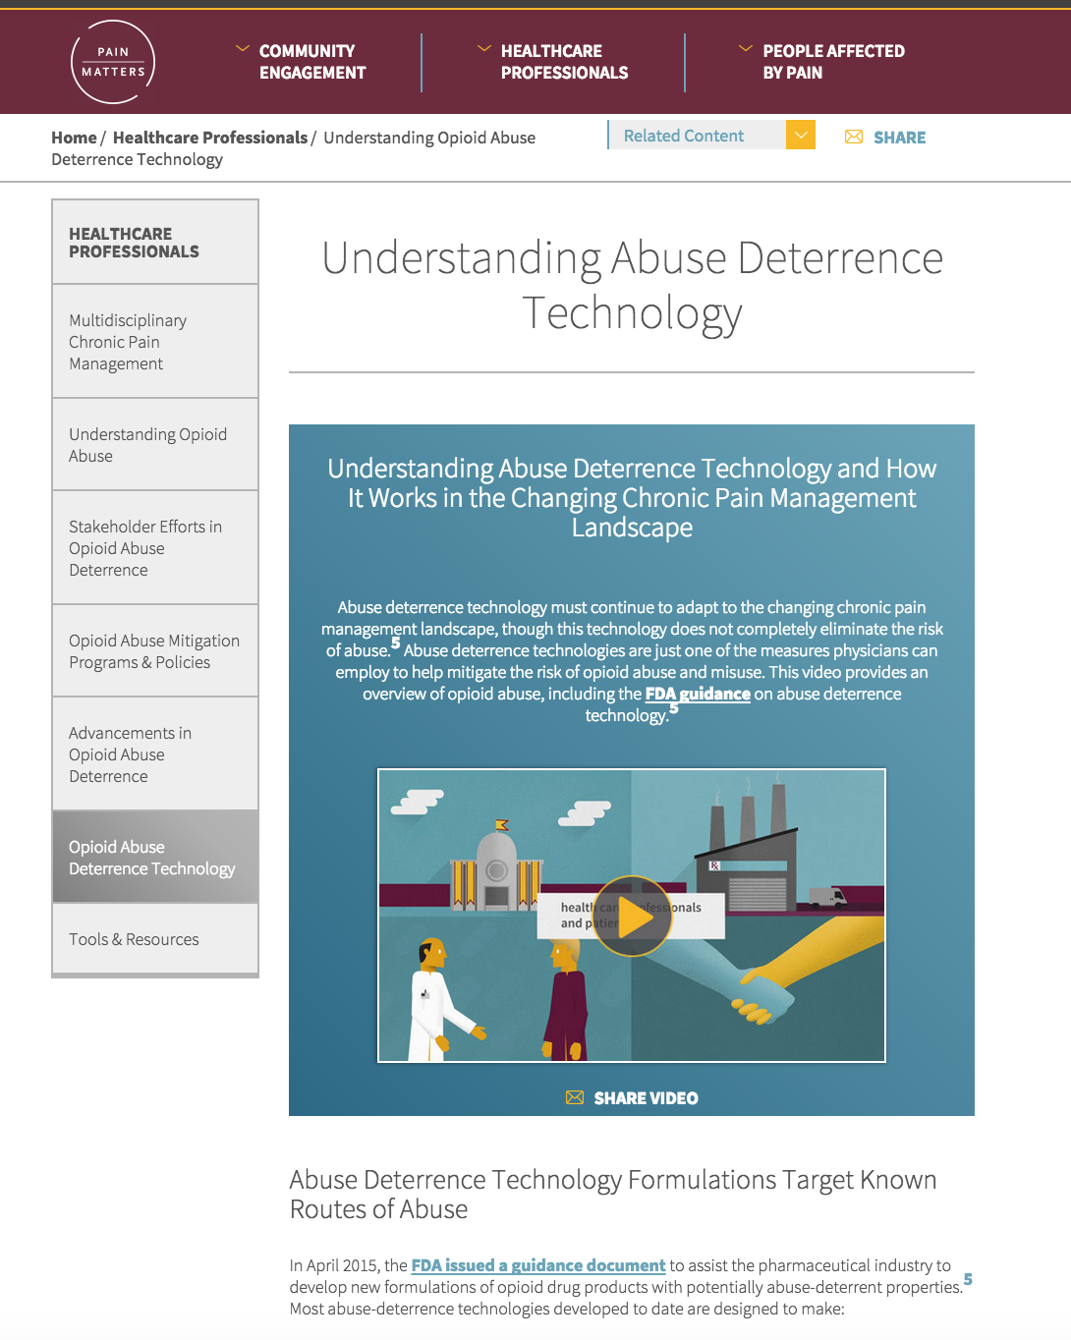
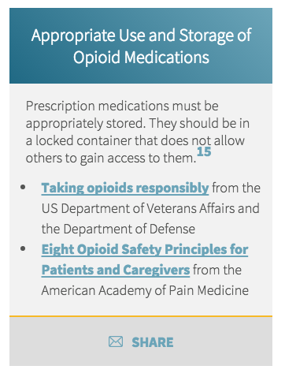
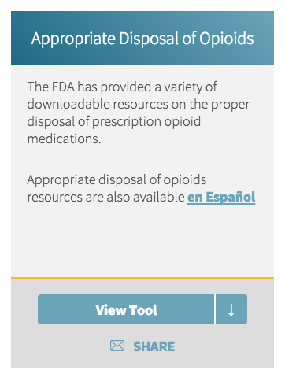
Develop Engaging Video to Illustrate Importance of Responsible Opioid Use
Strategic Purpose: Introduce Pain Matters as a resource to a larger percentage of key stakeholders with breakthrough video content that demonstrates the importance of responsible opioid use, storage and disposal
Utilize engaging video content to capture attention of key audience segments
Shed light on common barriers and misperceptions around responsible use, storage, and disposal
Demonstrate Teva’s commitment to being part of the solution through innovative resources and proprietary abuse deterrence technologies
Explore partnership with Alliance to Prevent the Abuse of Medicines to further drive engagement among key stakeholders (extension opportunity: pitch for donated airtime/radio PSA to run in Q1 2016)
Timing: December 2015
Budget: $385,000 including creative strategy, content development, video production, editing, etc.
DRAFT - CONFIDENTIAL - FOR INTERNAL DISCUSSION PURPOSES ONLY – NOT FOR USE IN PROMOTION

Slide 6
Promote Responsible Solutions Across High-Impact Channels
Strategic Purpose: Employ a surround-sound, multi-media approach to expand reach of video content and reinforce that all stakeholders have a role to play in responsible pain management
Updated NPP plan (updated assets, new Facebook ads)
Targeted e-communication with KOL-authored video introduction and call to action
House video on Pain Matters website (home page & Pain Perspectives)
Radio public service announcement
Social media outreach (Pain Matters and advocacy channels) and targeted earned media
KPI: Social media engagement, email metrics, NPP metrics, website metrics, 2-3 original stories through earned media
Timing: December 2015-2016
Budget: $340,000 including $65K for asset creation, $120K paid social promotion; $15K updates to existing NPP materials; $50K KOL e-communication; $40K for Website updates; $50K for radio PSA
Enhanced
NPP Plan
(ad spend & assets)
HCP
Rich-Media Communication
Earned Media Outreach
Educational Video
Owned & Partner Social Channels
Pain Matters Website Updates
Radio
Public Service Announcement
DRAFT - CONFIDENTIAL - FOR INTERNAL DISCUSSION PURPOSES ONLY – NOT FOR USE IN PROMOTION

Slide 7
Timing & Budget
DRAFT - CONFIDENTIAL - FOR INTERNAL DISCUSSION PURPOSES ONLY – NOT FOR USE IN PROMOTION

Slide 8
Executional Strategy through End of Year
NOVEMBER:
DECEMBER:
Amplifying Current Assets
Expanding Reach with New Assets
Increase spend behind existing NPP plan assets to drive greater return
Paid search
Spotlight placements in key print
Specific (Contobox) Ad
HCP-focused digital ad placements (Medscape, Adprime, Cadreon, Millennial)
New video content illustrating the importance of responsible opioid use
High performing NPP assets promote new video & Design for Dialogue (with addition of paid social)
December DocAlert drives to HCP clinical presentations
PainMatters.com showcases new video
Radio public service announcement
Owned & earned media; advocacy partner communication
Multi-media e-communication drives qualified HCP traffic
DRAFT - CONFIDENTIAL - FOR INTERNAL DISCUSSION PURPOSES ONLY – NOT FOR USE IN PROMOTION

Slide 9
Timeline Snapshot
2015 |  |  |  |  |  |  |  | 2016
November |  |  |  | December |  |  |  | January
2nd – 6th | 9th – 13th | 16th – 20th | 23rd – 27th | 30th- 4th | 7th – 11th | 15^{4h} – 19th | 22rd – 25th | 28th – 1st | 4th -
Thanksgiving
25th – 27th
Christmas
24th – 26th
New Video Content
~Nov 30
Potential Donated Broadcast Airtime
Radio PSA
~Dec 3
Air Radio PSA
Website updates Phase 6
~Dec 3
Targeted e-communication
~Nov 30
Social/traditional media materials
~Nov 19
Earned Media Outreach
NPP materials to be updated
~Nov 19
Increase promotion spend behind existing NPP materials
DRAFT - CONFIDENTIAL - FOR INTERNAL DISCUSSION PURPOSES ONLY – NOT FOR USE IN PROMOTION
Estimated PARC Meeting Date

Slide 10
Estimated Incremental 2015 Budget
Activity | Budget
Amplifying Current Assets (November)
Additional promotional spend behind NPP plan (Nov/Dec)
~Paid search | $50,000
~Print promotion | $75,000
~Specific Media (Contobox) Ad | $75,000
~HCP-Specific digital promotion | $75,000
Expanding Reach with New Assets (December)
New video creation (creation & production) | $385,000
Paid social media spend | $120,000
Radio PSA spot | $50,000
Updates to Existing NPP Materials | $15,000
Pain Matters Phase 6 Expansion | $40,000
Traditional & Social Media Assets (media materials, YouTube refresh; FB posts; Advocacy comms) | $65,000
Targeted e-communication for HCPs (creation, list purchase, & distribution) | $50,000
Total | 1,000,000
DRAFT - CONFIDENTIAL - FOR INTERNAL DISCUSSION PURPOSES ONLY – NOT FOR USE IN PROMOTION

Slide 11
Appendix
DRAFT - CONFIDENTIAL - FOR INTERNAL DISCUSSION PURPOSES ONLY – NOT FOR USE IN PROMOTION

Slide 12
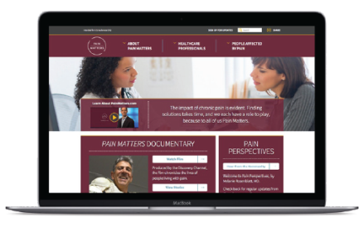
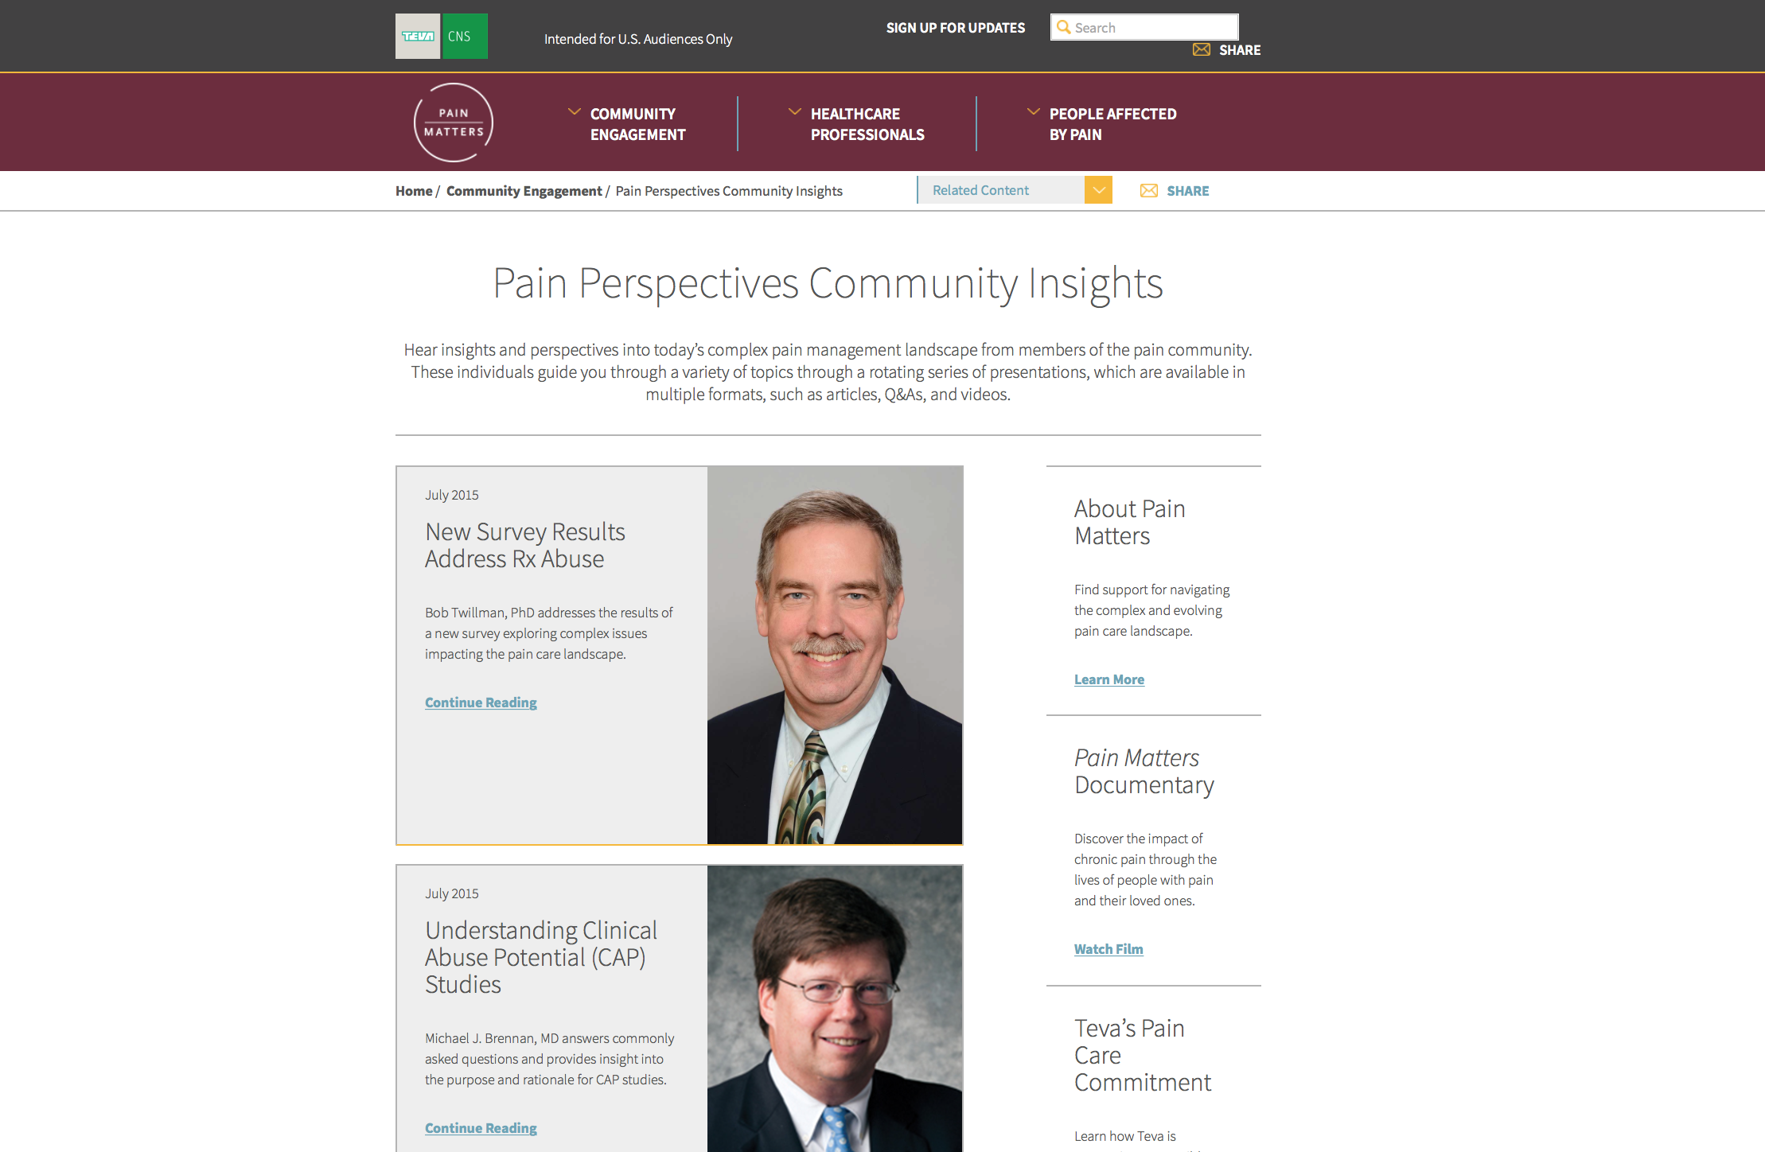
Update PainMatters.com to Highlight New Video
Strategic Purpose: Enhance engagement with new video content and drive increased CRM enrollments
Update homepage to replace the “About Pain Matters” video with new video content (keeping “About Pain Matters” in Community Engagement)
New KOL-authored Pain Perspectives post highlights solutions to support responsible pain management including:
Responsible use, storage, and disposal
Advancements in ADT
Promote new website content through a CRM email
KPI: Increase in website engagement and interaction metrics; video views
Timing: December 2015
Budget: $40,000 includes design and production
Promote new video
New entry highlights solutions to support responsible pain management & the role of ADT
DRAFT - CONFIDENTIAL - FOR INTERNAL DISCUSSION PURPOSES ONLY – NOT FOR USE IN PROMOTION

Slide 13
Broaden Exposure through Social & Traditional Media
Strategic Purpose: Deliver relevant content to our target audience segments through earned and owned media and via third parties
Develop pitch letter and conduct targeted media outreach
Create new post content on Pain Matters Facebook page and promote posts to targeted audience segments
Upload new video resource on Pain Matters YouTube
Provide key partners with content to increase exposure to qualified target audience segments
Create and disseminate social media promotions through 2016
KPI: Engagements, video views, advocacy partnership engagements/follower uptake
Timing: December 2015
Budget: $185,000 includes asset creation and promotion via earned and owned media, advocacy channels and paid social media
DRAFT - CONFIDENTIAL - FOR INTERNAL DISCUSSION PURPOSES ONLY – NOT FOR USE IN PROMOTION

Slide 14
Expand Reach through Radio Public Service Announcement
Strategic Purpose: Reinforce Teva’s commitment to providing solutions to responsible pain management by reaching a greater number of key stakeholders by executing a radio public service announcements across targeted radio outlets
Partner with KOL spokesperson to record PSA on the importance of advancements in ADT, responsible use, storage, and disposal
Collaborate with vendor to record PSA and distribute to appropriate radio outlets across the U.S. when a current event brings the issue of excessive sleepiness to the top of public conversation
KPI: Thousands of radio impressions
Timing: December 2015 - 2016
Budget: $50,000 including script development, production and distribution

Slide 15
Engage Pain Specialists with Multimedia e-Communication
Strategic Purpose: Reach a nationwide pain specialist network to increase awareness of Teva’s commitment to responsible pain management and the Pain Matters program
Develop a multimedia email communication featuring an introduction from respected pain specialist / KOL providing context on the importance of the subject matter
Disseminate email to a network of pain specialists
Within the email, include:
Message from KOL on importance of ADT & responsible use, storage, and disposal
Conversation starters for exam room discussions
New video on responsible use
Call to action to visit PainMatters.com
KPI: 110,350 healthcare professionals including Pain Specialists: 9,630; Pharmacists: 69,455; NPs/PAs (Pain Medicine): 31,275
Timing: December 2015
Budget: $50,000 includes development of the materials, list purchase and distribution
DRAFT - CONFIDENTIAL - FOR INTERNAL DISCUSSION PURPOSES ONLY – NOT FOR USE IN PROMOTION

