Slide 1
GFD 2.0
Clinical GFD DUR
Jon Arends
April 2019

Slide 2
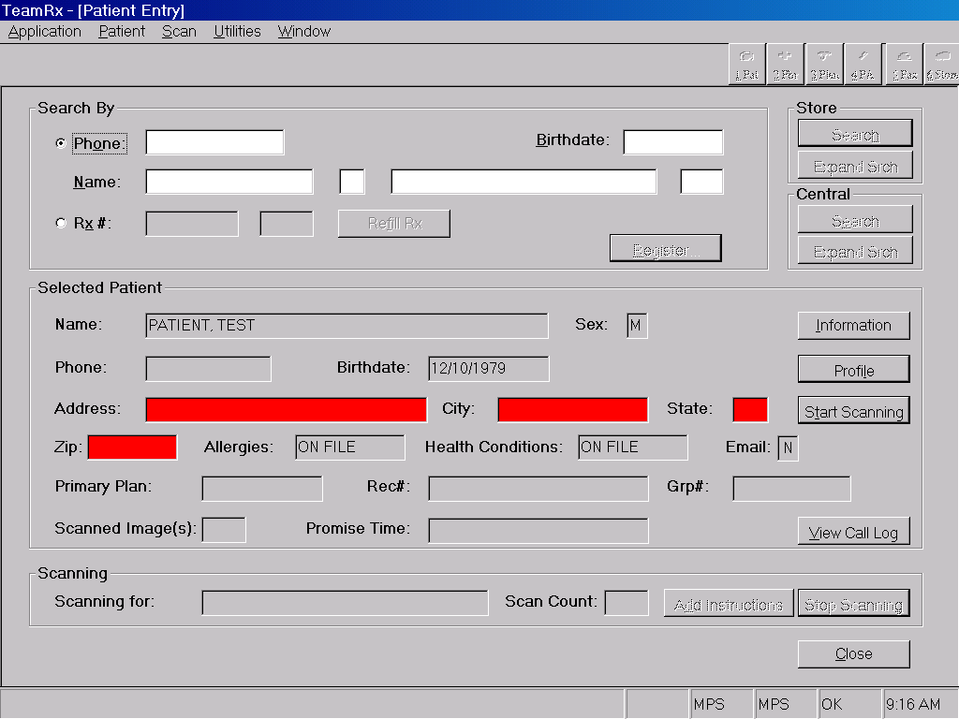
A new button will take team members directly to Good Faith Dispensing Information housed in the Patient Profile
Nice to Have
Allows efficient viewing of GFD determination prior to data entry of prescriptions
Enables denial logging tied to a specific patient even if an Rx number is not created
GFD Info

Slide 3
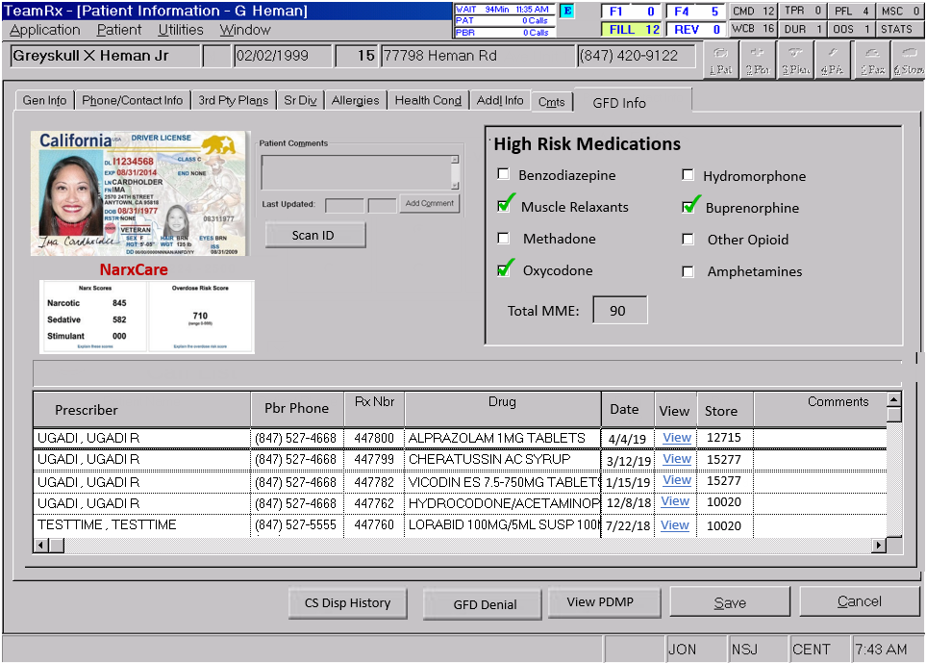
The GFD Info tab displays a patient-centric summary of controlled substance dispensing history and information
❶ ID section enables team members to scan and view patient ID
❷ High Risk medications are automatically identified from patient dispensing history
Help prevent dispensing of dangerous combinations
❸ Integrated NarxCare score helps pharmacist make efficient clinical determinations
❹ A log of GFD denials enables pharmacists to view detailed analysis of previous red flags
❺ Displays a curated list of Walgreens-dispensed CS medications for the patient
❻ Allows efficient entry of a Denial separate from the prescription dispensing workflow.
A blank GFD Review Worksheet is displayed that can be manually populated with minimal required information
Workflow enables scanning of hardcopy image and association to specific patient
❷
MVP
A patient-level landing page:
Aggregates relevant information needed for Good Faith Dispensing evaluation
Must always be available to all users of IC+/POWER
High Risk Medications
Automatically displays previously dispensed medications for quick identification of potentially dangerous combinations
Displays Morphine Milligram Equivalents (MME) based on entire patient profile
List of target medications is configurable
PDMP
Link or pathway to PDMP
In non-Appriss states, link directly to State-specific log-in page
Log of previous GFD worksheets from all Walgreens sites
Ability to filter and display only denials
Ability to view fill-level GFD worksheet from this window
Medication History that is filtered to show only CS and other drugs of interest
Displayed drugs configurable
Ability to create a GFD denial directly from this screen – without needing to go through Data Entry workflow
GFD denial must enable scanning of prescription image
❶
❸
❹
Previous GFD Worksheets
Denials Only
Nice to Have
Patient ID image Section
Allows scanning/capture of patient ID
NarxCare integration Section
❺
❻

Slide 4
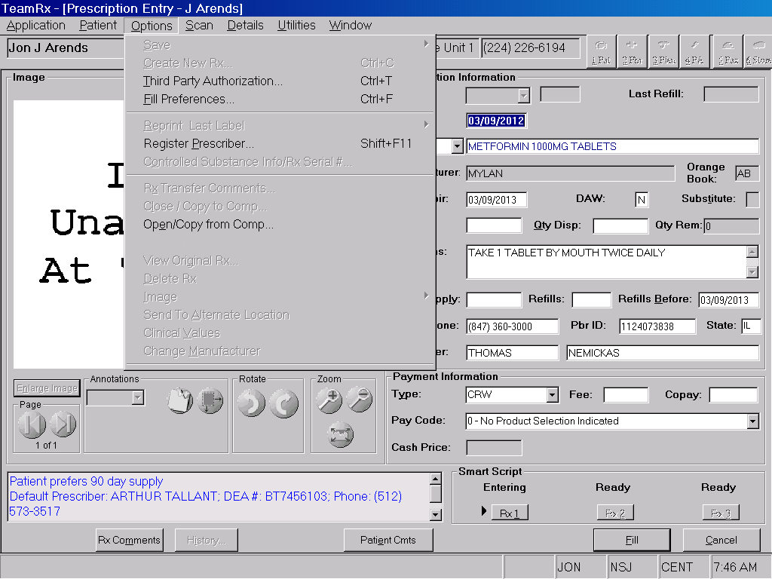
MVP
During Data Entry, Technicians have the ability to add information to the GFD Worksheet
GFD Worksheet Ctrl+W

Slide 5
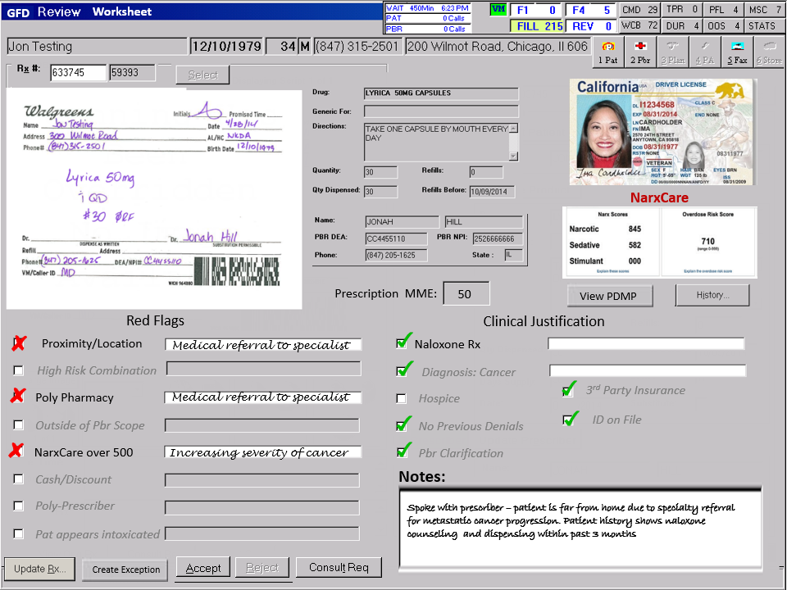
The new GFD Review Worksheet automatically summarizes and documents indisputable clinical justification for dispensing
MVP
A fill-level worksheet:
Aggregates relevant information needed for Good Faith Dispensing evaluation
Must always be presented to local pharmacist no matter where other portions of the workflow are completed
Available for all CS prescriptions
Required for select prescriptions
Triggering must be configurable
For example: Drug, State, Patient, Prescriber, store pharmacy
Triggered for all prescription fills (New and Refills)
For refills, previously entered information must be prepopulated
Displayed with timing similar to current DUR
Rx Information Section
Displays relevant information about the current prescription
Image, Data Entry info, Do Not Dispense Before Date, Rx MME
PDMP
Link or pathway to PDMP
In non-Appriss states, link directly to State-specific log-in page
Tracking that the PDMP was accessed via the link
Red Flags Section
Ability for Business to create ad-hoc red flags
MVP: Text entries that end users will manually select and resolve Must be resolved/dispositioned before continuing workflow
Some Red Flags must be a hard block and not resolvable
Clinical Justification
Similar to Red flags – but positive indicators
Free text responses available for certain ones, but not all
Free text documentation for pharmacist comments
Ability to create CAP block
Ability to create exception (DUR) and resolve later
This worksheet is always presented to pharmacists at the dispensing location as part of DUR screening
For all prescription fills (New and Refill)
Similar to current GFD Checklist, but automatically populated information to streamline the process
Available for all CS medications, mandatory for target drugs
❶ Relevant prescription information is displayed
Including Prescription MME, Do Not Dispense Before date and prescriber specialty
❷ If captured, patient ID would display. Otherwise – Patient ID Not On File would be listed as a Red Flag
Patient Is Known To The Pharmacist would be an appropriate resolution to this Red Flag
❸ Integrated NarxCare score helps pharmacist make efficient clinical determinations with direct link to patient-specific external information
Usage of the link and length of pharmacist time within PDMP site can be monitored
❹ Red Flags and Clinical Justification would automatically populate based on business-defined criteria
Can be modified to react to emerging trends
Entries can be created for manual selection by pharmacists to document red flags that can’t be automated
All Red Flags would require documented resolution before prescription may be dispensed
❺ Rejection of the GFD Worksheet would automatically create GFD denial documentation
❷
❶
❸
❹
Nice to Have
Patient ID image Section
NarxCare integration Section
Different workflows driven by returned NarxCare scores
Red Flags Section
New Red flags created by business rules or queries that automatically populate into the GFD worksheet if triggered
For example: If payment type is cash, then automatically select “Cash Prescription” Red Flag.
Automated identification and population of appropriate information
Rules triggered by information returned by NarxCare
❺

Slide 6
Potential Rules
Red Flags:
Previous GFD refusal
First Refill
Multiple Prescribers of Controlled Substances
Multiple pharmacies dispensing CS
Use of Cash or Discount Card payment method
Patient address not able to be USPS standardized (probably due to bad data in Address field)
Distance calculations – between pharmacy, prescriber and patient
Morphine Milligram Equivalent (MME) over threshold
Length of time on therapy
Long term use of immediate release products
Drug Combinations or Cocktails
Benzodiazepine + opioid + Muscle relaxant or Gabapentin
Amphetamines and opioids
Immediate release and Extended Release
Prescriber scope of practice
Early Refill
Patient appears intoxicated
Clinical Justification:
Patient ID on file
No previous GFD refusal
Indicator that PDMP viewed by RPh
Use of Third Party Insurance
Opioid Naïve or low MME
Short duration of therapy
Previously dispensed Naloxone
Diagnosis/Health Conditions on inclusion list
Appropriate Place of Service (Hospice)

Slide 7
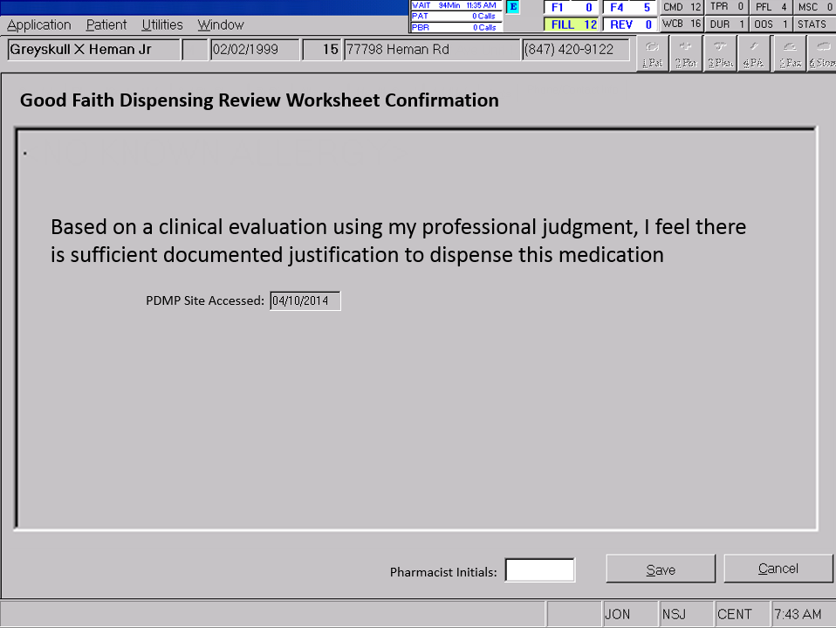
An optional double confirmation step would reinforce the change in mind-set with pharmacists
Nice to Have

Slide 8
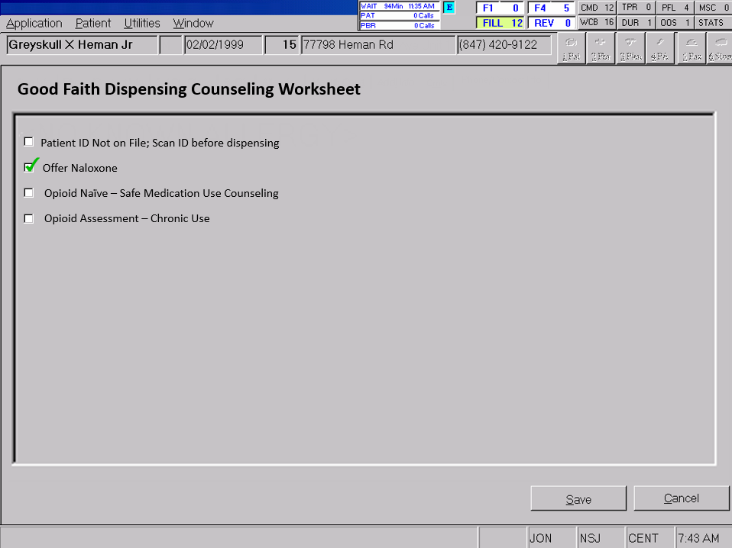
Nice to Have
An optional workflow would streamline and standardize patient counseling, ensuring essential information is conveyed

Slide 9
Appendix

Slide 10
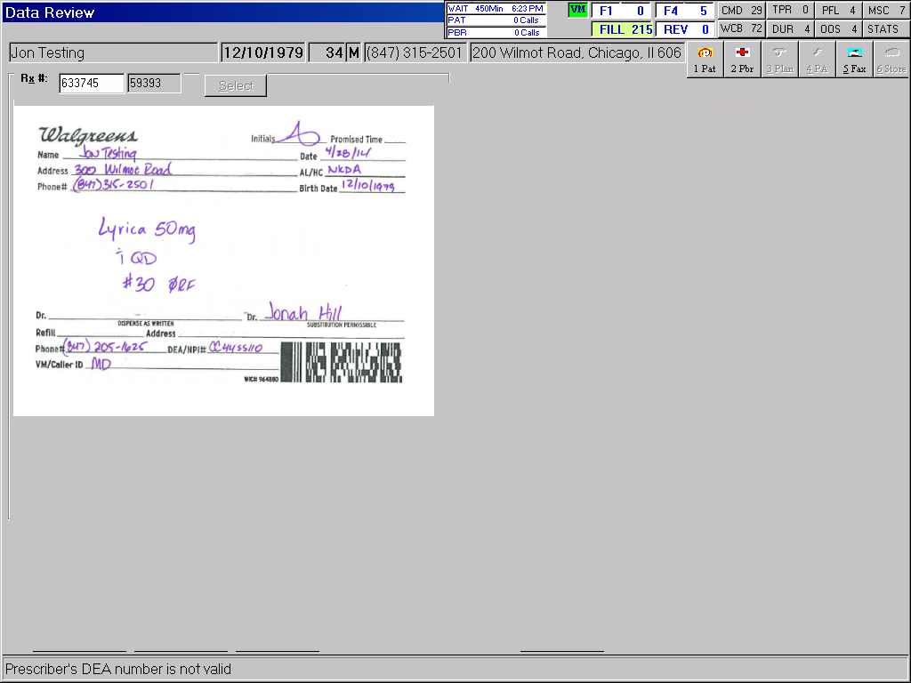
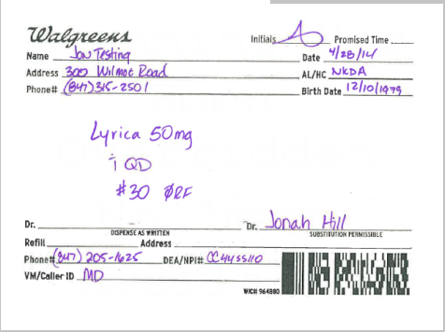
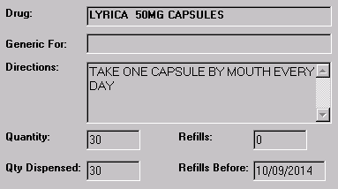
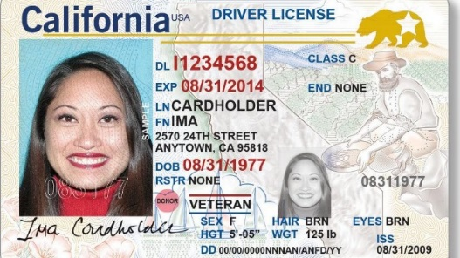
GFD
Worksheet
NarxCare
Original mockup
Prescription MME:
50
View PDMP
Red Flags
Clinical Justification
Proximity/Location
Medical referral to specialist
Naloxone Rx
High Risk Combination
Diagnosis: Cancer
Poly Pharmacy
Medical referral to specialist
Hospice
3rd Party Insurance
Outside of Pbr Scope
No Previous Denials
ID on File
NarxCare over 500
Increasing severity of cancer
Pbr Clarification
Cash/Discount
Notes:
Poly-Prescriber
Spoke with prescriber – patient is far from home due to specialty referral for metastatic cancer progression. Patient history shows naloxone counseling and dispensing within past 3 months
Pat appears intoxicated
Create Exception

Slide 11
GFD Info
High Risk Medications
Benzodiazepine
Hydromorphone
Muscle Relaxants
Buprenorphine
Scan ID
Methadone
Other Opioid
Original mockup
NarxCare
Oxycodone
Amphetamines
Total MME:
90
Prescriber
Pbr Phone
Date
View
Store
4/4/19
View
12715
3/12/19
View
15277
1/15/19
View
15277
12/8/18
View
10020
7/22/18
View
10020
CS Disp History
GFD Denial
View PDMP

Slide 12
Good Faith Dispensing Review Worksheet Confirmation
Based on a clinical evaluation using my professional judgment, I feel there is sufficient documented justification to dispense this medication
Original mockup
PDMP Site Accessed:
Pharmacist Initials:

Slide 13
Good Faith Dispensing Counseling Worksheet
Patient ID Not on File; Scan ID before dispensing
Offer Naloxone
Opioid Naïve – Safe Medication Use Counseling
Original mockup
Opioid Assessment – Chronic Use

Slide 14
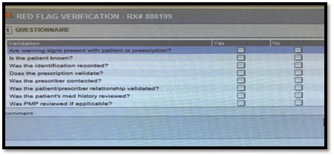
Example of system-enforced documentation

