Slide 1
Rx Integrity Update Market Leadership Meeting
Rex Swords
October 2013

Slide 2
Agenda
Accomplishments since the Agreement
Rx Integrity Website
Rx Integrity Web Portal
Ceiling Limits Tool
Controlled Substance Order (CSO) Override Form
Electronic DEA 106 Form
Pharmacist GFD Opportunities Review Tool
Notes:
We have listened to the feedback from the field and have taken suggestions and come up with ideas of ways we can make things easier.
The next few slides are the tools we’ve developed.

Slide 3
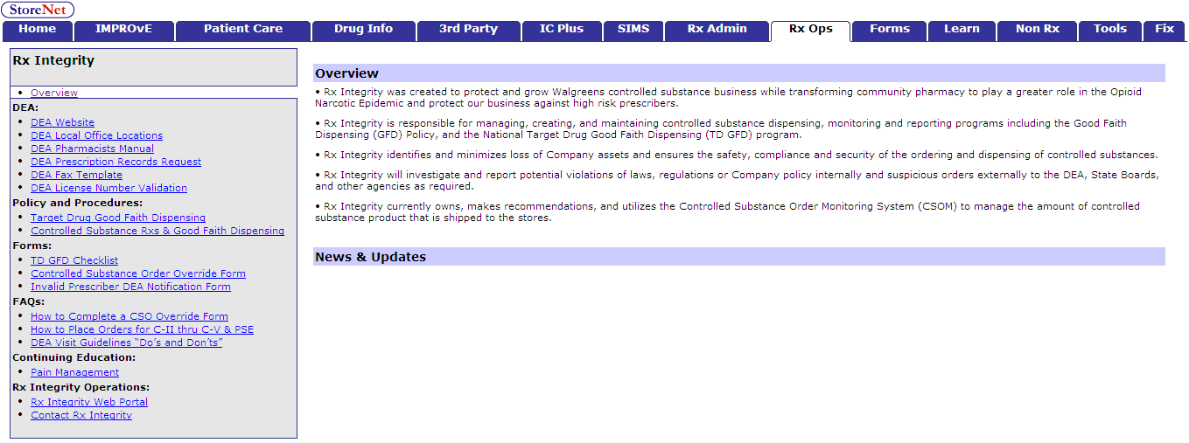
Rx Integrity Website
StoreNet > RxOps > Pharmacy Policy and Procedures > Rx Integrity
Notes:
The Rx Integrity Website is the one stop of all DEA related info.
You can find it under Snet > Rx Ops tab > Pharmacy Policy and Procedures > Rx Integrity

Slide 4
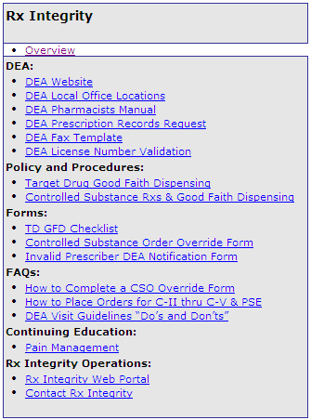
Rx Integrity Website
Is the complete resource for:
DEA and controlled substance information
GFD & TD GFD Policy & Procedures
Forms and FAQs
CEs on pain management
Web Portal for detailed reporting
Notes:
You’ll find the policy and checklist here with just one click now.
Forms: checklist and the Controlled Substance Override request form are available with just one click.
We’ve added continuing education specific to Pain Management for those pharmacists wanting to learn more around chronic pain.
And the RxIntegrity webportal (this was the link we were emailing you each month to access reports from) has been added

Slide 5
Visibility into Quantities at Store Level
How do I know where my stores are in relation to the controlled substance limits set?
Ceiling Tool
Notes:
One of the challenges the stores had was not knowing if the reason they weren’t getting a drug in their order. Is it the wholesalers, is it RxIntegrity or is it an out of stock from the wholesaler.
The ceiling tool will allow to see which drugs they are approaching the ceiling on and which they are at the ceiling.

Slide 6
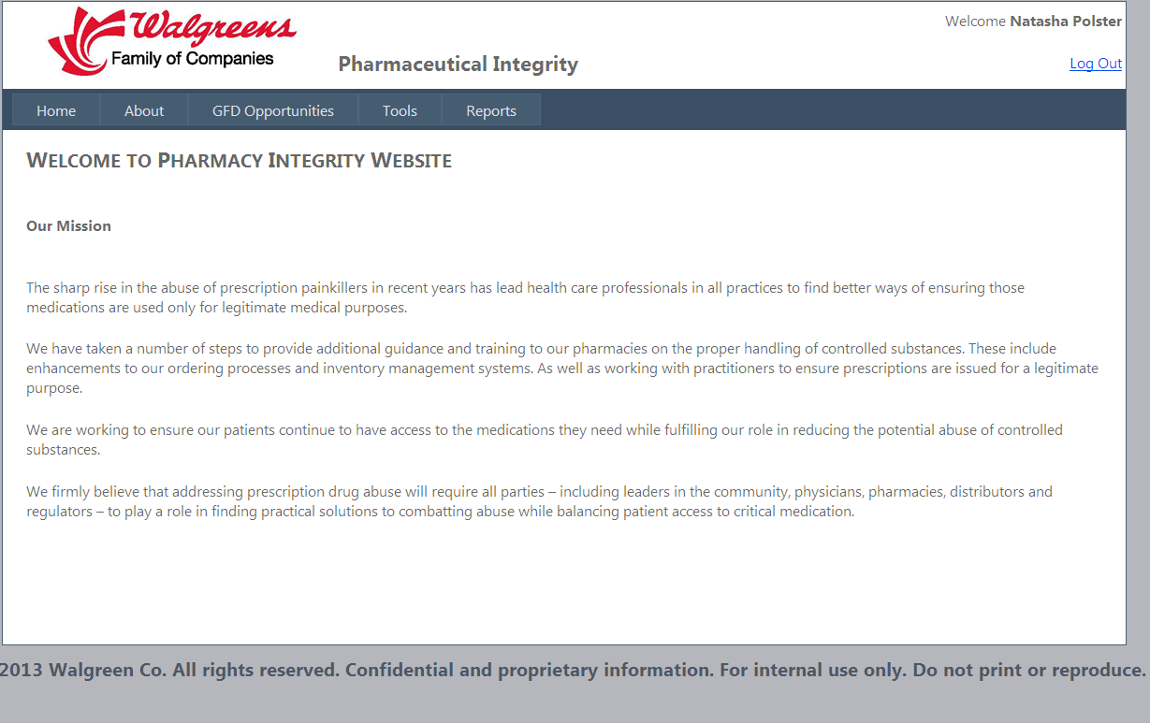
Rx Integrity Web Portal
Notes:
You can locate the link on the Webportal under tools

Slide 7
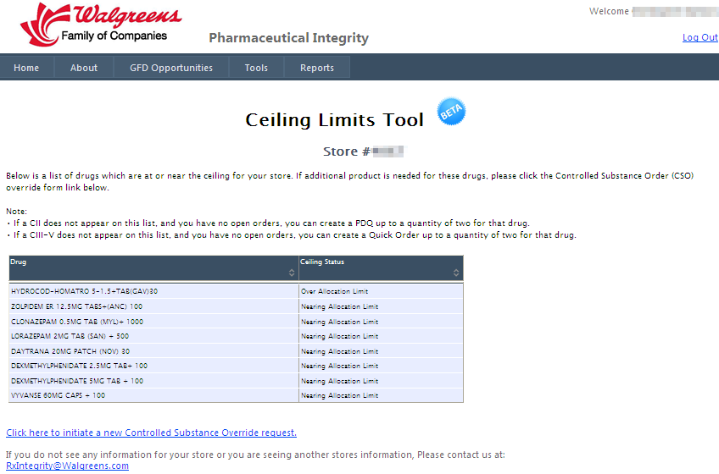
Ceiling Limits Tool: gives stores, district and markets visibility
Drugs listed may need a CSO form filled out, if more product is needed
Link to the CSO form
Notes:
Pathway: Tools > Ceiling Limits Tool
This is the first place stores and RxS must go in order to understand if a CSO override from needs to be initiated
Authenticator ID based views:
EPDs can view a operation
MPDs can view a market
RxS can view a district
RxMs, staff pharmacists, store managers, and technicians can view their store
Each store will be able to see the drugs they may need to consider filling out a CSO (controlled substance override) form for in order to get more product in.

Slide 8
Controlled Substance Order (CSO) Override Form: can now be completed by stores
REQUIRED Search Fields
WIC, UPC, NDC, and Drug Name/Strength will auto-populate when an item is selected.
Enter the requested Order Quantity in total units. DO NOT enter in the number of Caps/Tabs/GM’s/ML’s needed.
Select ONE reason which best describes the situation.
Provide a detailed explanation for the reason selected. This required field should include specifics of why additional product is needed.
Click Submit to send Request
Notes:
Pathway: StoreNet > RxOps > Pharmacy Policy and Procedures > Rx Integrity > Forms > Controlled Substance Order Override Form
Also available at the bottom of the Ceiling Limits Tool screen
CSO override form is for:
All controlled substances, including PSE products.
Stores should initiate this form after reviewing the Ceiling Limits Tool
Only one CSO override form can be completed every seven days for a product

Slide 9
Approval Process for CSO Override Form
Step1 - Store
Step 2 - Pharmacy Supervisor
Approves the request and sends it to Rx Integrity for review
Rejects the request and sends it back to the pharmacy
Step 3 - Rx Integrity
Approves or rejects the request
Allow 48 business hours for your request to be reviewed
Submits the CSO override form for review
Stores can view the status of the submitted CSO override form on the Rx Integrity Website
We keep documentation on file for all district level approvals
Notes:
Any override will go through a step approval process. The store will initiate the request, the pharmacy supervisor must fill out their portion in order for the approval to be considered in our group. Documentation is required and we retain it in case we’re asked to produce data on why a store was allowed to go over their allotment.

Slide 10
DEA 106 Forms
Previously handled by Regulatory Law
Transitioned to Rx Integrity
Form is now electronic
RXM or RXS completes the form and submits to Rx Integrity
Rx Integrity approves and forwards electronic copy to the DEA
Store receives and email with a link to print a copy for their records
District Loss Prevention Manager automatically receives a copy via email
Notes:
We have moved the DEA 106 processing over to our team. It was previously handled by Dwayne’s group in Regulatory Law.
We have made the form electronic now. The RXM or RXS can complete the form and it comes to our team for final approval. Once we approve we automatically send it off to the DEA. An email goes to the store with a reminder to access the completed form via the link provided and print for their records at store level. We also copy Loss Prevention for the store, so they receive at the same time.

Slide 11
Rx Integrity Web Portal
To access DEA 106 form
Notes:
Access the link under the Webportal > under the Tools drop down

Slide 12
Electronic DEA 106 Form
Link found under tools
The online DEA 106 form allows:
Improves ease of use
Improves efficiency
Same day loss calculations for all suspected drugs
Fully tracked
Streamlines DEA reporting process
Notes:
Pathway: Tools > DEA 106

Slide 13
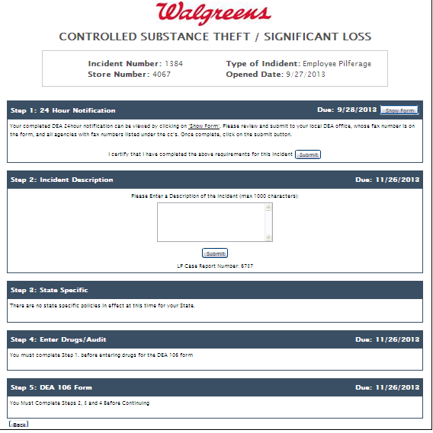
Electronic DEA 106 – Entering a loss
Form is intuitive
Each section must be completed before going to the next portion of the form
A Loss Prevention case number must be included to ensure LP knows about the event before form can be started
Notes:
In order to begin processing a new report, the store (or RXS) will need an LP case number. This ensures that LP knows about the event before it’s started. The form is then intuitive. Follow the prompts in each section to get the report filled out.

Slide 14
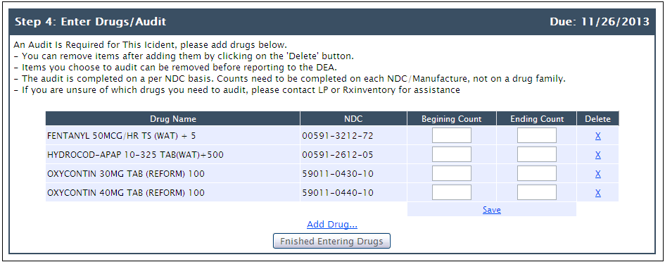
Electronic DEA 106 – Drug Audit Portion
Pharmacy enters in drugs, counts from the June annual inventory and the ending actual count, the audit runs in the background to pull sales, purchases and claims
Notes:
One of the really nice features is the Drug Audit portion. Drugs are selected and put into the table. Along with the starting inventory (obtained from the June 9th annual inventory) and the current on-hand.

Slide 15
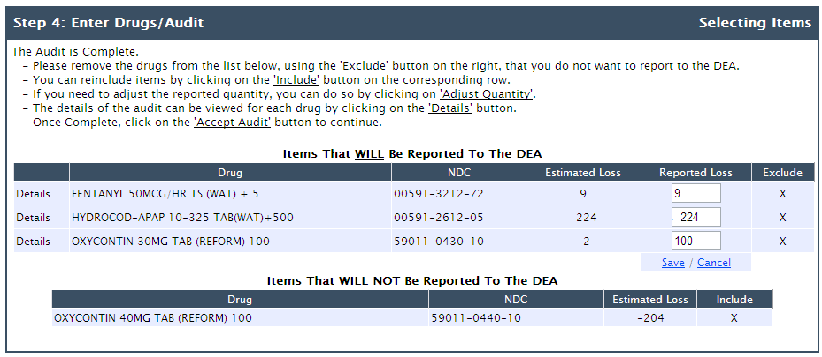
Rx Integrity Runs the Audit in the background
Follow directions to determine which drugs to include
Notes:
Once the data is entered, and submitted, a report is run on the back end. This takes about 6 hours. Then the store receives an email letting them know the audit is complete and they can go back into the system to finish the report.
Step by step directions are on the report letting the store (or RXS) know what to do.

Slide 16
Completed DEA 106
Once complete the RXM or RXS submits the form
Completed form comes to Rx Integrity for final approval before submission the DEA
Copy emailed to DLPM automatically
Notes:
Once the report is final, it can be submitted.
The report then comes to RxIntegrity to be reviewed before it is submitted to the DEA.
Once it’s submitted to the DEA, the store and LP will receive a copy.

Slide 17
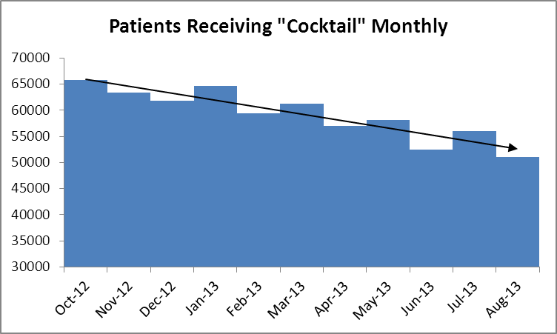
Trend for “Cocktail” dispensing
.
Since October 2012 we have seen a 22% reduction in the number of patients receiving a cocktail monthly
Notes:
We’re still seeing a high number of cocktails being dispensed. (Opiate + benzo + muscle relaxant) Gabapentin is now being substituted for Soma.
On our supervision visits, reinforce the importance of checking PDMP (if you have one) is the cocktail being prescribed by the same doctor? If not do each of the prescribers know about one another? What sort of documentation does the pharmacy have for this patient taking the cocktails?

Slide 18
I Talk About GFD, but What can I do on a visit?
The GFD Opportunities Report was developed to help district level supervision on store visits. The report will highlight pharmacists and specific prescriptions that were filled recently that can be pulled up at store level for coaching purposes.
Notes:
Lastly, we wanted to talk to you a little bit about what you can do on a supervision visit.
We developed a report that will give you specific stores and pharmacists examples to work from.

Slide 19
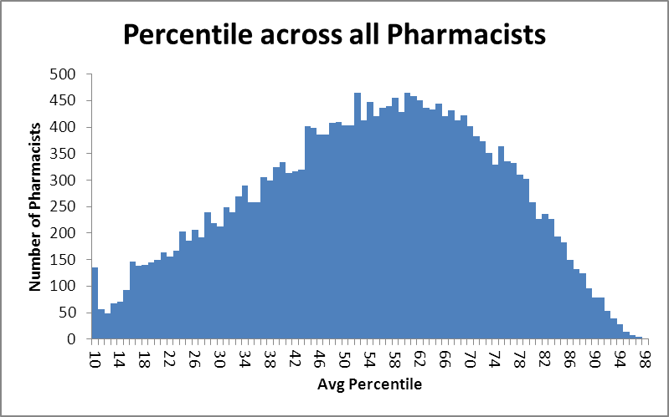
RPh GFD Opportunities
Pharmacists show in the tool based on quantity, proportion of prescriptions dispensed and percent paid in cash across multiple categories. These include Hydrocodone, Hydromorphone, Oxycodone, Methadone, Carisoprodol, Alprazolam, C2s and All Controls.
Pharmacists which appear in the 94th or higher percentile in 5 or more categories are included in the report. The resulting number of pharmacists which appear in the report is approximately 1% of all pharmacists.
Example of the data for one Pharmacist:
Notes:
Pharmacists show in the tool based on quantity, proportion of prescriptions dispensed and percent paid in cash across multiple categories. These include Hydrocodone, Hydromorphone, Oxycodone, Methadone, Carisoprodol, Alprazolam, C2s and All Controls
Approximately 1% of our pharmacists that will show in the tool.
Let me stress, this does not pinpoint problems, this is a tool to be used to ensure GFD is going on when previously on a supervision visit you go in and talk about GFD, but have nothing to follow up on.
This tool will give you real, recent examples to look at on a supervision visit.

Slide 20
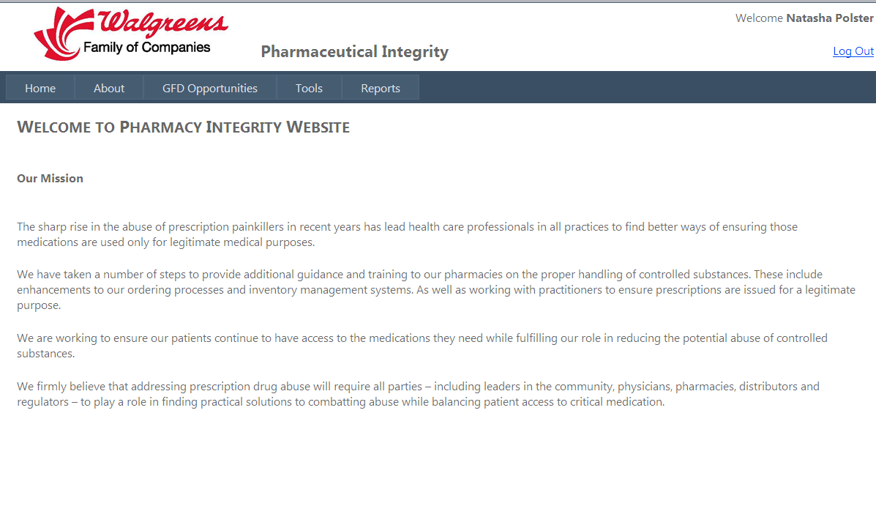
Pharmacist GFD Opportunities Report
Click to access RPh GFD Opportunities
Notes:
Access the tool from the Webportal. Under GFD Opportunities. Choose it from the drop down.

Slide 21
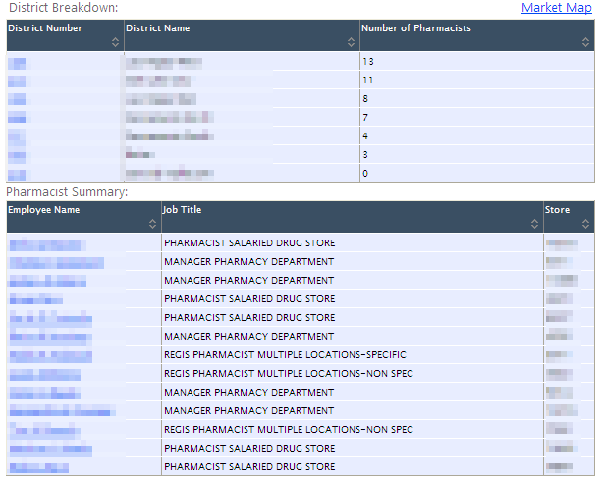
Pharmacist GFD Opportunities Review
Notes:
Pathway: Tools > GFD Opportunities > Pharmacist GFD
This tool was designed to provide a framework for the RXS to review controlled substance dispensing in our stores.
This process is intended to assist pharmacists and assess, as well support, their exercise of professional judgment while carrying out their corresponding responsibility under the law.
Authenticator ID based views:
EPDs can view a operation
MPDs can view a market
RxS can view a district
On a supervision visit, the RXS/DM can pull up real examples to pull to look for documentation or to go over with the pharmacists to reinforce GFD.

Slide 22
Pharmacist GFD Opportunities Webinar
Webinars will be held with Pharmacy Supervisors later this month
Tool gives visibility into pharmacist’s dispensing
Provides recent real examples RXS’s can use for coaching
Doesn’t mean there was anything wrong in filling the prescription
RXS can look for
Documentation
Ensure checklist was completed
Notes:
RxIntegrity will be holding videoconferences in the upcoming weeks going over the GFD Opportunity tool.
This is a tool that should be used for coaching.
There is nothing pointing that this prescription shouldn’t have been filled, but rather a specific example the RXS/DM can pull up to ensure we have the proper documentation to support our corresponding responsibility.

Slide 23
What We Need From You
Your support in referring your teams back to Rx Integrity when questions from the field arise
Engage your Rx Integrity Manager as they are available to participate in Market meetings and videoconferences to provide specific market and district information, identify trends, etc.
Encourage your teams to use the Rx Integrity site as a resource for everything GFD related
Reiterate that Pharmacy GFD Opportunities Tool is intended as a coaching tool for our pharmacists
Notes:
Help us ensure the stores know about the RxIntegrity website, the webportal and that the RxIntegrity team is there to help you.
The site is intended to be a resource.
The GFD opportunities tool is intended to be a coaching tool, it provides real examples that are recent that can be used during a store visit. Caution needs to be used so that the pharmacists don’t go the extreme opposite spectrum and stop filling prescriptions for controlled substances.

Slide 24
Questions?

