Slide 1
Welcome Back to Frontier!
Day 2
Store Leadership (SM, RXM, ASM)
We make the path by walking!
regional_toolkit_regional_events_dpr_dm_2day_complete_eventdeck_v1.2

Slide 2
Ground Rules ….. for the entire Workshop
Be respectful of others
All ideas are good ideas
Differences of opinion are expected
Allow one person to speak at a time
Cell phones off……or at least on silent
We are all on the same team
No hierarchy in the room…..we are all equals
This is a “safe” place (be open and honest)
Tell it the way it is…..use your own words
Be respectful of timings
Use this opportunity to network
……and have some fun !!!

Slide 3





Objectives for the 2 days
To explain the background context as to why we are doing Frontier
To explain how Frontier fits into the bigger One Plan Transformation program
To Introduce & up skill you on the new Core Skills
To ensure you have a clearer understand of the program & timelines
To ensure you have a clearer understanding of your roles within this rollout and the support you will get from your area teams
To understand any questions or concerns you may have so that they can be addressed ahead of rollout

Slide 4
Frontier Store Leadership Launch: Agenda Day 2
Presenter | Session | Input/Process | Materials Needed | Time
Pick facilitator/ scribe (DPR/HCS/OLS/APM) | Welcome & Agenda for the day 2 | Explain the day and Capture Expectations Team Check in on the change curve | Flips | 8.00 – 8.15 (15 min)
OLS | Diagnostics overview | Overview of the diagnostic materials process Q & A | Slides Support Material (Posters) | 8.15-8.45 (30 Min)
DM led | Diagnostics Round Robin: OSA Pharmacy Shrink Focus Group/Storyboard TM survey/Customer survey/Data request/Customer Behavior study | 2 rotations, 45minutes each Small Groups 5min to travel to new station | Flips Support material | 8.45 – 10.25 (5 min + 45min 5 min + 45 min)
 | BREAK |  |  | 10.25-10.40 (15 min)
DM led | Diagnostics Round Robin: OSA Pharmacy Shrink Focus Group/Storyboard TM survey/Customer survey/Data request/Customer Behavior study | 3 rotations, 45 minutes each Small Groups 5min to travel to new station | Flips Support Material | 10.40 – 12.15 (45 min + 5 min + 45 min)
 | Lunch |  |  | 12.15 to 1.00 (45 min)
DM led | Diagnostics Round Robin: OSA Pharmacy Shrink Focus Group/Storyboard TM survey/Customer survey/Data request/Customer Behavior study | 1 rotations, 45 minutes each Small Groups 5min to travel to new station | Flips Support Material | 1.00 – 1.45 (45 min)

Slide 5
Frontier Store Leadership Launch: Agenda Day 2
Presenter | Session | Input/Process | Materials Needed | Time
OLS | Quick Debrief of Diagnostics Round Robin Storyboard and Quick Win overview | Benefits and Concerns H2 keep the storyboard alive (discussion) Q & A | Flips | 1.45-2.05 (20 min)
DM (facilitator) (DPR/HCS/ OLS/APM/FL supported) | Practice PSTBs OSA or RX | Break out into District Group Practice run PSTB on “How to reduce outs” OR “How to improve pharmacy service.” | Fishbone sheets Post-its Sharpies/Flips | 2.05--3:05 (60 min)
 | BREAK |  |  | 3:05-3.20 (15 min)
DPR | Overview of Phase 2 | High Level Summary of Phase 2 – Pulse and PDR and Sustainability Review | Slides | 3.20 – 3.35 (15 min)
DPR | The Approach & Store Detail | Run through the Store Plan Week by Week – Keys Dates | Slides and Plans | 3:35 – 4:00 (25 min)
DM led | Reflection Time and Planning time | Break into store teams – think through details and work up final plans for store launch – share and discuss any concerns with FLs | Flips | 4.00-4:40 (40 min)
DPR | Wrap Up | Team Check in: Change Curve COVP Video (4 min) Final Summary – Key Take Aways, Q&A | Slides Flips Video | 4:40-5:00
one to facilitate, one to scribe DPR/HCS/OLS/APM | Review Day and close | Review 2 days – Harvey Ball – B’s and Cs and close | Flips | 5:00-5:15 (15 min)

Slide 6

Expectations
What do you want to get out of this meeting?

Slide 7
Your Personal Change Journey
Check-in on the Change Curve
<Insert Facilitator>

Slide 8
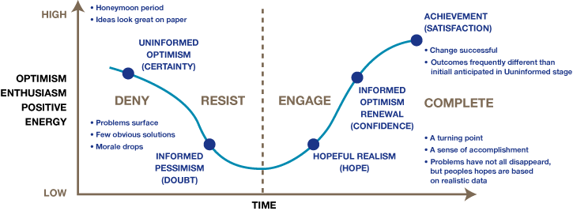
How is everyone feeling?
At your tables, take 3 minutes to plot on your flipchart where each of you are on the change curve and briefly discuss why.
Discuss at your table and we will revisit this at the end of the day.
Notes:
Brief overview of the change curve (what it is, how we can use it)
Have each table plot how they feel. It’s OK if we feel overwhelmed. Share your authentic experiences. Utilize hidden slide as talking points to change. Explain stages of change curve and that it’s ok to be at different places. WE ARE ALL ON THE JOURNEY TOGETHER. DMs will be at tables to support the activity.

Slide 9
Frontier Diagnostics Guidance
A Toolkit for Driving Positive Change
Diagnostics_diagnostics_guidance_v3.4

Slide 10
Diagnostics Overview
Preparation
Trainers Notes
Locate from SharePoint & add in slides for diagnostics overview
Allow 30 mins for this session
Introduce the session and the objectives to the whole group
Objectives: To give you an overview of all the diagnostics that are completed at the start of the program. To explain why we do them and how we do them.
Explain the reasoning for doing diagnostics –why?
How they help to create the storyboard
Using the slides at a high level - Explain the different ones – how they work – how Many – how long
Answer questions as you go through

Slide 11
Contents
Objectives of the Frontier Diagnostics Guidance:
What are the Frontier Diagnostics?
Why do we do Diagnostics?
The timeline to run The Diagnostics
Diagnostics Explanation Summary
Standard Operating Practices: How to run each diagnostic
Focus Group
Customer Survey
Great Customer Availability
Team Member Survey
Rx Wait Time Survey
Rx Diagnostic Data
Rx Drive Thru Survey
Customer Behavior (optional)
Store Data Request
Insights Guidance: How to analyze each diagnostic
How you will receive your survey results
Great Customer Availability
Rx Waiter Customer Survey and Rx Diagnostic Data
Appendix
Diagnostics RACI
Great Customer Availability Instructions
Store Data Request and Results Form
Focus Group: Objectives and Summary Agenda
Focus Group: Detailed Facilitator Guide

Slide 12
Objectives of the Frontier Diagnostics Guidance
To provide an overview of the diagnostic process
To explain the purpose of each diagnostic and how to use it
To provide guidance on how to analyze the results and draw out issues and opportunities
To provide a framework on how to run sessions that build solutions to identified opportunities

Slide 13
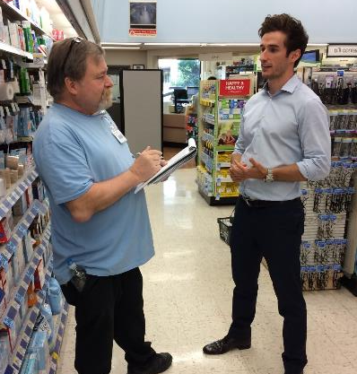
What are the Frontier Diagnostics?
The diagnostics are made up of surveys and studies to help us understand our current performance and develop ideas on what and how we can improve. The results can tell us more about life at Walgreens through the eyes of staff and customers and help us build the right solutions to make a better, simpler and faster Walgreens.

Slide 14
Why do we do diagnostics?
Diagnostics enable us to:
Create a true picture of what life is like in store today and a compelling case for change
Help build a shared understanding of strengths, challenges and opportunities within the store
Build team member engagement and momentum around Frontier
Diagnostics are:
Diagnostics are not:
  An inclusive method of gaining feedback and opinions from your customers and team members
  Tools to help identify opportunities for improvement
  A method of understanding the reasons behind performance
  An opportunity to build a holistic picture of how the store and team operate – and how component parts link together
  An opportunity to ‘check up’ on your team
  A test of how good you are
  A way of comparing one person or team with another
  A chance to place blame
Diagnostics help engage the store team in creating the compelling case for change

Slide 15
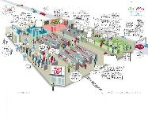



The timeline to run the diagnostics – weeks 1 to 3
Launch
Collect the Data
Analyze the results
Share Findings
Day 1
Weeks 1 to 3
End week 3
Week 3/ 4
Brief store team on Frontier Diagnostics and their role within them
Agree ‘owner’ for the diagnostics in store to ensure everything is completed
Run Focus Group around the Story Board
Complete Team Member, Customer, and Pharmacy Surveys and use the scoring tools
Complete OSA and Rx diagnostics and send data to DM
Collate information on the data request list
Store analyzes the results from the scoring tools
DM shares the OSA and Rx single page reports with store
Store team populates the Story Board with the data
Share the completed Story Board with the store team
Discuss learnings and opportunities for improvement
Explain what happens next and agree next steps with the team

Slide 16
Diagnostics Summary
Diagnostic | Description | Number per store | Format | Who completes it | Time to complete one | When
Focus Group | Group discussion around the opportunities for improvement in the store Team members identify their ideas and priorities and mark them on the Story Board | 1 | Group workshop | DMs lead with TMs | 1.5 hrs | Days 1-3
Customer Survey | Interview shoppers as they leave the store to hear about their store experience and get feedback | 30 | Paper Survey | Customers | 3 mins | Week 1
Great Customer Availability | A review of store availability and outs 1 detailed count to be completed once with Telxon scanners to see which departments are causing outs 2 visual count checks to be completed weekly to match visual outs versus system outs | 3 (2 x Visual Counts 1 x Detailed Count) | Paper | TMs with DMs collating results | 1-2 hrs (Visual Count) 5-6 hrs (Detailed Count) | Week 1 and visual counts every week thereafter
Team Member Survey | A survey including a series of questions regarding employee satisfaction, development and training which will give a measure of engagement, motivation and morale. | One for each member of staff | Paper Survey | All team members | 5 min. | Week 1
Rx Waiter Customer Survey | Survey for pharmacy customers around waiting in store for their prescriptions drop-off and collection | 30 | Paper Survey | Customers | 3 mins | Week 2 or 3
Rx Diagnostic Data | A diagnostic for Pharmacy performance and help build an understanding of the impact of waiters | 1 each day for a week | Paper Chart | Rx Champion | 15 mins | Week 1
Rx Drive Thru Survey | Survey for Drive Thru pharmacy customers around their experience | 30 | Paper Survey | Customers | 3 mins | Week 2 or 3
Store Data Request | List of information and statistics to be downloaded from the store system to help understand store’s current performance | 1 | Paper | SM | 30 mins | Week 1
Customer Behavior (optional) | Map customers shopping behaviors/path taken around the store to produce a heat map showing how customers shop your store | 15+ | Paper | All team members | 10 mins | Week 3

Slide 17
How to run each diagnostic

Slide 18
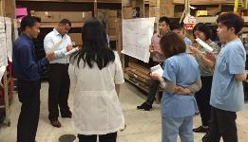
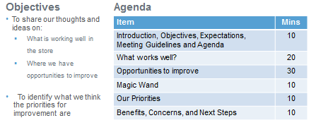
Focus Group
What is it?
What it looks like
A facilitated discussion with Team Members to explore and capture thoughts on what is working well and where there are opportunities for improvement in the store
How to run it
Follow the objectives and agenda guidance in the Focus Group supporting deck
Select a cross section of team members (6-10) to participate and schedule a 1.5 hour meeting (including FE & Rx)
Materials required will be the Story Board poster, post it notes, a flip chart and some pens
How to score it
During the session capture thoughts and ideas on the Story Board poster or on a flip chart if required
Key Roles
 | SM | ASM | SFL | TM | RXM | DM | FL
Choose Team members to participate | A |  |  | I |  | C
Schedule meeting | A |  |  | I |  | C
Facilitate session |  |  |  |  |  | A/R | C
Summarize outputs | R |  |  |  |  | A
Hints & Tips
This is an opportunity for team members to talk openly about what they think is good and where they have ideas for improvement – it is important to create an atmosphere where people feel free to speak and will be listened to
Capture thoughts and ideas on post it notes and place them on the Story Board poster or flip
At this stage it is about understanding where there are opportunities and where to focus attention – there is no need to jump in to creating solutions in this session, that will come later in the process
R: Responsible for carrying out the action
A: Ultimately accountable for ensuring the action is done
C: Must be consulted before the action is carried out
I: Must be informed that the action has taken place

Slide 19
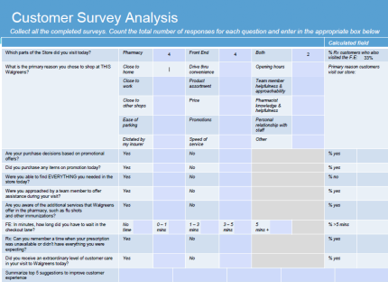
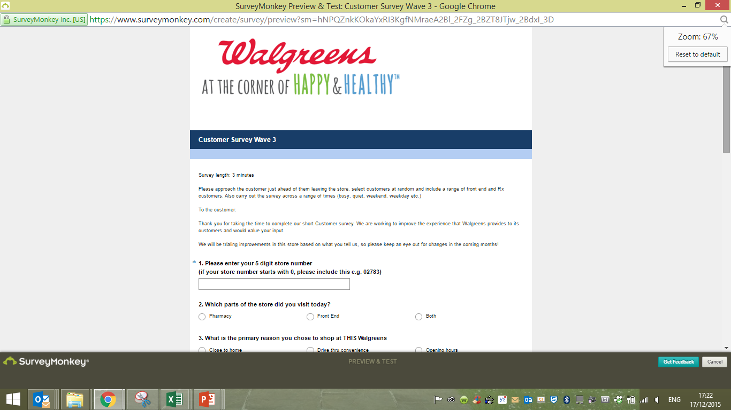
Customer Survey
What it is
A survey asking customers about their experience and what is important to them when shopping / collecting their prescriptions at a Walgreens store
How to run it
How to score it
Print off copies of the Customer survey PDF
Politely ask customers who are about to leave the store if they can spare a few minutes (no more than 5) to fill out the survey and then step through the questions with them and record the responses
Complete 30 surveys across a week
Enter the responses for each survey into the Customer Survey Analysis Form. This will analyze the results automatically and then include the results on the Storyboard
What it looks like
Key Roles
 | SM | ASM | SFL | TM | RXM | DM | FL
Find Team members to run the survey | A | R | R | C
Interview Customers |  |  |  | R
Enter responses in Scoring tool | A/R | R | R
Analyze results | A/R | R | R
Hints & Tips
Be sure to ask a wide variety of customers, including those who may not have had a great experience- this will help us identify what we can do to improve!
Conduct the survey at different days during diagnostic week and throughout the day (morning, afternoon and evening).
R: Responsible for carrying out the action
A: Ultimately accountable for ensuring the action is done
C: Must be consulted before the action is carried out
I: Must be informed that the action has taken place

Slide 20
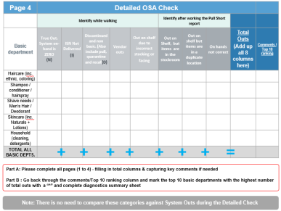
Great Customer Availability Study
What it is
2 studies designed to measure and track store availability, providing a basis to improve availability for customers
Detailed OSA check = Tracking specific departments with Telxon and tracking the reasons for outs
Visual OSA check = Entire store count to compare outs against those in the system
How to run it
What it looks like
Both checks will be run in store by TMs but the detailed check will require a Telxon
Detailed guidance and materials are provided in the Getting Ready for Great Customer Availability pack provided to your store
The individual instruction guides for each of the two checks can be found in the appendix
How to score it
Score the outs in tally format under the relevant category and cause of out (Detailed check only)
For the Visual counts, tally the results according to the aisle numbers
Key Roles
 | SM | ASM | SFL | TM | RXM | DM | FL
Find TMs to run the checks studies | A | R
Carry out the checks | A |  |  | R
Record results on scoresheets | A |  |  | R
Send Results to DM | A | R | R
Provide analysis back to store |  |  |  |  |  | A/R
Sample page from the Detailed OSA Check worksheet
Hints & Tips
Do the detailed check with a partner, with one person scanning the bar codes and the other recording the reason code for the out
After you’ve tallied the outs convert them to numbers before you send them to your Frontier DM
R: Responsible for carrying out the action
A: Ultimately accountable for ensuring the action is done
C: Must be consulted before the action is carried out
I: Must be informed that the action has taken place

Slide 21
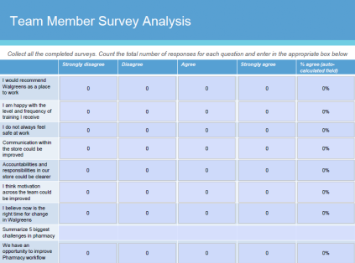
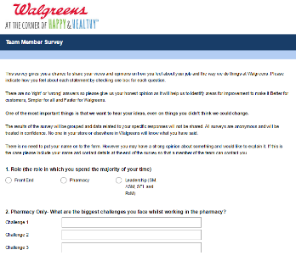
Team Member Survey
What it is
A survey that asks a series of questions regarding employee satisfaction which will give a measure of engagement, motivation and morale. The survey results are anonymous, results will be combined to give averages for the store
How to run it
How to score it
Print off copies of the Team Member survey PDF
The survey will take no longer than 5 minutes
Ask as many team members to complete as possible
Enter the responses for each survey into the Team Member Survey Analysis Form. This will analyze the results automatically and then include the results on the Storyboard
What it looks like
Key Roles
 | SM | ASM | SFL | TM | RXM | DM | FL
Complete survey | R | R | R | R | R
Enter responses in scoring tool and analyze results | A/R | R | R
Hints & Tips
All questions are anonymous, so answer them as honestly as possible
R: Responsible for carrying out the action
A: Ultimately accountable for ensuring the action is done
C: Must be consulted before the action is carried out
I: Must be informed that the action has taken place

Slide 22
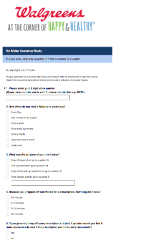
Rx Waiter Customer Survey
What it is
A survey of Pharmacy customers focusing on preferred and actual wait times for prescription collection
How to run it
What it looks like
You will print copies of the RX Waiter Customer survey PDF
Politely ask Pharmacy customers who are about to leave the Pharmacy if they can spare a few minutes (no more than 2) to fill out a survey and then step through the questions with them and record the responses
Complete 30 surveys across a week, complete the summary sheet and then send it to your DM for analysis
How to score it
DM’s will analyze the summary sheet and present back a one page including your Rx Diagnostic Data results. The data graphs and tables are generated automatically and your DM will share this with each store to be included on the Story Board
Key Roles
 | SM | ASM | SFL | TM | RXM | DM | FL
Find Team members to run the survey | I | R | C | C | A/R
Interview Customers | I |  |  | R | A/R
Send summary to DM |  |  |  |  | A/R
Enter data into Rx Analysis spreadsheet |  |  |  |  |  | A/R
Provide analysis back to store |  |  |  |  |  | A/R
Hints & Tips
Be sure to ask a wide variety of customers, including those who may not have had a great experience. This will help us identify what we can do to improve
Conduct the survey on different days during diagnostic week and throughout the day (morning, afternoon and evening).
R: Responsible for carrying out the action
A: Ultimately accountable for ensuring the action is done
C: Must be consulted before the action is carried out
I: Must be informed that the action has taken place

Slide 23
Rx Diagnostic Data
What it is
What it looks like
A diagnostic to baseline performance and help build an understanding of the impact of waiters
Store number: | Data
Number of deletes to stock
Mon | 24
Tues | 42
Wed | 35
Thur | 39
Fri | 51
Sat | 24
Sun | 31
7 Day Average number of deletes to stock | 35
How to run it
You will print a copy of the RX Diagnostic Data Summary Sheet
The Rx team should complete the data entry over the course of a week
Once completed, please send a copy to your DM for analysis
How to score it
Print the PDF summary sheet and tally the responses for each question (using the sheet to help you). Once tallied, average the numbers for Number Delete to Stock and Prescriptions on 7 day Call List. Use the figures from the summary sheet to fill out the Storyboard. Save a copy of the summary sheet and email it to your DM
Pharmacy Baseline Data
 | Data Request | Where to get the data | When to collect the data | For when
Pharmacy | Verified by Promise Time- VBPT (%) | StoreNet --> IMPROVE--> Customer scorecard --> “Verified By Promise Time %” total | Diagnostics Week, and then every week after | Last period for diagnostic, then weekly
 | % of Waiters | StoreNet -->IMPROVE --> Customer Scorecard “RX % Waiters” | Diagnostics Week, and then every week after | Last period for diagnostic, then weekly
 | Rx Sold – 90 Day Adjusted | StoreNet → KPI → Pharmacy → View “Rx Sold- 90 Day Adjusted” row | Diagnostics Week | Last period for diagnostic, then weekly
 | Pharmacy Customer NPS score | StoreNet → KPI → Service → Receipt Survey → All Reports → Pharmacy Coach report | Diagnostics Week, and then every month after | Previous Month
Key Roles
 | SM | ASM | SL | TM | RxM | DM | FL
Collate data | I |  |  | R | A/R
Send data to DM | I |  |  |  | A/R
Enter data into spreadsheet |  |  |  |  |  | A/R
Provide analysis back to store |  |  |  |  |  | A/R
Hints & Tips
Assign a couple of Rx team members to this task to ensure coverage over the week
R: Responsible for carrying out the action
A: Ultimately accountable for ensuring the action is done
C: Must be consulted before the action is carried out
I: Must be informed that the action has taken place

Slide 24
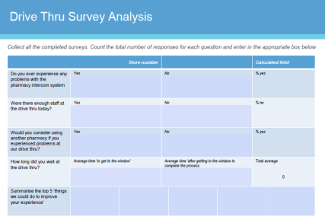
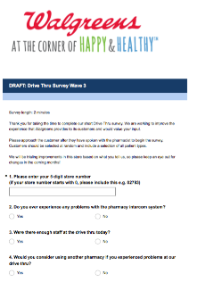
Rx Drive Thru Survey
What it is
A survey of Pharmacy Drive Thru customers
How to run it
How to score it
You will print copies of the RX Drive Thru survey PDF
Politely ask Pharmacy customers who are about to leave the Drive Thru Pharmacy if they can spare a few minutes (no more than 2) to fill out a survey. Ask them to park up in a designated area and then step through the questions with them and record the responses
Complete 30 surveys across a week, complete the RX Drive Thru survey scoring tool and include the results on your Store Story Board
Enter the responses for each survey into the Drive Thru Survey Analysis Form. This will analyze the results automatically and then include the results on the Storyboard
What it looks like
Key Roles
 | SM | ASM | SFL | TM | RXM | DM | FL
Find Team members to run the survey | I | R | C | C | A/R
Interview Customers | I |  |  | R | A/R
Enter responses in scoring tool | I |  |  |  | A/R
Enter data onto StoryBoard |  |  |  |  | A/R
Hints & Tips
Be sure to ask a wide variety of Drive Thru customers, including those who may not have had a great experience. This will help us identify what we can do to improve
Conduct the survey on different days during diagnostic week and throughout the day (morning, afternoon and evening).
R: Responsible for carrying out the action
A: Ultimately accountable for ensuring the action is done
C: Must be consulted before the action is carried out
I: Must be informed that the action has taken place

Slide 25
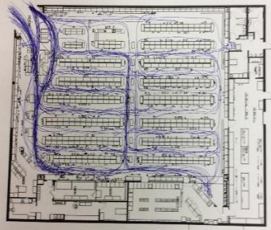
Customer Behavior (optional)
What it is
A study designed to provide insight around customer behavior: How they respond to our store layout and shop the store
How to run it
What it looks like
Print copies of the Customer Behavior study PDF
Select a customer at random as they enter the store (at the very beginning of their shopping trip). Do not approach them but observe at a distance, discreetly.
Try to mark exact route and all stopping points (with an ‘x’) as accurately as possible, as this will confirm hot and cold spots within the store
Complete 15+ studies across a week
How to score it
In order to produce the final output, trace all the individual customer behaviour observations onto a single summary floor plan
Use the customer flow information to help make changes to improve customer experience and sales
Key Roles
 | SM | ASM | SFL | TM | RXM | DM | FL
Find Team members to run the survey | A | R | C | C | C
Complete the study | A | R | R | R | R
Compile the summary sheet | A | R
Hints & Tips
Conduct the survey on different days during diagnostic week and throughout the day (morning, afternoon and evening). to get a well rounded view of customer shopping behaviors
If you are spotted and the customer asks you what you are doing, explain fully – need to see how the store is currently shopped to know how to improve it. Try to get a good mix of customers across the week
R: Responsible for carrying out the action
A: Ultimately accountable for ensuring the action is done
C: Must be consulted before the action is carried out
I: Must be informed that the action has taken place

Slide 26
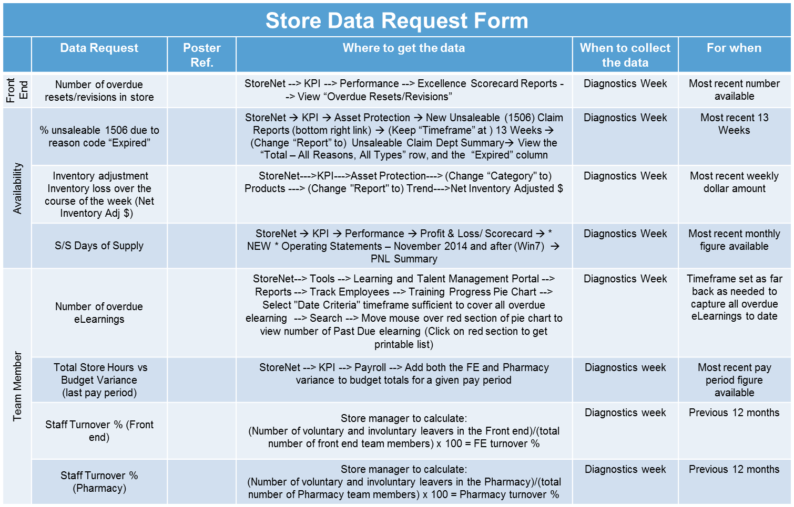
Store Data Request
What it is
The collation of some core store statistics to that will form part of the store Story Board
How to run it
What it looks like
Work through the Data Request form (image shown) and log your results on the Results form that can be found in the appendix
The Data Request form will provide you with references on where you can find the information you need
How to score it
Once you have located your store’s results for each of the data request points fill in the results on the Data Request Results Form, found in The Appendix
In addition, the form will tell you where exactly to put the results on your store’s story poster, found under the “Reference on Poster” column
Key Roles
 | SM | ASM | SFL | TM | RXM | DM | FL
Obtain data points from Data request sheet | A/R | R |  |  | R | I/C
Screen shot of data request points table
Hints & Tips
This activity may take between 30 mins and 1 hour, so you may need to plan your time
Place close attention to the “For when” column, it will tell if you need to collect last week’s, month’s or year’s results
R: Responsible for carrying out the action
A: Ultimately accountable for ensuring the action is done
C: Must be consulted before the action is carried out
I: Must be informed that the action has taken place

Slide 27
Insights Guidance
How to score and analyze the diagnostics

Slide 28






How you will receive your survey results
How results from the surveys are analyzed
What happens once we have completed all the surveys in store?
  For Team Member Survey, Customer Survey, and Drive Thru Survey, store teams should enter the data into the scoring tools provided.
  For Great Customer Availability, Rx Waiter, and RX Diagnostic Baseline Data you will send the results to your DM.
How will I receive my store’s results from the Great Customer Availability, Rx Waiter, and RX Diagnostic Baseline Data surveys?
  Your District Manager (DM) will send you one page outputs from the Great Customer Availability and Rx Waiter Customer Surveys
  Your results will be put into graphs to help you build your store’s unique story on the Storyboard poster
3. Who can I contact?
  Your DM will be the point of contact if you have any further questions
The Team Member Survey, Customer Survey, and Drive Thru Survey is completed on paper and then entered into the scoring tool by the store.
Great Customer Availability, Rx Waiter, and RX Diagnostic Baseline data are completed on paper and entered in a summary sheet completed by the store and sent to the DM
DMs will send the outputs to the stores who will then use the results to fill out Storyboard
Stores will then then enter the results from The Team Member Survey, Customer Survey, and Drive Thru Survey into the scoring tool and analyze the results and fill out Storyboard
This applies to
Great Customer Availability, Rx Waiter, and RX Diagnostic Baseline Data should be completed in store and then sent to your DM for summary analysis at which point you will receive all the final results on a one page summary sheet
Customer Survey
Team Member Survey
Great Customer Availability
Rx Waiter Customer Survey
RX Diagnostic Baseline Data
Rx Drive Thru Survey

Slide 29
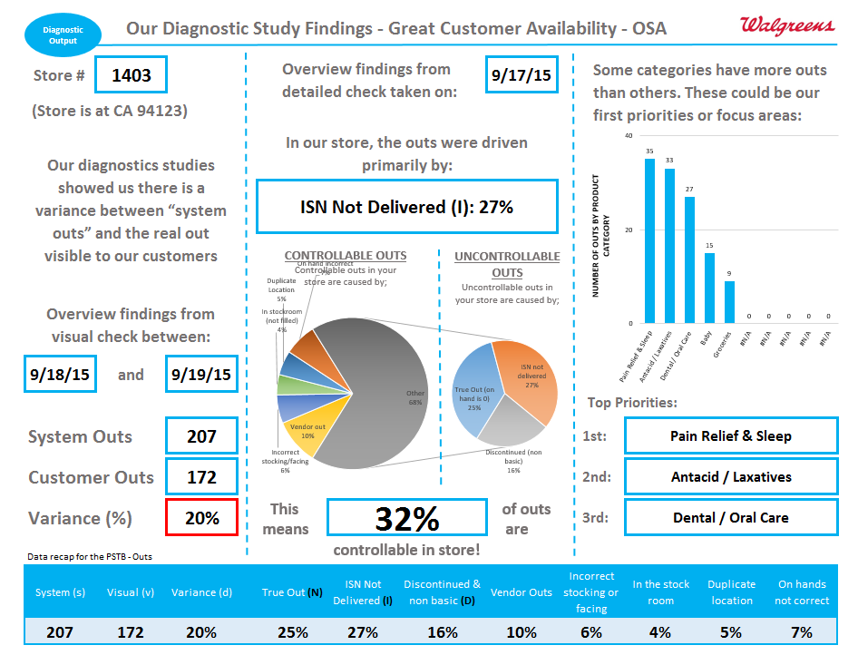
Great Customer Availability
The information on this page is intended for use by District managers (DMs), who will be responsible for inputting the data for this diagnostic.
Using the OSA Scoring Tool file, enter the store’s results for both the visual and detailed counts in the “Input tab”.
(Note: The Detailed Count has two parts: 1. a and 1. b, the Visual Count just one. These are both clearly indicated)
Once you have entered all the data, click “Go To Output”
This will generate all the results onto an output poster, shown in the picture to the left.
The Detailed Check data will help tell you: Cause of outs, # of outs by product category and % of controllable outs
The Visual Check data will help to give you a week-by-week snapshot of your performance and the difference between real outs in store and what the system says
How to enter the data
How to generate the analysis
Hints and tips
An example of the output you will receive after doing the study and logging the results. Both the Visual and Detailed Check results will appear on one page

Slide 30
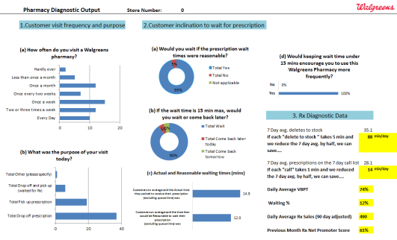
Rx Waiter Customer Survey & Diagnostic Data
The information on this page is intended for use by District managers (DMs), who will be responsible for inputting the data for this diagnostic.
Using the Diagnostic Rx Analysis excel file, enter the store’s summary results for both the Rx Waiter Customer survey and RX Diagnostic data summary sheet.
You will find these in the following two tabs:
Input Rx Waiter Customer Summary
Input Rx Diagnostic Data
Once you have entered all the data, switch to the Rx Analysis Output worksheet
This will automatically generate all the results onto an output poster, shown in the picture to the left.
The output poster is divided into three sections to help with your analysis:
1) Customer visit frequency and purpose
2) Customer inclination to wait for scripts
3) Rx Diagnostic Data
Share the analysis with the Store Manager and Pharmacy Manager so they can add the summary output analysis to the Store Storyboard.
How to enter the data
How to generate the analysis
An example of the output the Store will receive after completing the Rx Waiter Customer Survey and Rx Diagnostic Data.
Hints and tips

Slide 31
Appendix

Slide 32
Diagnostics RACI | Store Manager (SM) | Assistant Store Manager (ASM) | Shift Lead (SFL) | Team members (TMs) | Pharmacy manager (RXM) | District Manager (DM) | Frontier Leader (FL)
Focus Group
Facilitate discussion on key issues for store with Team Members |  |  |  |  |  | A/R | C
Customer Survey
Find Team members to run the survey | A | R | R | C
Interview Customers |  |  |  | R
Enter responses in scoring tool | A/R | R | R
Analyze results | A/R | R | R
Great Customer Availability
Find Team Members to run the checks (Detailed and Visual) | A | R
Carry out the checks | A |  |  | R
Record results on scoresheets | A |  |  | R
Send Results to DM | A | R | R
Provide analysis back to store |  |  |  |  |  | A/R
Team Member Survey
Complete the TM Survey | R | R | R | R | R
Enter responses in scoring tool and analyze results | A/R | R | R
Rx Waiter Customer Survey
Find Team members to run the survey | I | R | C | C | A/R
Interview Customers | I |  |  | R | A/R
Complete and Send Rx Waiter Summary Sheet to DM | I |  |  |  | A/R
Enter data into Rx Analysis spreadsheet |  |  |  |  |  | A/R
Provide analysis back to store |  |  |  |  |  | A/R
Rx Diagnostic Data
Collate data | I |  |  | R | A/R
Send summary data to DM | I |  |  |  | A/R
Enter data into Rx Analysis spreadsheet |  |  |  |  |  | A/R
Provide analysis back to store |  |  |  |  |  | A/R
Rx Drive Thru Survey
Find Team members to run the survey | I | R | C | C | A/R
Interview Customers | I |  |  | R | A/R
Enter responses into scoring tool | I |  |  |  | A/R
Enter results onto Storyboard |  |  |  |  | A/R
Other
Obtain data points from Data request sheet | A/R | R |  |  | R | I/C

Slide 33
Round Robin:
How to run each diagnostic

Slide 34
Diagnostics– Round Robin
Preparation
Trainers Notes
Print of sufficient copies of each diagnostic
Set up 5 stations
  OSA
  RX
  Shrink
  Focus Group/Storyboard
  TM Survey/Customer Survey/Data Request/Customer Behavior
Place all the materials in each station
Arrange team into 5 groups and display names and groups on a flip
Print of example data for practice sessions
Arrange times with SM from the store (if your completing any diagnostics there)
Use slides or flips to write up general intro/ overview of each diagnostic. Create an engaging learning session
- Whole Team
Introduce the session and split the team into 5 groups
Groups
Introduce the diagnostic by explaining the reason for completing it and how it helps us
Run through the instructions for completion
Practice completing with the teams – if in a store you can use real data – or use data from a previous store as an example
Run Q and A session at the end of each one to check understanding and clarify any questions or concerns

Slide 35
Use SharePoint for most recent core skill deck
SharePoint > Frontier Roll Out Documents Store Roll Out Tool Kit > Diagnostics
Shrink Diagnostic is NOT on storenet, please see next slide
Diagnostic Planning
Focus Group/Storyboard (insert room) – <insert facilitator>
OSA (insert room) – <insert facilitator>
Pharmacy (insert room) – <insert facilitator>
Shrink (insert room) – <insert facilitator>
TM Survey/Customer Survey/Data Request/Customer Behavior (insert room)- <insert facilitator>
Notes:
Plan private space for session

Slide 36
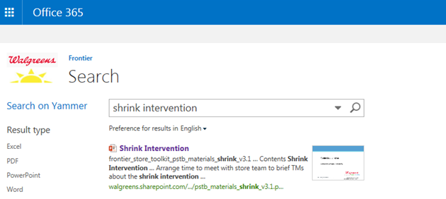
Shrink Diagnostic- Not available on StoreNet. DM will need to send PDF copy to the store manager
Shrink PDF
Shrink PowerPoint
Shrink Diagnostic can be located on SharePoint by searching: Shrink Intervention

Slide 37
Diagnostic Round Robin….
Insert Room- Station 5
Insert Room- Station 1
TM Survey/Customer Survey/Data Request/Customer Behavior
<insert facilitator>
Focus Group/Storyboard
<insert facilitator>
45 minutes per station
(5 minutes to move)
Optional to bring Pen/Paper to take notes
Insert Room-Station 4
Insert Room- Station 2
Shrink
<insert facilitator>
Insert Room-Station 3
OSA
<insert facilitator>
Pharmacy
<insert facilitator>
2 Rounds then Break
Notes:
UPDATE slide with room space and facilitator name
Room is set up with diagnostic stations run by Frontier Leaders or team members comfortable with material.
OSA
Pharmacy
Shrink
Focus Group/Storyboard
TM survey/Customer survey/Data request/Customer Behavior study

Slide 38

BREAK

Slide 39
Diagnostic Round Robin….
Insert Room- Station 5
Insert Room- Station 1
TM Survey/Customer Survey/Data Request/Customer Behavior
<insert facilitator>
Focus Group/Storyboard
<insert facilitator>
45 minutes per station
(5 minutes to move)
Optional to bring Pen/Paper to take notes
Insert Room-Station 4
Insert Room- Station 2
Shrink
<insert facilitator>
Insert Room-Station 3
OSA
<insert facilitator>
Pharmacy
<insert facilitator>
2 Rounds then Lunch
Notes:
UPDATE slide with room space and facilitator name
Room is set up with diagnostic stations run by Frontier Leaders or team members comfortable with material.
OSA
Pharmacy
Shrink
Focus Group/Storyboard
TM survey/Customer survey/Data request/Customer Behavior study

Slide 40


Slide 41
Diagnostic Round Robin….
Insert Room- Station 5
Insert Room- Station 1
TM Survey/Customer Survey/Data Request/Customer Behavior
<insert facilitator>
Focus Group/Storyboard
<insert facilitator>
45minutes per station
(5 minutes to move)
Optional to bring Pen/Paper to take notes
Insert Room-Station 4
Insert Room- Station 2
Shrink
<insert facilitator>
Insert Room-Station 3
OSA
<insert facilitator>
Pharmacy
<insert facilitator>
1 Round to go
Notes:
UPDATE slide with room space and facilitator name
Room is set up with diagnostic stations run by Frontier Leaders or team members comfortable with material.
OSA
Pharmacy
Shrink
Focus Group/Storyboard
TM survey/Customer survey/Data request/Customer Behavior study

Slide 42
How to keep the Storyboard alive (review and discussion)
Diagnostic Debrief
<Insert Facilitator>

Slide 43

The process behind getting to a storyboard
Hypotheses generation
Diagnostics creation
Run diagnostics
Analyze diagnostics
Populate storyboard
Interpret & share story
Notes:
Voiceover the process behind getting to the storyboard, how it links to diagnostics, and the purpose of it – an engagement tool

Slide 44

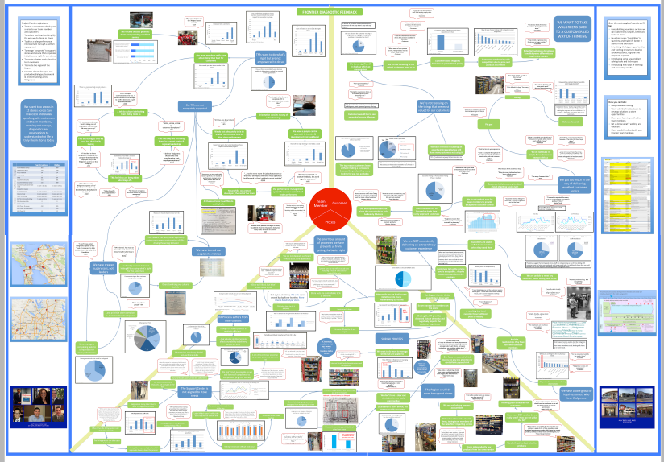
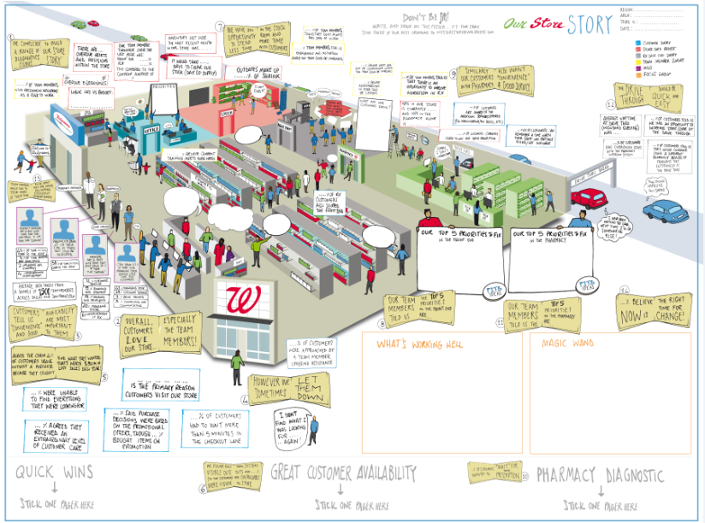
The evolution of the Frontier storyboard
Notes:
Share the evolution of the storyboard, from where we started with the original hypotheses, diagnostics and storyboard back in April/May of 2015 to now. A method to share the story of each store with team members across the Rx and F.E. It should be in a place prominent to all and is built out during the course of the diagnostics week

Slide 45
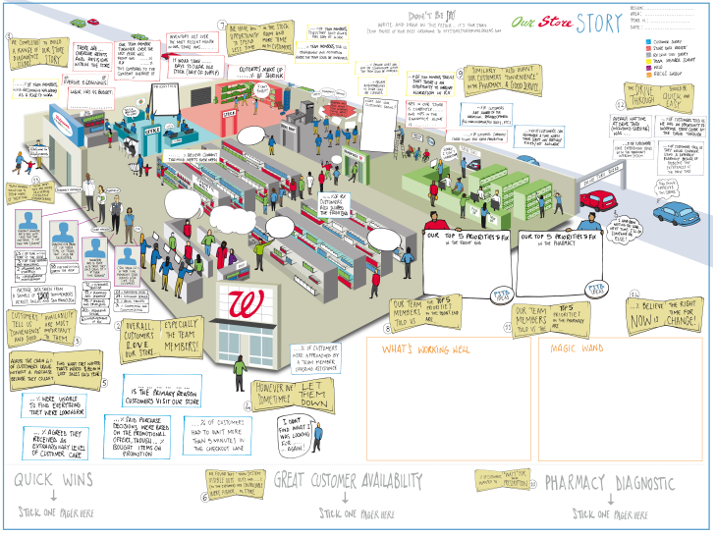
Storyboard:
Notes:
Show an example of the store storyboard
Describe what it is and how it works and how it links to the diagnostics
Explain How the information is compiled – what needs to be sent to DM and how its returned

Slide 46

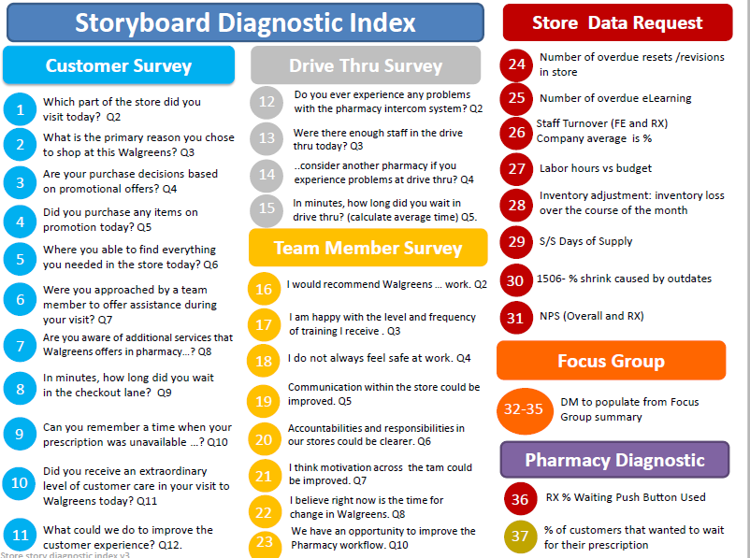
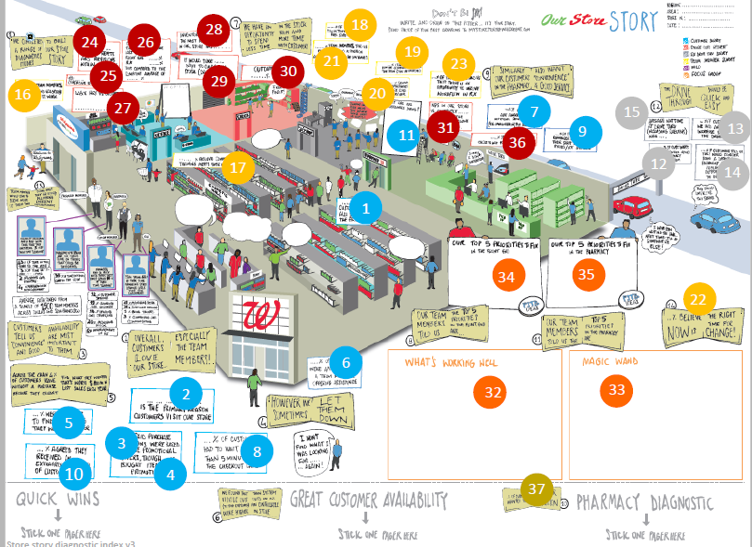
The storyboard index helps stores to understand which results go where on the storyboard
From analysis to development and interpretation…
After analyzing data, running focus groups and receiving outputs from DMs, stores populate their storyboard in line with the storyboard index
Interpreting the data, and understanding how it relates back to store operations is the key here
Store leadership then share this storyboard with members of the store team from both the pharmacy and front end
It is placed in a location visible to all team members across the store
Notes:
Use the diagnostics guidance deck to share how to enter data into scoring tools, how to interpret the outputs etc.
Hold an open discussion on data analysis. Pattern recognition, how to relate finding back to operation, what story is the data telling. What creates noise in the data.

Slide 47

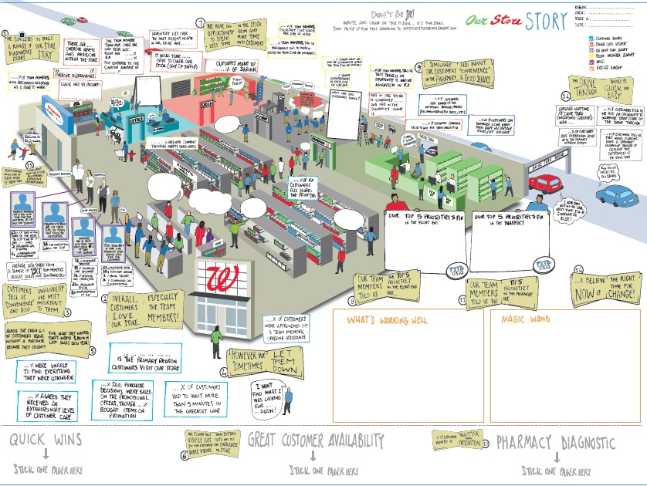
59
28
18
24
26
19
30
21
23
25
29
16
20
27
7
15
11
31
9
13
36
17
12
14
1
34
35
22
6
2
32
33
5
3
8
10
4
37
Store story diagnostic index

Slide 48
Storyboard Diagnos c Index
Store Data Request
Customer Survey Drive Thru Survey
24
Number of overdue resets /revisions in store
1
Which part of the store did you visit today? Q2
What is the primary reason you chose to shop at this Walgreens? Q3
Are your purchase decisions based on promo onal offers? Q4
Did you purchase any items on promo on today? Q5
Where you able to find everything you needed in the store today? Q6
Were you approached by a team member to offer assistance during your visit? Q7
Are you aware of addi onal services that Walgreens offers in pharmacy…? Q8
12
Do you ever experience any problems with the pharmacy intercom system? Q2
25
26
Number of overdue eLearning
13
Were there enough staff in the drive thru today? Q3
..consider another pharmacy if you experience problems at drive thru? Q4
Staff Turnover (FE and RX) Company average is %
2
14
15
27
Labor hours vs budget
3
In minutes, how long did you wait in drive thru? (calculate average me) Q5.
28
Inventory adjustment: inventory loss over the course of the month
4
Team Member Survey
29
S/S Days of Supply
5
16
I would recommend Walgreens … work. Q2
30
1506- % shrink caused by outdates
6
17
I am happy with the level and frequency of training I receive . Q3
31
NPS (Overall and RX)
7
18
I do not always feel safe at work. Q4
Focus Group
8
In minutes, how long did you wait in the checkout lane? Q9
Communica on within the store could be improved. Q5
19
32-35
DM to populate from Focus Group summary
9
Can you remember a me when your prescrip on was unavailable …? Q10
Accountabili es and responsibili es in
20 our stores could be clearer. Q6
Pharmacy Diagnos c
Did you receive an extraordinary level of customer care in your visit to Walgreens today? Q11
21
I think mo va on across the tam could be improved. Q7
I believe right now is the me for change in Walgreens. Q8
We have an opportunity to improve the Pharmacy workflow. Q10
10
36
RX % Wai ng Push Bu on Used
22
23
11
What could we do to improve the
37
% of customers that wanted to wait for their prescrip on
customer experience? Q12.
Store story diagnos c index v3

Slide 49



Quick Wins
Why we do this intervention
What it entails & how to do it
Empowers employees to give suggestions
Improves the store/customer experience
Generates better, simpler, faster solutions to improve in store processes
Improves the store’s overall operation
Drives employee engagement and buy-in
Create a space on the story board for suggestions and find a convenient place for employees
Brief store TMs on the quick win process
TMs to use post its to highlight likes and what needs to change
Weekly responses to ideas by SM (Consult with DM on larger issues)
SM makes a point of talking to each TM every week about some aspect of store operations
Who should do it
Key dependencies / situation-specifics
 | DPR | DM | SM | RXM | ASM | TM
R |  |  |  | X | X | X
A |  |  | X
C |  | X*
I |  | X
Starts early in Frontier roll out
Effective two way communication
Consistent feedback, explaining the whys, and why nots
Supporting tools & resources
KEY:
R: Responsible for carrying this intervention out
A: Ultimately accountable for ensuring this is done
C: Must be consulted before the intervention is carried out
I: Must be informed that the intervention has taken place
NOTES:
1 * Only on large scale or large cost projects
Story Board Poster
Post its
Pens/Markers
©2016 Walgreen Co. All rights reserved.
Notes:
Discussion around how to keep it alive to drive engagement and empowerment and create a better.simpler.faster Walgreens.

Slide 50
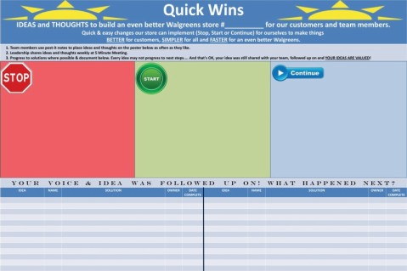
Quick Wins Poster
Notes:
Discussion around how to keep it alive to drive engagement and empowerment and create a better.simpler.faster Walgreens.

Slide 51
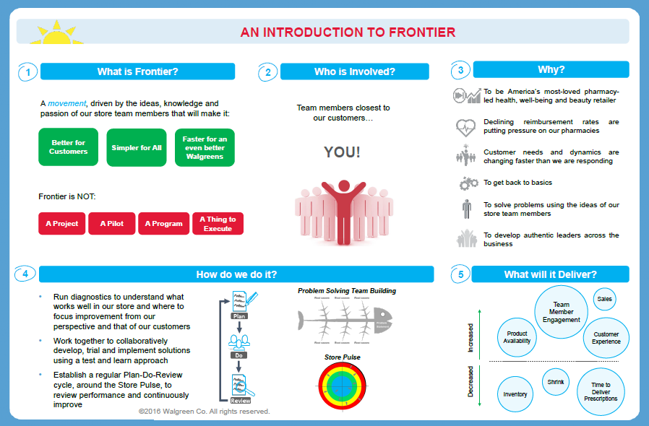
Frontier Wall: Phase One

Slide 52
Debrief Activity:
Store Diagnostics, Storyboard, Quick Wins
At your table, take 5 minutes to discuss the Benefits and Concerns
Use the flipcharts at your tables to capture your thoughts
Every table will select a spokesperson to present back to the group (2 min) one benefit and concern (try not to repeat)
The Concerns will be worked through during the Reflection and Planning session (by district)
Notes:
Insert district #.
Build on the ideas from the discussion. Collect flip charts for output deck.

Slide 53
Core Skill Practice
Problem Solve Team Build

Slide 54
PSTB Practice with OSA or RX Service Diagnostic
Break into District Group
Practice PSTB for 50 minutes
Debrief for 10 minutes

Slide 55
Core Skill PSTB Practice
PREPERATION
TRAINERS NOTES
Print the one page summary for PSTB
Prepare Fish bones
All Material required for PSTB
  Create an output for OSA or RX to support background of problem statement
Allow 50 Mins for PSTBs
Allow 10 mins to debrief
Introduce the session and split into District groups (DM led facilitator, DPR/HCS/OLS/APM/FL co-facilitate/scribe)
Explain that this a time for them to see and practice PSTB
PSTB topic
- OSA – How to reduce Outs
OR
- RX Service – How to Improve Waiters
Notes:
OSA facilitated by DPR or DM (supported by FL or OLS)
RX Service facilitated by HCS or DM (supported by FL or OLS)

Slide 56
OSA Role Play
Introduce the Team to the Session

Slide 57
Before you start share the Objectives of the session and capture any Expectations from the participants….
Objectives
To share background information / diagnostic findings
To discuss the barriers and solutions related to our problem identified
To work as a team and promote ownership of team members ideas which lead to actionable next steps
Agenda | Timing
Agenda, Objectives, Expectations | 5 min
Ground Rules | 5 min
Why are we here | 5 min
PSTB Process Steps Overview | 5 min
Run PSTB session | As Required
B’s and C’s, expectations review, next steps | 5 min

Slide 58
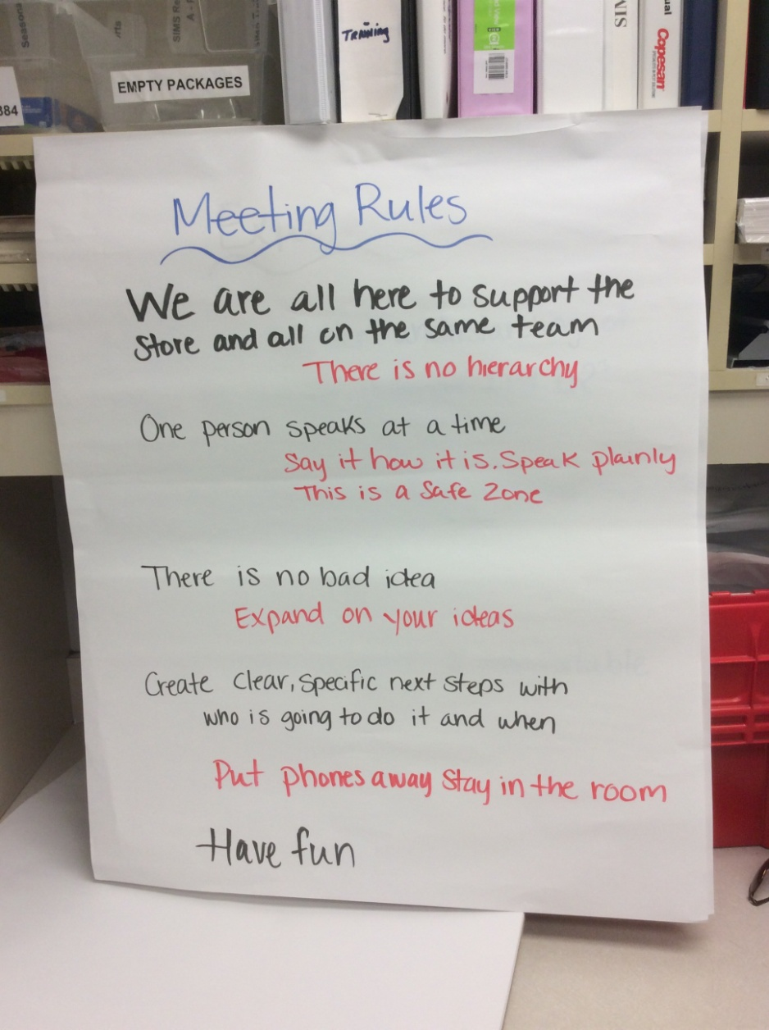
… and also set out the ground rules that will help deliver a great PSTB
Ground Rules:
We’re all on the same team – so no hierarchy in the group
One person speaks at a time
Say it how it is, don’t dress it up
It is a safe zone – speak honestly
No idea is a bad idea
Expand on ideas – don’t shut them down
Develop clear, specific next steps with who is going to do it and by when
Cells – put them on silent and put them away

Slide 59
OSA Role Play
PSTB SET UP

Slide 60
The facilitator if they follow these Key Tips will be on the way to a successful PSTB
Key Tips:
Having the right audience is critical to success. Ensure people are invited to attend who have relevance to the problem you are trying to solve
Don’t let individuals dominate the meeting, encourage participation by all
Do not stop to evaluate any ideas – either in root causes or solutions generation - just capture them all
Facilitator must remain neutral at all times, Mind your body language– you could be seen to be shooting ideas down
When voting, Team Members vote first – SM’s / DM’s and above etc., vote last
Don’t try to be too ambitious with lots of next steps & actions. Fewer, but more focused actions are the key. Don’t try to boil the ocean in one go!

Slide 61
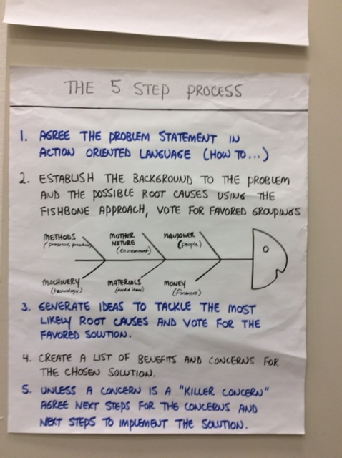
What are the 5 steps to a PSTB?
1
Agree the problem statement in action oriented language (i.e. How to…)
2
Establish the background to the problem and the possible root causes
3
Generate ideas to tackle the most likely root causes and vote for the favored solution
4
5
Create a list of Benefits and Concerns for the chosen solutions
Agree next steps to resolve the concerns and the next steps to implement the solutions. If a concern is a ‘killer concern’ (choose the idea with the next highest number of votes and redo step 4)

Slide 62
OSA Role Play
Introduce the 5 Steps

Slide 63
Step 1: Agree the problem statement in action oriented language (i.e. How to…)
1
Our problem Statement today
How to reduce visual outs, system outs & the variance between them with the aim of improving customer availability & sales

Slide 64
OSA Role Play
Step 1

Slide 65
Step 2: Establish the background to the problem and the possible root causes and barriers
  Establish the background to the problem and the possible root causes
  Group the root causes in common themes – use the fish bone approach
  Vote on the barrier that you think is contributing the most to the problem statement
Machinery
(Equipment)
Manpower
(Resources)
Materials (Products)
✔
✔
✔
✔
2
✔
✔
PROBLEM
✔
✔
Money
(Management)
Methods
(Processes)
Mother Nature
(Environment)
You can also create categories in the session dependent on what barriers come out of the brainstorm

Slide 66
Group the Barriers and vote on those you think are contributing most to the problem statement
As the Facilitator, engage with the participants to solicit barriers
The Facilitator may need to ask the 5 WHY’s to get to the root cause of the barrier.
Remember to keep the problem statement visible so that you can refer back to it and ensure you stay on track.
Group the common barriers, sometimes this is a good time to take a break
Ensure Team Members vote on a group and not the individual root causes.

Slide 67
OSA Role Play
Step 2

Slide 68
Steps 3: Generate solutions
Brainstorm as many ideas as possible, All ideas are good ideas
Sometimes the ideas can to be paired or grouped together
Give everybody 3 votes for the ideas they like best
Put ticks on the flip chart
As the facilitator, solicit ideas from the entire team and not just one individual.
Do not stop and evaluate any of the ideas or solutions just capture them.
Vote on the ideas or solutions you want to take forward
Again when voting, let team members vote first.
3

Slide 69
OSA Role Play
Step 3

Slide 70
Steps 4: Capture the B’s & C’s for the most voted solutions
Take the most voted for solutions (maximum 5) and do benefits and concerns (always benefits first)
When listing benefits, think about how this helps solve our problem
When listing concerns, think about
  What are the costs of this proposed solution
  Might this solution cause any new problems
Decide if any of the concerns are killer concerns and therefore rule the solution out e.g. Changes to IT systems
4

Slide 71
OSA Role Play
Step 4

Slide 72
Step 5: Set an Action Plan from
  Agree next steps to implement the solution and next steps for the concerns. If a concern is a killer i.e. is not possible to overcome (choose the idea with the next highest number of votes and redo step 4) benefits and concerns,
  Each next step/action should have, a person and a time by which it should be accomplished
  These actions must be reviewed regularly until complete
5
Next steps should be clear so everyone can read them.
Next steps can not be delegated to someone that is not in the room.
Next steps are taken by volunteers within the room.
Next steps should not fall on the same person or one role.
Next steps should have a completion date and not ongoing.

Slide 73
OSA Role Play
Step 5

Slide 74
Possible Step 6
If time permits after you have captured the next steps:
Revisit the next highest voted solution ideas and repeat from the benefits and Concerns step to Next Steps
or when weeks later you have completed all the next steps and want to revisit the problem statement:
Revisit additional barriers and redo from the Idea Generation step.

Slide 75
Finally capture Benefits and Concerns for the meeting, and review the session Objectives and Expectations
After detailing the next steps for implementing the proposed solutions, capture Benefits and Concerns of the entire PSTB workshop.
If any concerns are raised these are resolved by creating a next step.
Alternatively the concern might be recognized as a “Watch out”

Slide 76
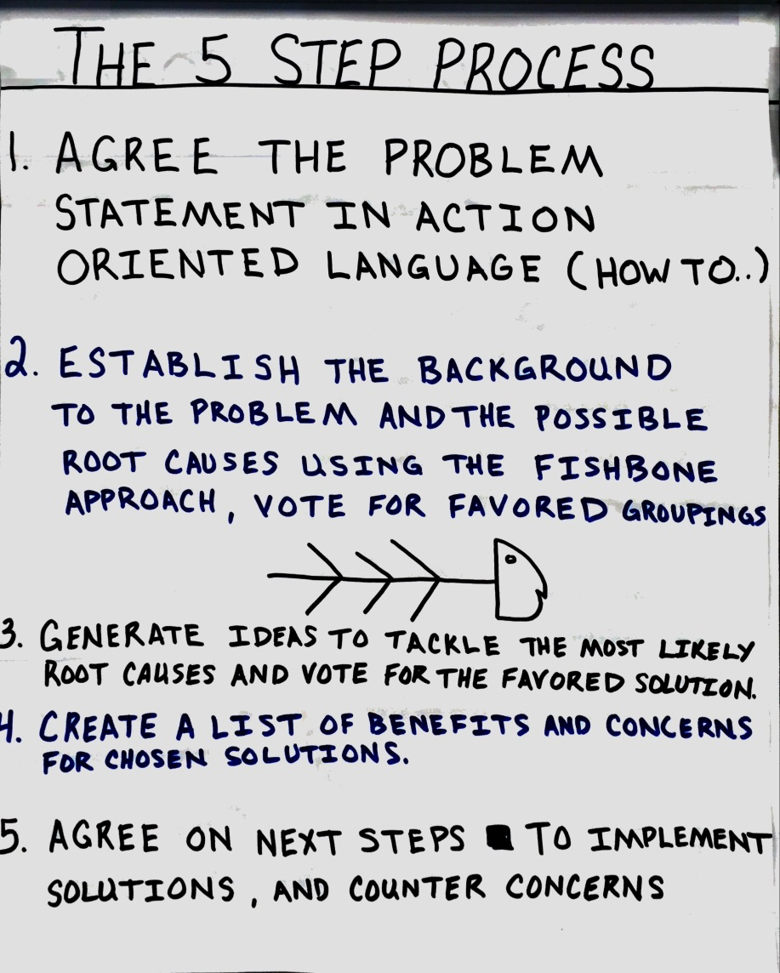

Slide 77
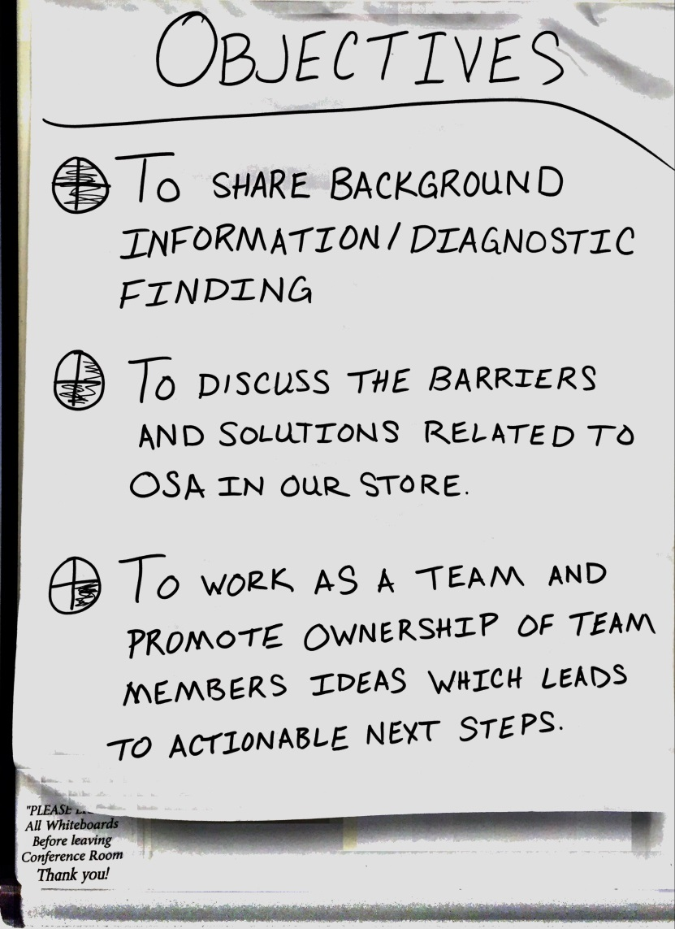

Slide 78
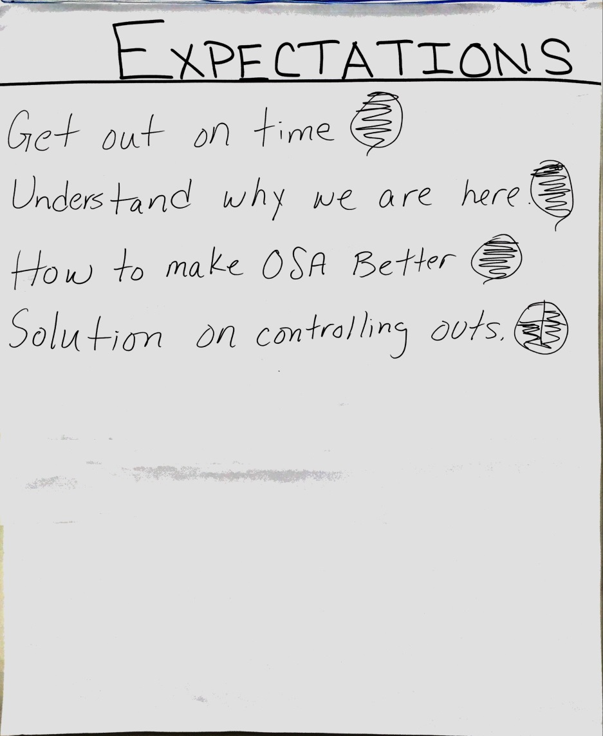

Slide 79
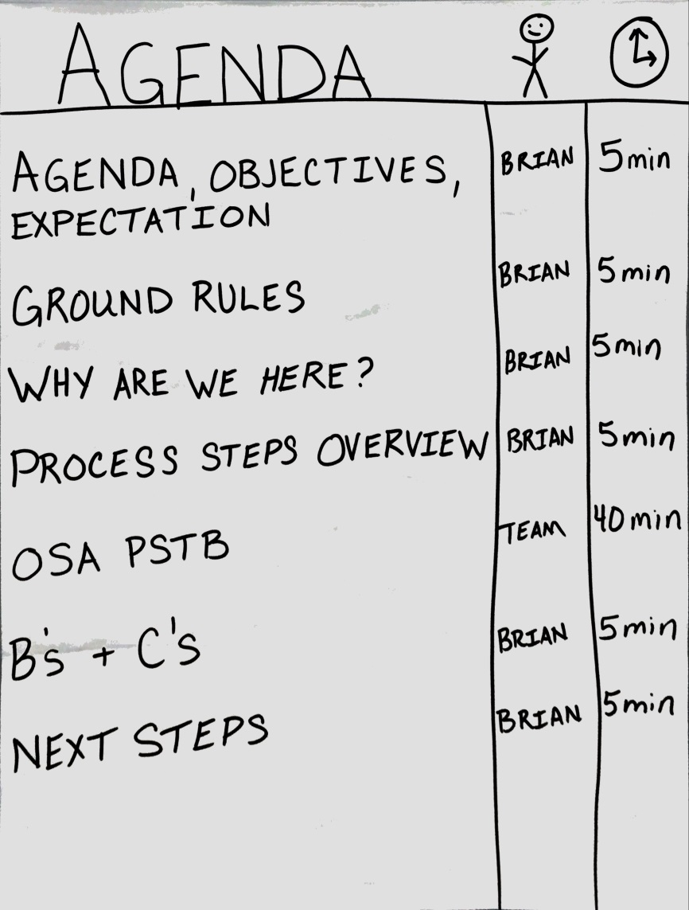

Slide 80


Slide 81
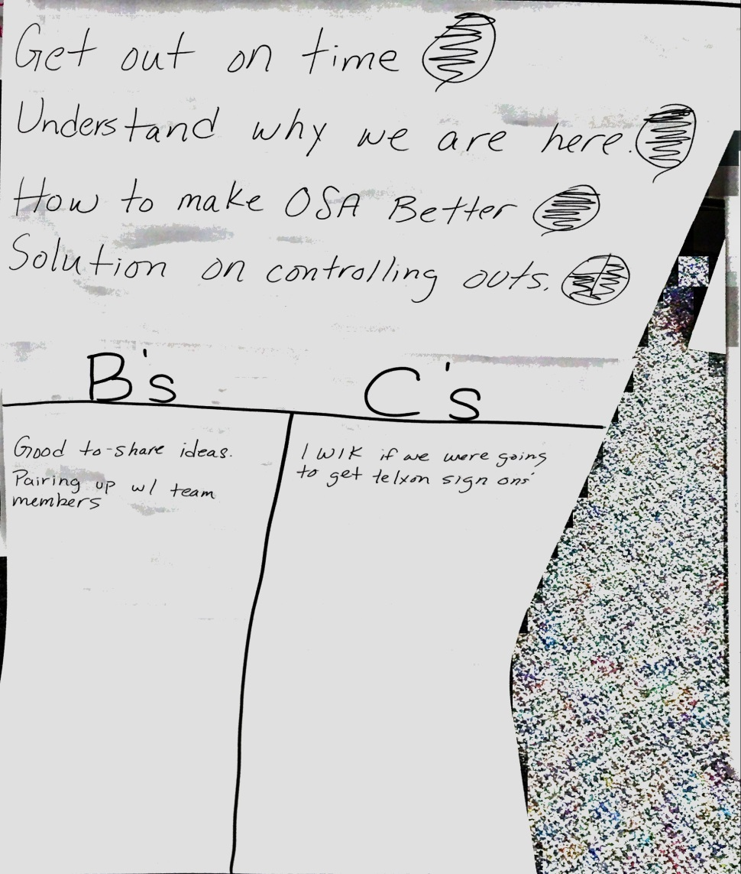

Slide 82
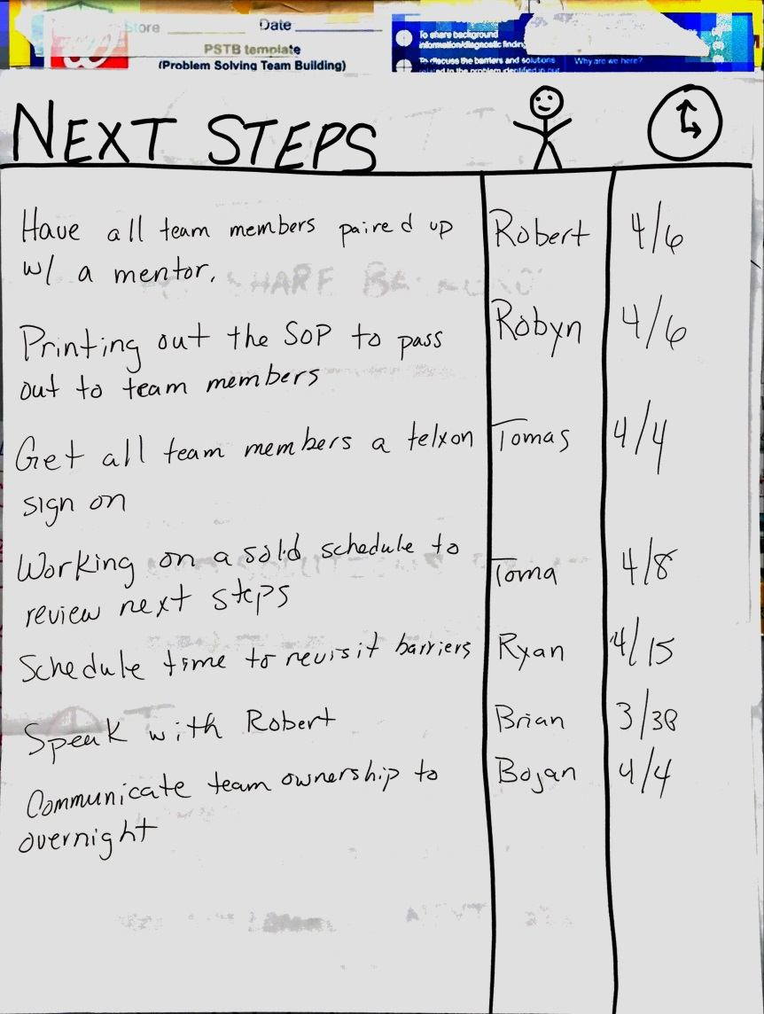

Slide 83
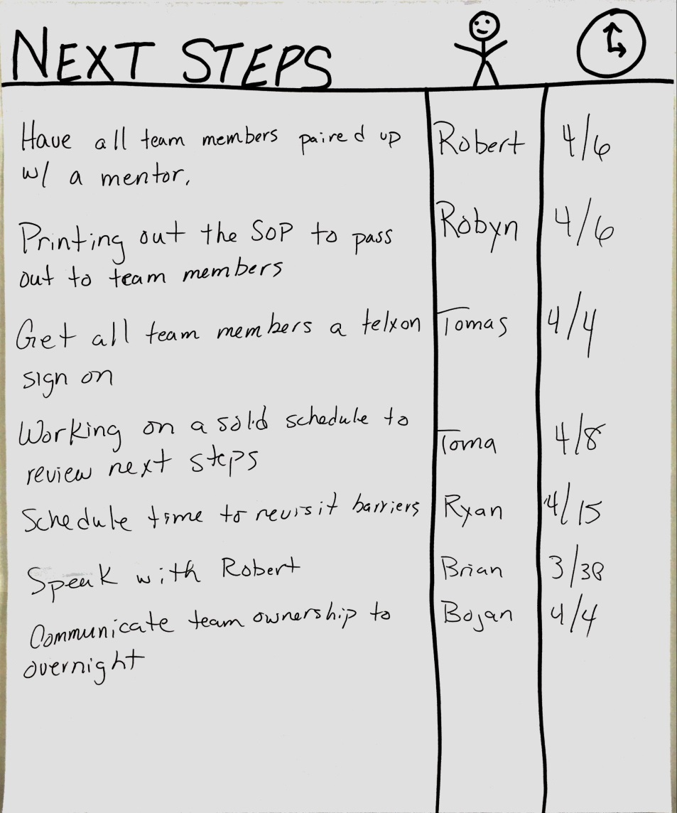

Slide 84
OSA Role Play
Close and Debrief using PSTB Meeting Review

Slide 85



PSTB: Meeting review
To be used after the meeting as part of Plan Do Review.
This is ONLY a guide and could be used while learning to run PSTBs.
Date Behavior
Were the right team members invited to get the best solutions?
Was the meeting flips prepared ahead of time?
Was the EMM process followed?
How well did we respect each other?
Did management refrain from interjecting their own views and did they support if needed?
Are the solutions focused on the right areas?
Are the next steps actionable & right quality?
How well did we share the accountabilities?
Benefits | Concerns
Next Steps

Slide 86
RX Service PSTB Role Play
Introduce the 5 Steps

Slide 87
BREAK

Slide 88
Phase 2
Quick High Level Overview
Store Weekly Pulse & Sustainability
<Insert Facilitator>

Slide 89
Phase 2 Overview – What’s to come ?
PREPERATION
TRAINERS NOTES
Prepare the Slides
Introduce the session and explain the purpose of this session is to give them a high level summary of what’s coming in phase 2

Slide 90
Phase 2 – What will be covered at the meeting
The Objectives for the week 5 briefing with SM’s / ASM’s are:
To get feedback on phase 1
To run through the weekly plan for phase 2
To brief SM and ASM on the:
Store Weekly Pulse
Plan – Do Review meeting process
Other Interventions for PSTB
Sustainability plans – “what good looks like”
Agree what’s next

Slide 91
What is a Pulse and what is the point of it?
A visual tool to help us embed a Plan-Do-Review approach to daily store operations, maintaining focus on the basics that drive performance
©2016 Walgreen Co. All rights reserved.

Slide 92
The Pulse is a visual tool for helping us manage and improve performance
What it is
What it isn’t
A visible tool, which is constantly reviewed
A way of developing more realistic and achievable targets
A way to help us deliver our Walgreens’ strategy by linking it to day-to-day operations
A way of working which helps simplify and clarify daily activities
A tool to help the team focus on the few important things that drive performance, rather than multiple issues and metrics
A tool that empowers team members to take accountability for store performance and make a difference by resolving their own issues
A way to build engagement and strengthen teams
Just a means of gathering information/data
A top down tool which dictates acceptable performance
A reporting mechanism with no actions attached
A document which is circulated for information
©2016 Walgreen Co. All rights reserved.

Slide 93

Performance is sustained using a Plan Do Review approach
The Pulse is a visual management tool which supports the review of performance and drives action for improvement
Core Principles of the Pulse
Approximately 12 focus areas
Visible to all team members
Creates and embeds a culture of continuous improvement
Reviewed weekly in Plan Do Review format
Encourages team engagement (knowledge and ownership)
Drives behaviours and action
One for the Store, Area & Region
The Pulse cascade ensures the right measures are guiding our efforts of continuous improvement at each level of the business
The Pulse will be launched in Phase 2 (from week 6) at which point your DM will review the theory and materials with you

Slide 94


Pulse: Meeting review
To be used after the meeting as part of Plan Do Review.
This is ONLY a guide and could be used while learning to run Pulse meetings.
Date Behavior
Did all people attend?
Did it start and end on time?
Were next steps completed?
Did everybody prepare?
How well did we respect each other?
How well did our conversations focus on moving forward with actions?
How well did we confine detailed conversations to next steps?
How well did we share the load?
Benefits | Concerns
Next Steps

Slide 95
Sustainability Review
February 2016
regional_toolkit_sustainability_review_approach_and_guidance_v1

Slide 96
For any change effort to be successful and sustainable, 8 stages have to be achieved
Establish a sense of urgency (need for change)
Form a powerful guiding coalition
Create a vision
Communicate the vision
Empower others to act on the vision
Plan for and create short term wins
Consolidate improvements & produce more change
Institutionalize new approaches
Reviewing ourselves against each of these stages, in the context of Frontier, will:
  Highlight how well we are landing and sustaining change within stores, districts, areas and regions
  Help us understand the reasons behind what’s not working so well
  Support the creation of a plan and next steps to continuously improve
Source: “Leading Change: Why Transformation Efforts Fail” by John Kotter

Slide 97
Sustainability Review purpose
The purpose of the sustainability review is to hold an open discussion in regard to how Frontier is being implemented and sustained at a store/area/region level
It is not a judgement of understanding or competency but a dialogue to help identify areas of strength and opportunity
All levels of leadership can use this information to help highlight areas in which they can support the development of their teams and embed and sustain Frontier principles, closing the gap between the As Is and To Be state
The review should form part of normal business operations – as part of standard store visits, area or regional meetings

Slide 98
Running the Sustainability review
Agenda & Scoring mechanism
Purpose
To hold an open discussion regarding how well we are sustaining Frontier; understanding the reasons behind what’s not working so well, and creating a sustainability plan to course correct where necessary
Agenda
Agenda Item | Suggested Time | Detail
Intro, Objectives, Expectations | 10 | Why we are all here Overview of objectives and agenda (including an explanation of the sustainability review process where necessary)
Complete the review and define next steps | 90 | The purpose of the review is to have an open discussion and develop a Sustainability Plan Work through the sustainability review and score each area accordingly Understand the challenge/opportunity behind items reviewed as , taking realistic next steps to improve in the defined areas
Benefits & Concerns, Close | 5 | Benefits first Concerns to be stated with ‘how to…’ or ‘I wish I knew…’
Scoring mechanism
STORE level Sustainability Review
will fit into a
Store Visit
4 = | Stage goal reached 100%
3 = | Some tidying up/ rigour needs to be introduced before this is fully met
2 = | Some efforts made to deal with this; no significant results yet
1 = | Many of the barriers to change are still in place; a lot of work to be done
0 = | No efforts made to address this

Slide 99
Running the Sustainability review
Attendees, Frequency & Logistics
Each review should be held in relation to a group of team members, not just those present in the meeting
Review | Facilitator | Participants | Frequency | Facilitator notes
Store Level | DM | SM, ASM & RxM (recommended) | Every 6 weeks, starting wk 6 of store plan (post Pulse implementation) When regularly scoring 3 / 4 on all measures, move to quarterly | This review is carried out by the DM/SM/ASM/RxM in respect to the whole store If the RxM is unable to attend you will need to ask the SM/ASM to gather their thoughts and feedback ahead of the meeting to ensure their views are fully represented and captured in the review The review should form part of your standard store visit, it is not a separate event. You should enter findings and feedback into the system and record as one of your visits, with the objective of the session being to review Frontier sustainability
Area level | OLS | DPR, HCS, APM | Every 6 weeks, starting wk 8 of the regional plan When regularly scoring 3 / 4 on all measures, move to quarterly | This review is carried out by the OLS/DPR/HCS in respect to the whole area i.e. the aforementioned roles and DM’s
Region Level | RHRM/ Lead DM | RVP, RHD | Quarterly, starting wk 8 of regional plan | This review is carried out by the Lead DM/RVP/RHD in respect to the whole region i.e. the RVP/RHD and their direct reports (DPRs/cabinet team) The first session should be run by the Lead DM, with the RHRM in attendance. Subsequent sessions should be run by the RHRM, initially supported by the Lead DM The outputs of this discussion should form an input to your MBR with your CoVP. It is an opportunity to highlight areas of opportunity in which you need support

Slide 100
Guidance for completion
The examples provided in each review are prompts to guide discussion, you do not need to ask or answer every question and may choose to use alternate questions
Watch out: running through every question will be repetitive!
Where appropriate using other open ended questions such as: “Why do you think that is?” and “Can you expand on that?” will support the discussion and help avoid yes/no responses
Explore each area in depth before reaching a consensus on the score
Following on from the meeting you may also want to calibrate the score to align with other stores/areas/regions

Slide 101
Store Sustainability Review

Slide 102
Store Sustainability Review
Run by the DM with the SM/ASM in respect to their store
Stage of Change | What good looks like | Sample Questions to help guide an open discussion | Score
The extent to which the store understands that there is room for improvement | We fully buy into the need for Frontier and what we are trying to achieve We take appropriate steps to engage and manage team members who don’t understand or accept Frontier principles | To what extent do you feel everyone in the store buys into the need for Frontier? Dou you think they are engaged with what we are trying to achieve? Do you feel everyone in the store is familiar with the results of the diagnostics and storyboard? How are we coaching and supporting those who are not aware/understanding of it?
The extent to which a vision and plan to achieve it has been developed and communicated | We have a clear, simple and shared view of what Frontier is all about and what it means for us and how that contributes to the delivery of One Plan We regularly communicate in an engaging way about Frontier with store team members; challenges are addressed appropriately | To what extent are all team members in the store aware of Frontier? Is this view consistent amongst the team? How well do you think they would be able to hold a discussion around it’s core principles? How and when do you talk about Frontier within your store? Do team members in the store actively initiate Frontier related conversations?
The extent to which the store is gaining ownership and alignment behind the Frontier movement and the changes necessary to achieve it | We feel empowered to act on the Frontier and One Plan vision There is agreement amongst our team behind the changes necessary to achieve the vision | To what extent do you feel able to make the changes necessary to improve how you work within the store? Do you feel the store team are in agreement regarding what we can do in store to help us reach the Frontier vision?
The extent to which leaders role model the changes and behaviors | We lead our store and team members in an authentic way We trust our store team members We are “on the bus” and actively leading Frontier We prioritize the delivery of extraordinary customer care | To what extent are we taking a customer-back approach and focusing on coaching the right behavioral changes to better the customer/patient experience rather than being focused on hitting metrics/KPIs? What do you feel your store team would say about how you lead them? To what extent do you feel we engage team members in helping them to solve their own challenges (e.g. improving OSA in their department) as opposed to giving them the answer? To what extent do you actively use and apply Frontier core skills to daily operations and opportunities?
The extent to which a strong group of key people throughout the store support the change | We feel supported and encouraged by our district and area leadership (DMs & DPRs) We embrace and embody the principles of Frontier | Have all the team had an opportunity to participate in a Frontier related event? E.g. PSTB, Pulse meeting, focus group etc. To what extent are core skills alive with team members and do they understand how and when to use them? Do all team members understand how to interpret a PSTB Fishbone and Next Steps? Do team members have sight of store performance and a better understanding of it? To what extent are team members across the store committed to continuous improvement? How well supported do you feel supported by your district and area leadership (DMs & DPRs) in respect to Frontier?
Store:
Date completed:

Slide 103
Store Sustainability Review
Run by the DM with the SM/ASM in respect to their store
Stage of Change | What good looks like | Sample Questions to help guide an open discussion | Score
The extent to which we are implementing, measuring and communicating quick wins and longer term business improvements | We encourage team members to actively promote new quick win ideas and a process is in place to review and take action on them We generate solid next steps in Pulse meetings and PSTBs, which are followed through on and reviewed at regular intervals Pulse champions take ownership of their measures and use it as a performance management tool (not performance reporting) | Is the quick wins process alive in the store? How and when is it reviewed and action taken on it? Are Pulse champions taking ownership of their measures and preparing appropriately for Pulse meetings? Are Pulse review meetings seen as a platform to generate actionable next steps the team can take over the coming week(s) to improve store performance or a platform to report performance of measures? Are team members making connections between their day-to-day activities and the Pulse results? Do you generate solid next steps (which are realistic, actionable, followed through on and regularly reviewed) as part of your PSTBs and Pulse meetings? Are TMs aware of them? How are these revisited as part of a continuous improvement culture?
The extent to which store leaders support people through the changes in line with the Frontier vision | We support the team, upskilling them in core skills and empowering them to solve problems We appropriately manage resistant team members who cling on to “tell/do” methods We work with the District to escalate opportunities that we are unable to resolve at store level | To what extent are team members actively promoting new improvement ideas and taking action to follow through on them? Do you feel we are able to give them sufficient time to do so? How are you finding is the best way to manage resistant team members who cling on to “tell/do” methods? Have you been able to work with the District to escalate opportunities unable to resolve at store level? How do we ensure we continue to develop and upskill our existing team members in Frontier core skills? When we take on new team members how are we upskilling them in Frontier principles?
The extent to which Frontier learnings and behaviors are becoming part of our culture | Learning, problem solving & continuous improvement is becoming part of our culture rather than being seen as a project on top of our day job We are recruiting and creating development and succession plans consistent with the Frontier approach | Do you and your team feel PSTBs and Pulse activities detract from day-to-day business or do you view them as a means to support change and achieve results? Do team members actively identify the need for PSTBs from Pulse meetings To what extent are Frontier behaviors becoming part of the culture within the store? Do you feel Learning, problem solving & continuous improvement is becoming part of our culture rather than being seen as a one off project on top of our day job To what extent are the store’s recruiting, development and succession planning activities consistent with the Frontier approach? i.e. hiring more team members with a customer first rather than task first mindset
Store:
Date completed:

Slide 104
Sustainability Plan
Store/Area/Region
Opportunity/Challenge | Next Steps |  | 

Slide 105
Frontier
The Approach and Weekly Plans for Stores and DM’s
<Insert Facilitator>
Note to Area Teams: When planning out each wave, edit the top of each weekly timeline with the appropriate weeks where it shows 1: ## / ## / ####
frontier_store_toolkit_introduction_wklyplans_v3.4

Slide 106
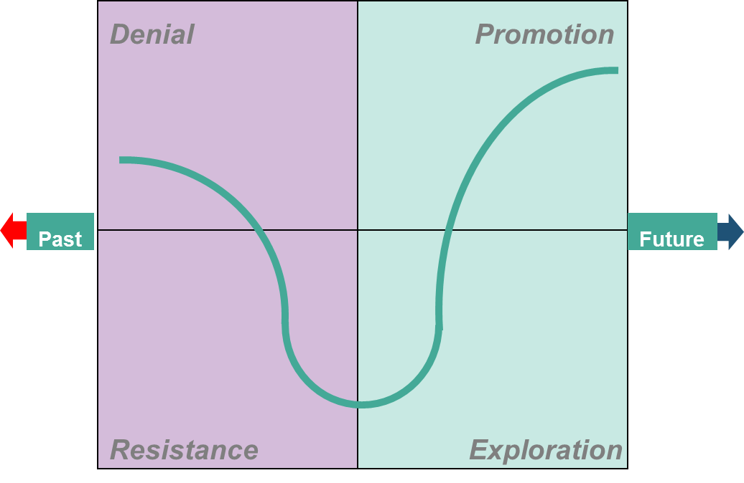
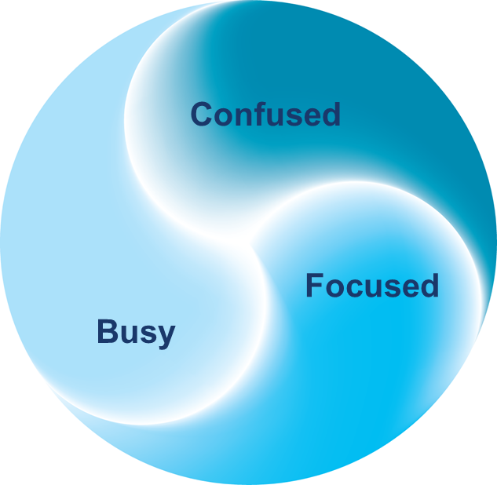
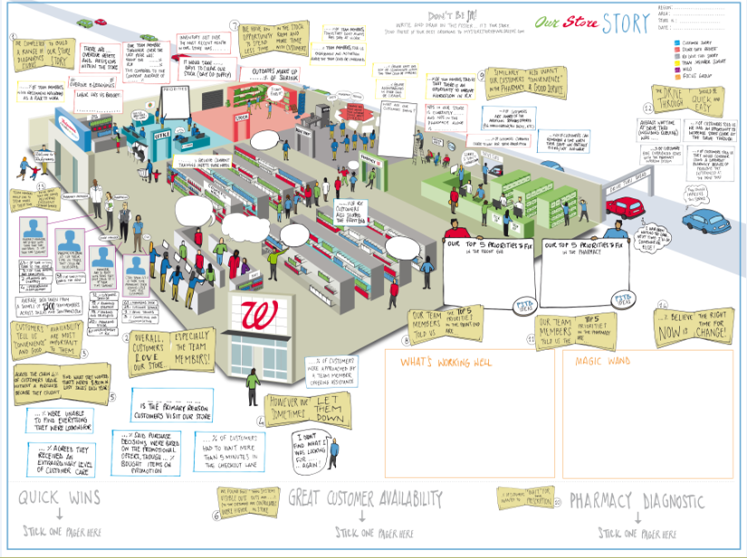

Frontier Store Approach
Weeks 1-6
Weeks 7-12
Ongoing
Phase 1: Establishing the Basics
Phase 2: Pulse and
Plan – Do - Review
Sustaining and Improving Performance
Phase
Launch Frontier to the store
Engage the store team in understanding what works well and where to focus improvement (Diagnostics)
Begin collaborative problem solving and implementing solutions
Establish plan – do – review cycle in the store based around the Pulse
Develop collaborative problem solving through PSTB sessions focussed on core store issues
Implement solutions to improve store performance
Sustain improvements made in store
Maintain weekly Plan – Do – Review approach
Set things up so that Frontier ways of working continue on their own
Objectives
Plan
Review
Plan
Review
Plan
Review
Plan
Pulse
Change Leadership
Attention Model
Do
Do
Do
Core Tools & Techniques
Problem Solving
Team Building
Diagnostics & storyboard

Slide 107
Frontier Stores Pre Launch
Week | -4: ## / ## / #### | -3: ## / ## / #### | -2: ## / ## / #### | -1: ## / ## / ####
Communications | Start & Finish Wk -4: DPR or DM Visit or Call Store Managers to inform them of selection for next Frontier wave Share with SM the 12 week plan with the key dates highlighted to assist with planning. Give some background to help understanding | Start & Finish Wk -3: COMPASS note will come down welcoming store to Frontier & will include high level overview attachment that can be used as talking points to share with store team members Frontier Overview Poster also shared as an attachment & to display for team to raise awareness of what’s coming Prepare PDF letter for TM from the store manager to inform of Frontier Launch – Elevator Speech | Start & Finish Wk -2: COMPASS note will come down that includes all store diagnostics including Store data request FE/RX that is optional to complete early Area leadership can share with MGR/ASM agenda for 2 day workshop as a pre read | Start & Finish Wk -1: District or Area Leadership will have sent the invite to the Area launch meeting Prepare to attend SM/ASM launch meeting Finish handing out TM PDF letter
Key Activities | Read through the plans and understand key dates. Start to add these to your weekly & monthly plans/schedules | Clear wall space ready for Frontier launch – display poster in a prominent position. Frontier starting in 3 weeks Display & begin sharing via 5MM with team members Frontier high level overview & poster | Pre-read compass on diagnostics & have questions ready for workshop Pre-read agenda for workshop SM to collate Store Data ready for workshop (optional this week) | SM/ASM attend 2 day Kick off workshop Hold optional RXM ½ day Launch Workshop Personalize each letter and handout to team members Can begin completing diagnostics
Success at the end of the week | SM is aware of the program and the 12 week plan. SM has better understanding of what’s to come | Frontier Poster is displayed Start to build excitement Team briefing has started | Agenda received by SM Store Data collected and ready to share (optional this week) | SM/ ASM have attended workshop Letter received and personalized Letter handed out to team members
Notes:
Update with correct dates

Slide 108
Frontier Stores – Phase 1 – Establishing the Basics
Week | 1: ## / ## / #### | 2: ## / ## / #### |  | 3: ## / ## / #### | 4: ## / ## / #### | 5:## / ## / #### | 6: ## / ## / #### | 7: ## / ## / ####
Key Activities | Start Wk 1 & Finish by end of Wk 2: Continue Briefing all Team Members via 5MM about what Frontier is
 | Start Wk 1 & Finish by end of Wk 3: Run 9 Diagnostics Document Baseline Diagnostic Results
 |  |  | Start Wk 2 & Finish by end of Wk 3: Build Storyboard & then Share Storyboard Results with all Team Members during 5MM
 |  |  |  | Start Wk 3 & Finish by end of Wk 5: Run Great Customer Availability- OSA PSTB session [MGR/ASM] Measure visible outs vs. system outs (every week) Implement next steps on OSA from PSTB [SM]
 |  |  |  |  |  |  | Start Wk 6 & Finish by end of Wk 7: SM & ASM attend Launch session & Introduced to Store Pulse with DM Setup Pulse area in store & hold Introduction meeting with Store Team SM/ASM] Review progress on OSA next steps [ASM] Continue to measure visible vs. system outs Run 2nd PSTB on RX Waiters
Success at the end of the week | Store team briefed and enthused Diagnostics starts Baselines collected | Diagnostics Continues Store specific Focus Groups completed |  | Finalizing Diagnostics Storyboard developed and starting to share with team | Quick Wins flowing from team after Focus Group Team members have experienced PSTB Next steps in place to improve OSA |  | OSA improving SM & ASM ready for Phase 2 Store Team understands the purpose of the Pulse and how to use Pulse area set up Solutions and next steps in place to improve Rx Waiters
Tools & Techniques | Frontier Diagnostics EMM (Effective Meeting Management) Change Leadership |  |  | Storyboard PSTB (Problem Solving Team Building) -Training Pack |  |  | Phase 2 launch pack for Stores PDR, Pulse and Pulse Tracker EMM, PSTB
Notes:
Update with correct dates

Slide 109
Frontier Stores – Phase 2 –Weekly Pulse Meeting & PDR
Week | 8:## / ## / #### | 9: ## / ## / #### | 10: ## / ## / #### | 11:## / ## / #### | 12: ## / ## / #### | Ongoing
Key Activities | Start Wk 8 & Finish by end of Wk 10: Run Shrink/PAR Diagnostics & Build 24x36 Shrink Storyboard Schedule & Run Shrink/PAR PSTB post diagnostics/storyboard Continue Weekly Store Pulse/PDR Cadence Review Progress & Revisit OSA & RX PSTB Fishbone/Next Steps as Need during Pulse Meeting
 |  |  | Start Wk 10 & Finish by end of Wk 11: Run 2nd RX PSTB Topic; determine based around Store Pulse discussion; Possibly RX Service or option to revisit original RX Fishbone for continuous next steps Continue Weekly Store Pulse/PDR Cadence Review Progress & Revisit Shrink/PAR PSTB Fishbone/Next Steps as Need during Pulse Meeting
 |  |  |  |  | Start Wk 12 & Ongoing: Rerun OSA PSTB or Run FE Service PSTB; determine based around Store Pulse discussion Review Progress & Revisit OSA & RX PSTB Fishbone/Next Steps as Need during Pulse Meeting DM leads Sustainability Meeting Ongoing: Continue Weekly Store Pulse/PDR Cadence Ongoing: Stores generate and hold PSTBs as needed based upon store pulse discussion
Success at the end of the week | Pulse meeting run with focused next steps Rx Waiters solutions implemented Next steps defined to improve OSA Team members comfortable with PSTB process |  | PDR/Pulse session flowing better and generating focused next steps Progress on OSA next steps made Progress on Shrink next steps made |  | PDR/Pulse next steps being completed and team comfortable with PDR process Next steps defined to improve FE Service Sustainability plan developed Stores Determine PSTB Topic based upon the Pulse discussions
Tools & Techniques | PDR/ Pulse EMM PSTB |  |  |  | Sustainability Pack – What Good Looks Like (WGLL)
Notes:
Update with correct dates

Slide 110
PSTB – Ideas / Options to choose from in the future
Here are some examples of PSTB’s that could be run in the stores. Stores should use the weekly pulse meeting to review performance and opportunities and determine the appropriate topic.
How to reduce our Visible outs - OSA – Availability - included in the program
How to improve the % of Customers that wait - RX Wait Times – included in the program
How to improve Front End Service
How to improve Rx Service
How to reduce Shrink – PAR or Non PAR stores – use supporting pack and diagnostics
How to Improve Fresh Food Availability
How to improve our Team Engagement
How to Improve Department Availability – Example Cosmetics Wall
How to Drive Up sales in a department – Example Beauty – see supporting pack
How to Improve our NPS Score
How to improve Hiring/Recruitment
How to decrease labor turnover
How to improve scheduling and improve replenishment and service
How to reduce the number of resets not completed on time
This is a guide to help you, please feel free to use PSTB to help your team solve
ongoing problems/issues that you identify during your weekly PDR meeting.
Notes:
These are additional PSTBs we have seen based on storyboard and diagnostics, this will vary based on individual store needs.

Slide 111




Sustainable ways of working & development
Expect mistakes to happen, but to learn from them is the key!
This process will take practice, practice, practice!
Practice Makes Perfect!
Learning & Training Approach
Learn 1 – Do 1 – Teach 1

Slide 112
PSTB’s
Learn 1 – Do 1 – Teach 1
OSA PSTB’s
DM | MGR | ASM | RXM (Does Not Attend OSA) | APM | OLS | FL
Deliver | Learn | Learn | Learn | Support | Support | Support
RX PSTB’s
DM | MGR | ASM | RXM (Does Not Attend OSA) | APM | OLS | FL
Support | Deliver | Learn | Learn | Support | Support | Support
Notes:
As we discussed earlier our learning approach will be: Learn 1, Do 1, Teach 1. As we role out new waves, you may be asked by your DM to help teach 1/support 1 (ex: if multiple PSTBs are scheduled for the same day due to vacations/lack of attendance on preferred days, DM may have 2 PSTBs happening at the same time). For new wave stores, DMs will conduct the 1st PSTB, SM will learn. We will continue this cycle of Learn 1, Do 1, Teach 1 (the intent is not to become the trainer, rather support 1-3 either by teaching or supporting, which is a temporary phase until additional waves are upskilled then they will support future waves)
Revisit example of Learn 1 – Do 1 – Teach 1 on next slide which supports this slide.

Slide 113
Shrink PSTB’s (diagnostics are in week 8)
Full Frontier Stores that have been selected for Shrink Diagnostic & PSTB
Why were these stores selected?:
Existing PAR Stores
APS Focus Stores/PAR Eligible
APM will Facilitate and DM/SM (co-facilitate) the Shrink PSTB at PAR and Focus Stores
Shrink PSTB’s
Partner
Store# | DM | APM | MGR | ASM | OLS | FL
 | Support | Deliver | Learn | Learn | Support | Support
Update store # as applicable.
Notes:
After OSA, RX, FE service PSTBs are complete, stores on this list will conduct a shrink PSTB.
All stores will complete shrink diagnostics and shrink PSTB
The stores listed have been selected based on APS Focus Stores and PAR Eligible and will have the APM facilitating the PSTB session: (see slide).

Slide 114
Reflection & Planning Time for
SM/ASM/RXM
<Insert Facilitator>

Slide 115
Reflection / Planning Time for Store Teams
PREPERATION
TRAINERS NOTES
Prep and print supporting material for planning session (use slides to follow in the deck)
Planning for team to leave with store supplies (suggestion)
  Flips, Sharpies, Post it
  Posters (storyboard, quickwin, 5MM poster)
SM/ASM/RXM get together and plan there next steps for launch and diagnostics.
DMs to sit at each table and be there to help answer and questions / issues
FL and Area Leadership team to support planning at tables

Slide 116
Let’s start PDR: Planning
40 Minutes (breakout into Districts)
Plan Out the next 1-5 weeks
  Use the Implementation guide
  3 month calendar
    Send invites to aligned FLs for PSTBs & Pulse
      Insert Area FL led Name
      Cc supporting <insert name Hopper FL> and James.RossIII@walgreens.com
      Cc Area Admin to create an Area Wide Event Calendar
  Rollout plan
Schedule in:
  5MMs to brief team members on Frontier & set up “Quick Win” board
  Schedule time to complete the 9 diagnostics (resource Diagnostic RACI)
  Storyboard briefing
  OSA, RX, FE service & Shrink (where applicable) PSTB
Notes:
We provided the rollout plan,

Slide 117
Store Implementation

Slide 118
Frontier Stores Pre Launch
Week | -4: ## / ## / #### | -3: ## / ## / #### | -2: ## / ## / #### | -1: ## / ## / ####
Communications | Start & Finish Wk -4: DPR or DM Visit or Call Store Managers to inform them of selection for next Frontier wave Share with SM the 12 week plan with the key dates highlighted to assist with planning. Give some background to help understanding | Start & Finish Wk -3: COMPASS note will come down welcoming store to Frontier & will include high level overview attachment that can be used as talking points to share with store team members Frontier Overview Poster also shared as an attachment & to display for team to raise awareness of what’s coming Prepare PDF letter for TM from the store manager to inform of Frontier Launch – Elevator Speech | Start & Finish Wk -2: COMPASS note will come down that includes all store diagnostics including Store data request FE/RX that is optional to complete early Area leadership can share with MGR/ASM agenda for 2 day workshop as a pre read | Start & Finish Wk -1: District or Area Leadership will have sent the invite to the Area launch meeting Prepare to attend SM/ASM launch meeting Finish handing out TM PDF letter
Key Activities | Read through the plans and understand key dates. Start to add these to your weekly & monthly plans/schedules | Clear wall space ready for Frontier launch – display poster in a prominent position. Frontier starting in 3 weeks Display & begin sharing via 5MM with team members Frontier high level overview & poster | Pre-read compass on diagnostics & have questions ready for workshop Pre-read agenda for workshop SM to collate Store Data ready for workshop (optional this week) | SM/ASM attend 2 day Kick off workshop Hold optional RXM ½ day Launch Workshop Personalize each letter and handout to team members Can begin completing diagnostics
Success at the end of the week | SM is aware of the program and the 12 week plan. SM has better understanding of what’s to come | Frontier Poster is displayed Start to build excitement Team briefing has started | Agenda received by SM Store Data collected and ready to share (optional this week) | SM/ ASM have attended workshop Letter received and personalized Letter handed out to team members
Notes:
Update with correct dates

Slide 119
Frontier Stores – Phase 1 – Establishing the Basics
Week | 1: ## / ## / #### | 2: ## / ## / #### |  | 3: ## / ## / #### | 4: ## / ## / #### | 5:## / ## / #### | 6: ## / ## / #### | 7: ## / ## / ####
Key Activities | Start Wk 1 & Finish by end of Wk 2: Continue Briefing all Team Members via 5MM about what Frontier is
 | Start Wk 1 & Finish by end of Wk 3: Run 9 Diagnostics Document Baseline Diagnostic Results
 |  |  | Start Wk 2 & Finish by end of Wk 3: Build Storyboard & then Share Storyboard Results with all Team Members during 5MM
 |  |  |  | Start Wk 3 & Finish by end of Wk 5: Run Great Customer Availability- OSA PSTB session [MGR/ASM] Measure visible outs vs. system outs (every week) Implement next steps on OSA from PSTB [SM]
 |  |  |  |  |  |  | Start Wk 6 & Finish by end of Wk 7: SM & ASM attend Launch session & Introduced to Store Pulse with DM Setup Pulse area in store & hold Introduction meeting with Store Team SM/ASM] Review progress on OSA next steps [ASM] Continue to measure visible vs. system outs Run 2nd PSTB on RX Waiters
Success at the end of the week | Store team briefed and enthused Diagnostics starts Baselines collected | Diagnostics Continues Store specific Focus Groups completed |  | Finalizing Diagnostics Storyboard developed and starting to share with team | Quick Wins flowing from team after Focus Group Team members have experienced PSTB Next steps in place to improve OSA |  | OSA improving SM & ASM ready for Phase 2 Store Team understands the purpose of the Pulse and how to use Pulse area set up Solutions and next steps in place to improve Rx Waiters
Tools & Techniques | Frontier Diagnostics EMM (Effective Meeting Management) Change Leadership |  |  | Storyboard PSTB (Problem Solving Team Building) -Training Pack |  |  | Phase 2 launch pack for Stores PDR, Pulse and Pulse Tracker EMM, PSTB
Notes:
Update with correct dates

Slide 120
Frontier Stores – Phase 2 –Weekly Pulse Meeting & PDR
Week | 8:## / ## / #### | 9: ## / ## / #### | 10: ## / ## / #### | 11:## / ## / #### | 12: ## / ## / #### | Ongoing
Key Activities | Start Wk 8 & Finish by end of Wk 10: Run Shrink/PAR Diagnostics & Build 24x36 Shrink Storyboard Schedule & Run Shrink/PAR PSTB post diagnostics/storyboard Continue Weekly Store Pulse/PDR Cadence Review Progress & Revisit OSA & RX PSTB Fishbone/Next Steps as Need during Pulse Meeting
 |  |  | Start Wk 10 & Finish by end of Wk 11: Run 2nd RX PSTB Topic; determine based around Store Pulse discussion; Possibly RX Service or option to revisit original RX Fishbone for continuous next steps Continue Weekly Store Pulse/PDR Cadence Review Progress & Revisit Shrink/PAR PSTB Fishbone/Next Steps as Need during Pulse Meeting
 |  |  |  |  | Start Wk 12 & Ongoing: Rerun OSA PSTB or Run FE Service PSTB; determine based around Store Pulse discussion Review Progress & Revisit OSA & RX PSTB Fishbone/Next Steps as Need during Pulse Meeting DM leads Sustainability Meeting Ongoing: Continue Weekly Store Pulse/PDR Cadence Ongoing: Stores generate and hold PSTBs as needed based upon store pulse discussion
Success at the end of the week | Pulse meeting run with focused next steps Rx Waiters solutions implemented Next steps defined to improve OSA Team members comfortable with PSTB process |  | PDR/Pulse session flowing better and generating focused next steps Progress on OSA next steps made Progress on Shrink next steps made |  | PDR/Pulse next steps being completed and team comfortable with PDR process Next steps defined to improve FE Service Sustainability plan developed Stores Determine PSTB Topic based upon the Pulse discussions
Tools & Techniques | PDR/ Pulse EMM PSTB |  |  |  | Sustainability Pack – What Good Looks Like (WGLL)
Notes:
Update with correct dates

Slide 121
So what do I need to do next?
Introduce Frontier to team members within your store
Print a copy of the ‘Frontier Overview’ poster and display in a prominent place in your store
In a series of 5 Minute Meetings, share the principles of Frontier with your team, outlining their involvement within it
Start planning for diagnostics
Review an Introduction to Frontier Diagnostics with your DM
Identify who in your team will support you in carrying out diagnostics
Think about how you will complete all surveys in the timeframe outlined
Begin collating the data outlined in the ‘data collection’ list
Launch Quick Wins
In line with the weekly plan, schedule dates and times for critical store Frontier events such as:
Feedback of diagnostic results and findings to your team
Introduction of the Pulse

Slide 122
Diagnostics RACI | Store Manager (SM) | Assistant Store Manager (ASM) | Shift Lead (SFL) | Team members (TMs) | Pharmacy manager (RXM) | District Manager (DM) | Frontier Leader (FL)
Focus Group
Facilitate discussion on key issues for store with Team Members |  |  |  |  |  | A/R | C
Customer Survey
Find Team members to run the survey | A | R | R | C
Interview Customers |  |  |  | R
Enter responses in scoring tool | A/R | R | R
Analyze results | A/R | R | R
Great Customer Availability
Find Team Members to run the checks (Detailed and Visual) | A | R
Carry out the checks | A |  |  | R
Record results on scoresheets | A |  |  | R
Send Results to DM | A | R | R
Provide analysis back to store |  |  |  |  |  | A/R
Team Member Survey
Complete the TM Survey | R | R | R | R | R
Enter responses in scoring tool and analyze results | A/R | R | R
Rx Waiter Customer Survey
Find Team members to run the survey | I | R | C | C | A/R
Interview Customers | I |  |  | R | A/R
Complete and Send Rx Waiter Summary Sheet to DM | I |  |  |  | A/R
Enter data into Rx Analysis spreadsheet |  |  |  |  |  | A/R
Provide analysis back to store |  |  |  |  |  | A/R
Rx Diagnostic Data
Collate data | I |  |  | R | A/R
Send summary data to DM | I |  |  |  | A/R
Enter data into Rx Analysis spreadsheet |  |  |  |  |  | A/R
Provide analysis back to store |  |  |  |  |  | A/R
Rx Drive Thru Survey
Find Team members to run the survey | I | R | C | C | A/R
Interview Customers | I |  |  | R | A/R
Enter responses into scoring tool | I |  |  |  | A/R
Enter results onto Storyboard |  |  |  |  | A/R
Other
Obtain data points from Data request sheet | A/R | R |  |  | R | I/C

Slide 123
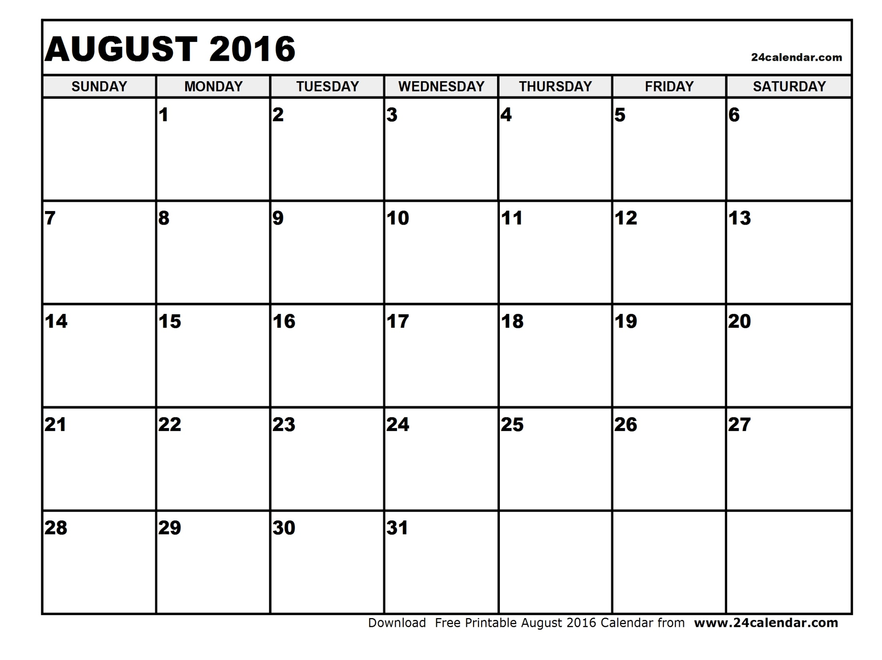

Slide 124
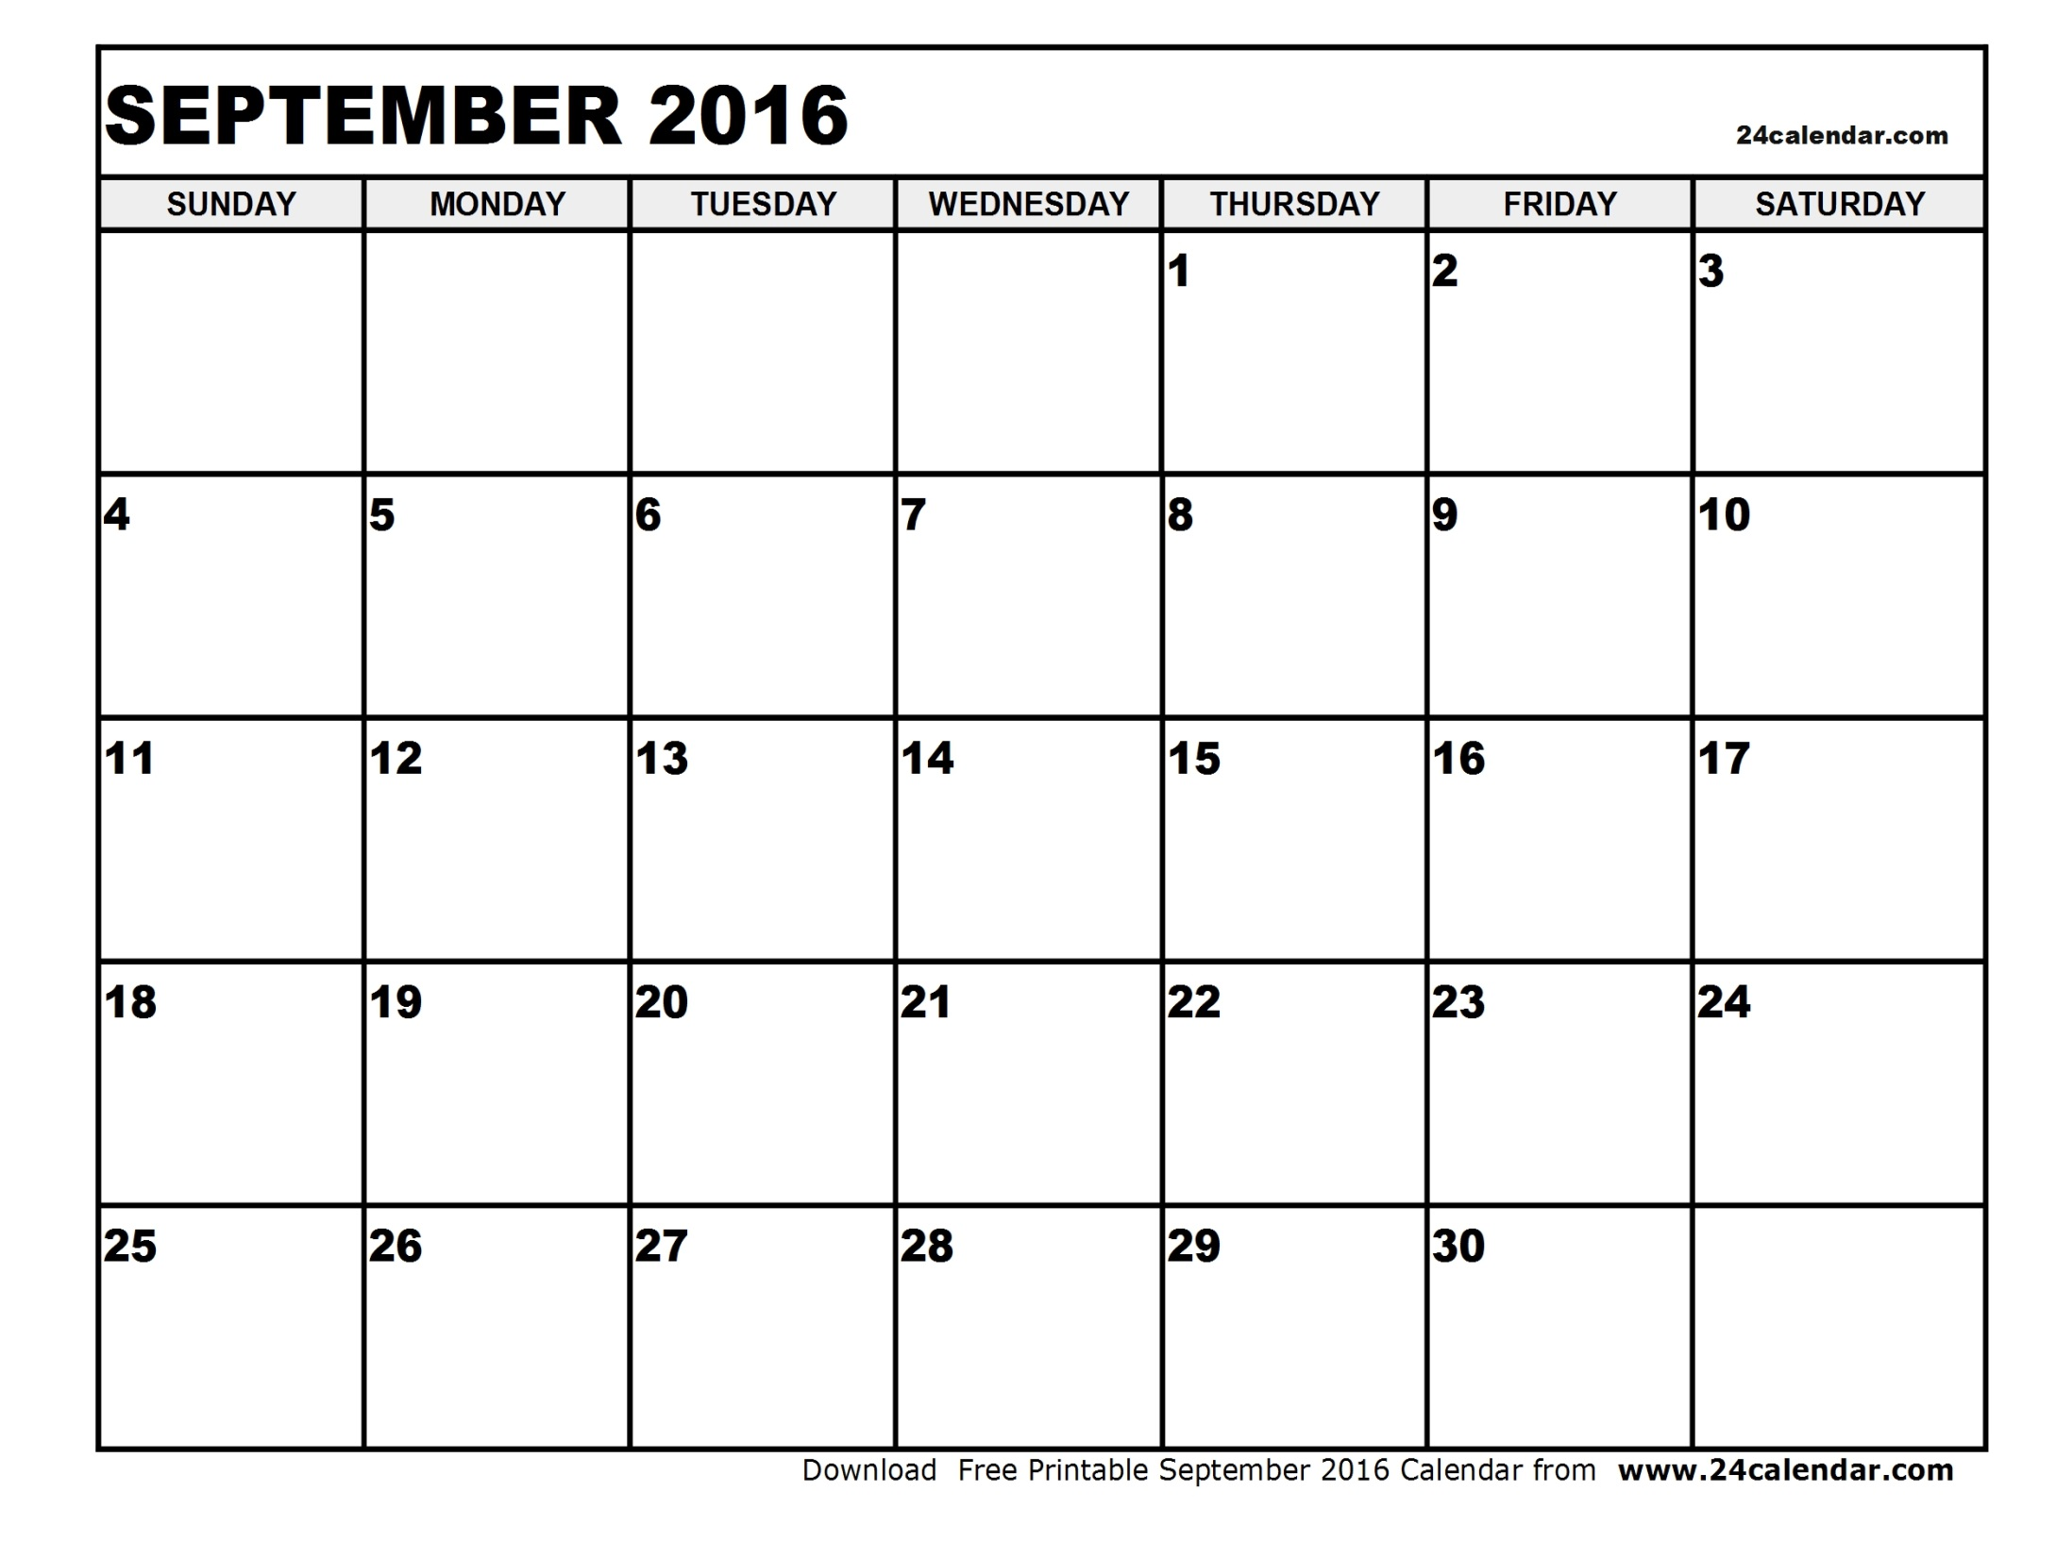

Slide 125
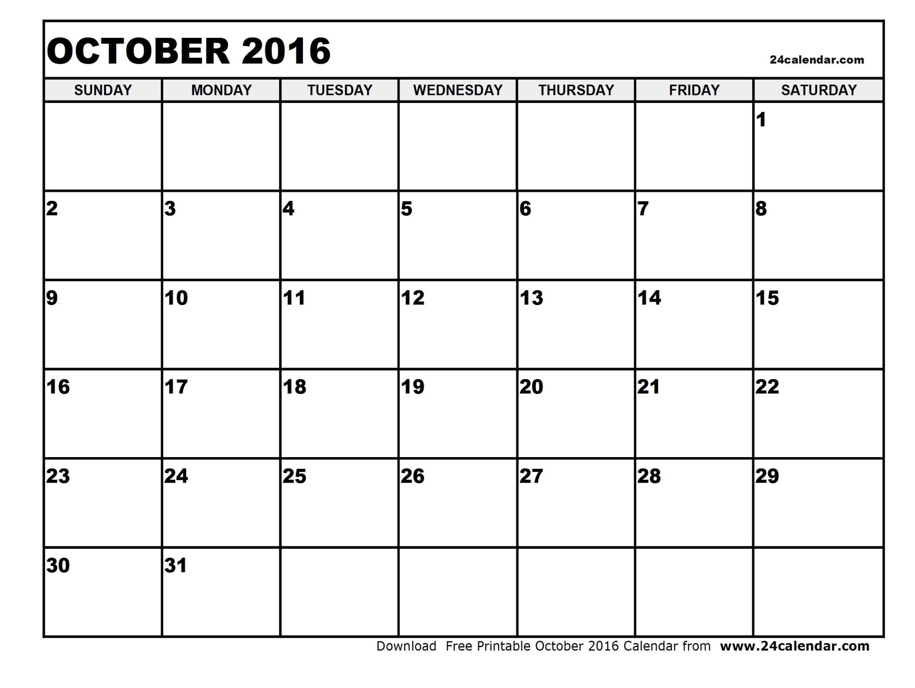

Slide 126

Planning and Discussion Time
Don’t forget to review Diagnostic/Storyboard/Quick Win Concerns (by district)
©2016 Walgreen Co. All rights reserved.

Slide 127
Team Check In on the Change Curve
<Insert Facilitator>

Slide 128
How is everyone feeling?
At your tables, take 3 minutes to plot on your flipchart where each of you are on the change curve and briefly discuss why.
Select a spokesperson to present back to all in the room about how your overall group feels (not individually).
Notes:
Have each table share back how they feel. It’s OK if we feel overwhelmed. Share your authentic experiences.

Slide 129

For those embracing change, the rewards are rich…
Our team members are growing, changing, becoming better leaders and followers as a direct result of Frontier.
Through embracing change, these team members are establishing an emotional connection with each other and with their customers.

Slide 130
Wrap Up and Review
<Insert Facilitator>

Slide 131

COVP Frontier Video
Notes:
COVP video link (3:42minute video)
So let’s here how all this hard work has paid off for other Frontier stores (SMs, RXMs, ASMs, CSA, RX Techs, etc)
Now, What questions do you have: Utilize all resources to support during this session (DPR, HCS, DMs, SMs/RXMs/ASMs with experience, FLs, etc.)

Slide 132
Benefits & Concerns
Harvey Ball
(Objectives & Expectations)
Next Steps
<insert Facilitator and Scribe>
Notes:
Flip chart this.
Start in order of:
-Bs, Cs (H2 & IWIK)
-Take next steps on Cs or possible watch out
-Harvey ball objectives & expectations
-Take next steps on partially filled harvey balls or possible watch out

Slide 133


Thank You!

