Slide 1
Prospective Drug Utilization Review (DUR) and Patient Consultation in the Retail Setting
“Patient Safety Work Product. May not be shared, distributed, or discussed outside of the Walgreen Patient Safety Evaluation System.”
Notes:
Hello and welcome to the learning module Prospective Drug Utilization Review and Patient Consultation in the Retail Setting
Today’s lesson is a refresher on appropriate procedures to perform DUR for drug therapy concerns and to document outcomes in IC+

Slide 2
What is Prospective DUR?
A prospective drug utilization is performed by a pharmacist to evaluate a patient’s medications and resolve any drug therapy concerns prior to dispensing.
“Patient Safety Work Product. May not be shared, distributed, or discussed outside of the Walgreen Patient Safety Evaluation System.”
Notes:
-A Prospective DUR is a process that ensures all clinical drug therapy concerns are resolved by the pharmacist prior to dispensing a prescription
-Not only is it a licensed pharmacist’s professional obligation, but it is an important step in providing quality health care and improving patient outcomes

Slide 3
Drug therapy concerns that are commonly addressed
Professional judgment must be used when performing drug utilization review on prescriptions using the patient’s history and record. The review should include but is not limited to the following:
DOB (Age) and Gender
Patient Profile
Drug Allergies
Drug- Drug Interactions
Drug-Health Conditions
Therapeutic Duplication
Previous dispensing history and DUR comments
Drug name, strength, dosage form, directions, days supply (current fill and previous fill)
Age-Dosage range and age appropriateness
Incorrect dosage or duration of therapy
Good Faith Dispensing Policy
Frequency of refills and refill compliance
Additional Medications
Drug-Food Interactions
Drug-Alcohol Interactions
Drug-Tobacco Interactions
“Patient Safety Work Product. May not be shared, distributed, or discussed outside of the Walgreen Patient Safety Evaluation System.”
Notes:
Professional judgement must be used at all times when performing a drug utilization review. Some of the areas of review should include but are not limited to:
Read the bullets on the slide

Slide 4
Documentation
Documentation of actions performed when resolving a DUR are extremely important to ensure patient safety and continuity of patient care
Documentation of actions taken involving the resolution of Major severity DURs must be recorded in IC+
e.g. Communication with the patient and/or prescriber regarding an adverse drug event, drug interaction, allergy or inappropriate dose
e.g. Using comments from prior prescriptions or profile notes to guide clinical decisions on current prescriptions.
“Patient Safety Work Product. May not be shared, distributed, or discussed outside of the Walgreen Patient Safety Evaluation System.”
Notes:
-Documentation allows anyone to know what you, the pharmacist, was thinking of at the time of fill – regardless of when they review; whether it is tomorrow, in a month or in a year.
-It is important that notes left are clear and concise and understandable by anyone who is taking over the patient’s care after the end of your shift or reviewing the patient’s profile for a future fill of the medication.

Slide 5
Which Documentation is Appropriate?
“A” MD Consulted: 12/07/2016 3:30PM: CFB. Per Debbie, RN, the MD is aware of major drug interaction. Has follow up appointment next week to monitor INR levels.
“B” MD Consulted: 12/3/2016 4:15PM: GDD. MD didn’t care about drug interaction
“C” Patient knows: 12/10/2016 10:00AM: MSS.
“D” Patient Consulted:12/14/2016: 2:32PM SJH. Counseled patient to hold Lipitor while taking Biaxin.
Notes:
Here are some examples of documentation of DUR comments. Which do you think are the most clinically appropriate?
Four voices read the bubbles.
Choices a and d are clinically appropriate and provide enough information about what actions were performed to resolve this DUR, what clinical considerations the pharmacist was thinking about at the time of fill and who, if anyone, provided information that helped the pharmacist resolve the DUR

Slide 6
Appropriately Documenting DUR Resolution Actions
“Patient Safety Work Product. May not be shared, distributed, or discussed outside of the Walgreen Patient Safety Evaluation System.”
Notes:
Next, we are going to walk through two examples of appropriately documented and resolved DUR’s.

Slide 7
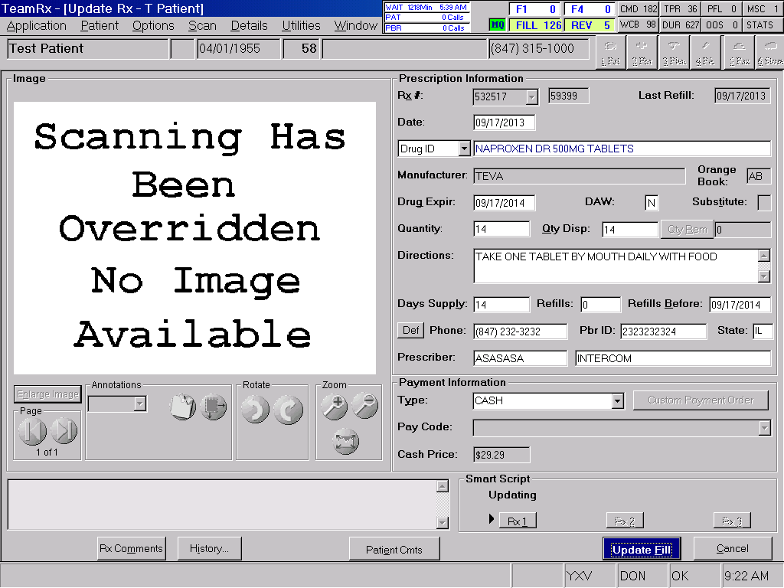
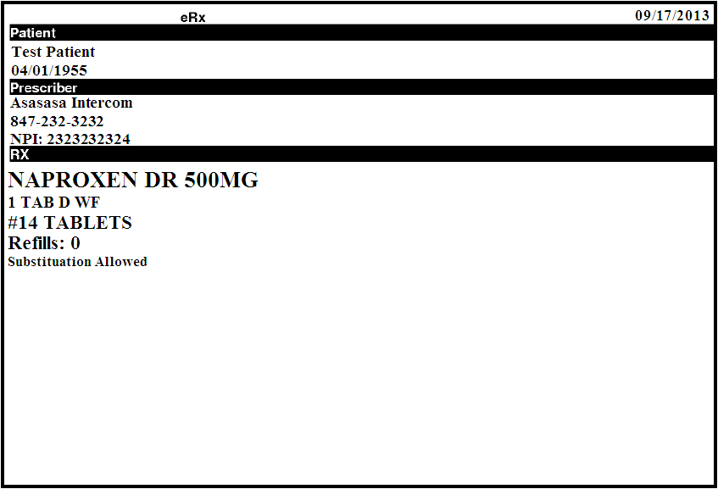
Case #1- Mr. Patient
“Patient Safety Work Product. May not be shared, distributed, or discussed outside of the Walgreen Patient Safety Evaluation System.”
Notes:
A prescription was brought in for Mr. Patient for naproxen 500mg DR. Sarah, our pharmacist on duty, takes in the prescription by asking the patient if he has any allergies or health conditions. Mr. Patient says he has an NSAID allergy and GI problem. Sarah sees these already in Mr. Patient’s profile and notices he is also taking warfarin 10mg. She asks Mr. Patient if he has ever had Naproxen in the past and he says that he takes the OTC version every once in a great while on the recommendation of his doctor. Through some open ended questions, Sarah learns that Mr. Patient gets hives when he takes some other NSAIDS. After data review of the prescription was completed, the DUR detail screen pops up with the different drug therapy concerns

Slide 8
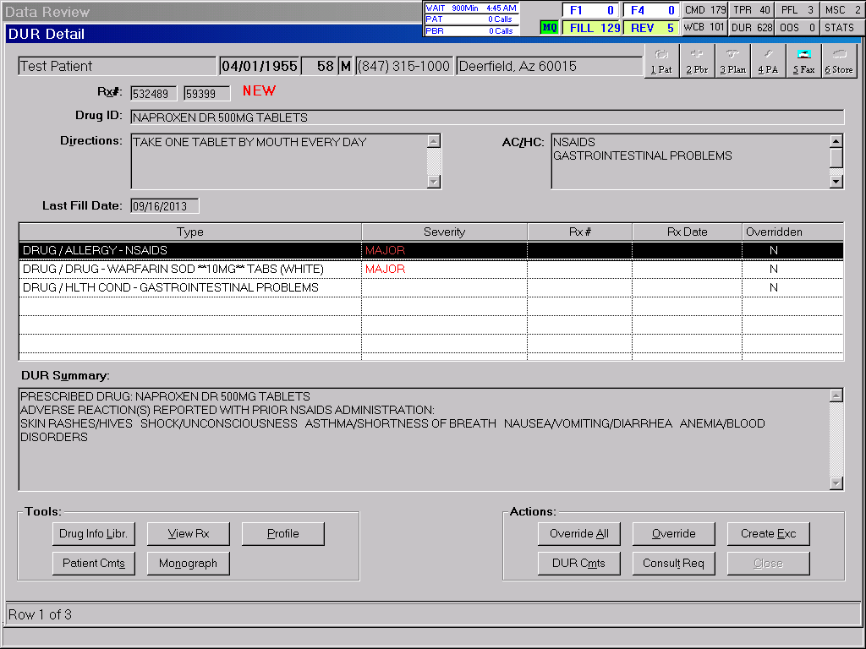
Case #1- Mr. Patient
For each type of DUR, a DUR comment should be made to document actions taken to resolve the drug therapy concerns.
For each type of DUR a DUR comment may be made to document actions taken to resolve them.
“Patient Safety Work Product. May not be shared, distributed, or discussed outside of the Walgreen Patient Safety Evaluation System.”
Notes:
This is the DUR screen that displays for Sarah. In this scenario, there are 3 DUR messages (will appear circled) that need her attention.
**Bring in animation**
ON the left, the type of DUR is populated. Here we have a drug/allergy therapy concern, a major drug/drug interaction therapy concern and a drug/health condition therapy concern. Sarah clicks on each DUR and uses the provided quick buttons such as the Drug info library or the Monograph to fully understand each DUR drug therapy concern. Once she is done researching all of the DUR’s she develops a resolution plan to address all DUR’s before initiating patient or physician contact. She decides she needs to speak with both the patient and prescriber to resolve these DUR’s.
She begins by resolving the first DUR flag, the drug/allergy therapy concern

Slide 9
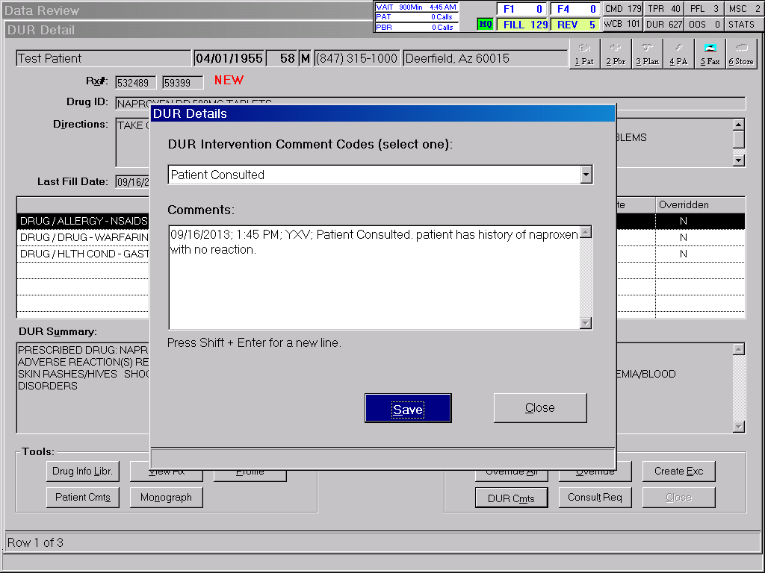
Case #1- Mr. Patient
“Patient Safety Work Product. May not be shared, distributed, or discussed outside of the Walgreen Patient Safety Evaluation System.”
Notes:
For the first DUR, the patient has a documented NSAID allergy. Sarah already spoke with the patient at the drop off station and the patient stated they have taken this in the past with no issues.
Sarah documents this under the “DUR Cmts” button by selecting “Patient Consulted” from the drop down. She then provides the information relayed by the patient in the comments field.
Remember, your peers should always be able to understand what actions you took and what factors influenced your clinical decision making. This could be a conversation with the patient as in this case, a review of previous therapy and DUR comments, or a conversation with the prescriber

Slide 10
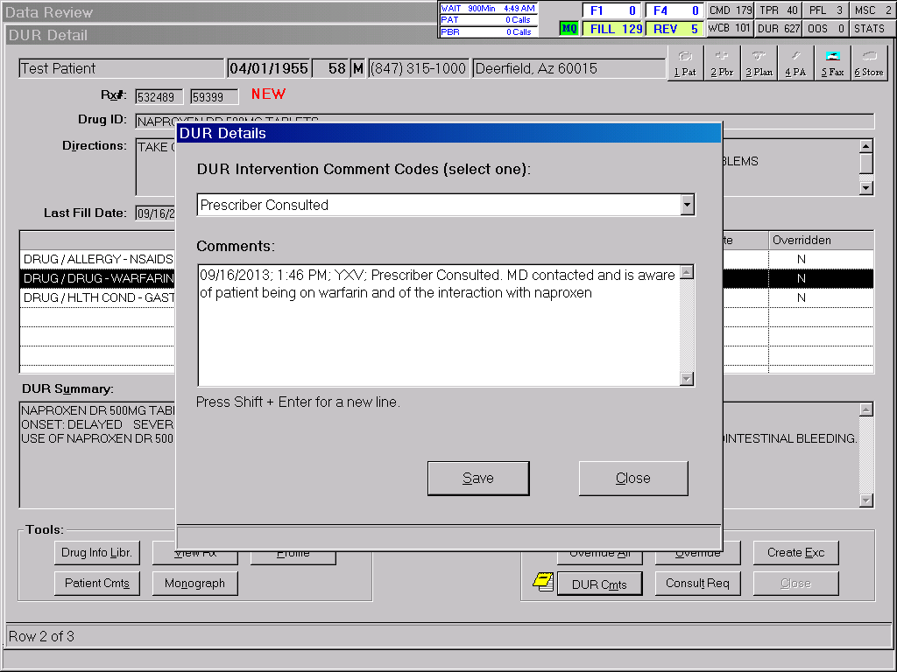
Case #1- Mr. Patient
“Patient Safety Work Product. May not be shared, distributed, or discussed outside of the Walgreen Patient Safety Evaluation System.”
Notes:
For the second DUR, Mr. patient is currently taking warfarin which triggers a major drug-drug interaction with Naproxen. Sarah reaches out to Dr. intercom who prescribed both the warfarin and the naproxen to alert her of the interaction between the medications. The doctor was aware of the interaction and stated that the therapy for naproxen is short term and she is monitoring Mr. Patient’s INR levels appropriately.
Sarah now documents under the “DUR Cmts” button, select “Prescriber Consulted” from the drop down and provides the information relayed by the MD in the comments field.
Remember, when documenting interactions with physicians and their offices, it is not always possible to talk to the MD. Be sure to document the names, and if possible, the credentials of the physician representative you spoke with.

Slide 11
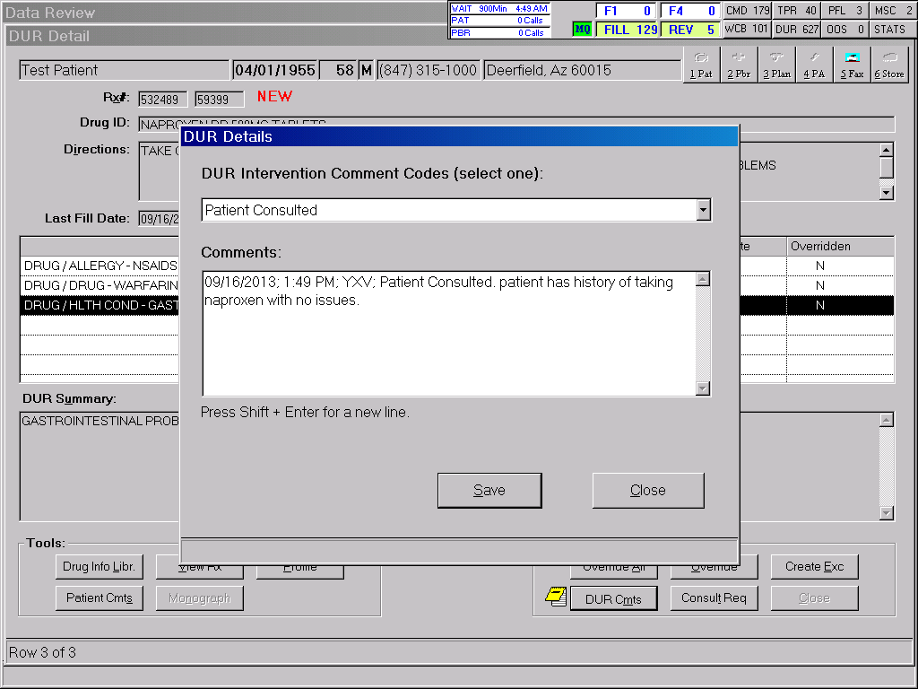
Case #1- Mr. Patient
“Patient Safety Work Product. May not be shared, distributed, or discussed outside of the Walgreen Patient Safety Evaluation System.”
Notes:
The third DUR triggers as a result of a drug-health condition therapy concern based on Mr. Patient’s documented GI issues. Since Sarah already spoke with Mr. Patient and learned that he has taken this in the past with no problems, she knew it was safe to proceed.
Sarah chooses “Patient Consulted” and repeats the comment “Patient has history of naproxen with no issues”
Let’s look at one more example of how to appropriately resolve and document a DUR

Slide 12
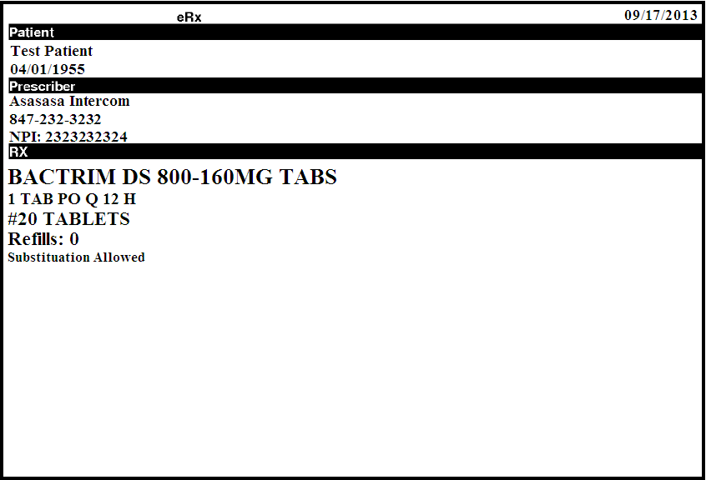
Case #2- Mrs. Patient
12/12/2016
“Patient Safety Work Product. May not be shared, distributed, or discussed outside of the Walgreen Patient Safety Evaluation System.”
Notes:
In this case, Mrs. Patient brought in a prescription for Bactrim DS.
Her profile reveals that she has a sulfa allergy and is taking warfarin 10mg.
Let’s see how our pharmacist Sarah handles this DUR.

Slide 13
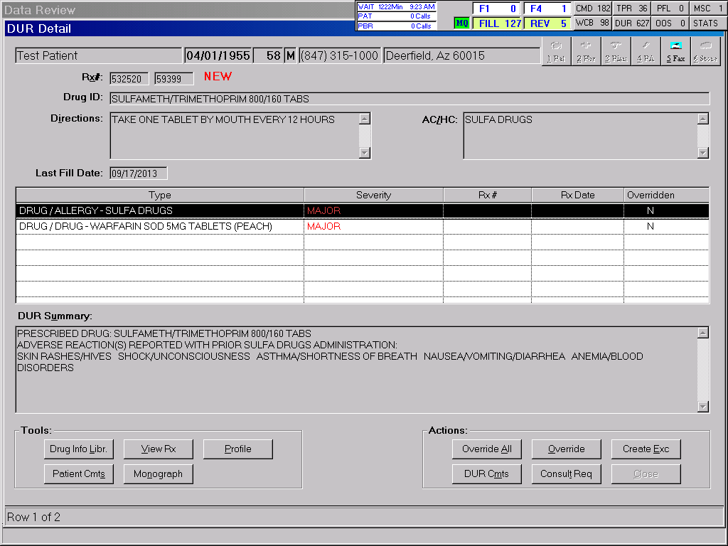
Case #2- Mrs. Patient
F
There are 2 major DUR types that have populated for this patient based on their sulfa allergy and warfarin 10mg medication.
For each type of DUR a DUR comment may be made to document actions taken to resolve them.
“Patient Safety Work Product. May not be shared, distributed, or discussed outside of the Walgreen Patient Safety Evaluation System.”
Notes:
This is the DUR screen that populates alerting the pharmacist to the two DURs.
Both the drug/allergy DUR and the major Drug/drug interaction DUR are drug therapy concerns that the pharmacist will need to resolve.
For each type of DUR appropriate documentation of actions taken should be recorded under the DUR CMTS button

Slide 14
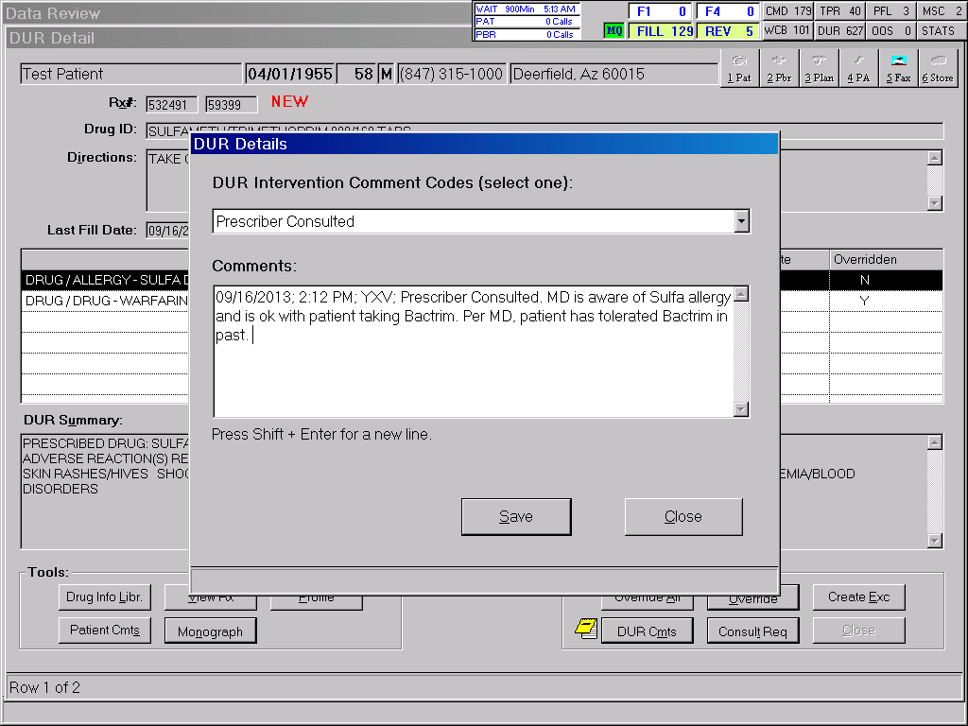
Case #2- Mrs. Patient
F
12/12/2016: 10:15AM: SJH; MD is aware of Sulfa allergy and is ok with patient taking Bactrim. Per MD, patient has tolerated Bactrim in the past.
“Patient Safety Work Product. May not be shared, distributed, or discussed outside of the Walgreen Patient Safety Evaluation System.”
Notes:
In this case, the patient did not answer her phone when Sarah attempted to contact her about the Drug/allergy DUR. The pharmacist contacted Mrs. Patient’s GP, Dr. Intercom, who wrote the prescription for Bactrim regarding the patient’s documented sulfa allergy.
Dr. Intercom stats that she was aware of the patient’s drug allergy and that the patient has tolerated this drug in the past.
Sarah also tells Dr. Intercom that the patient is on Warfarin. The doctor said that she already knew that and that Mrs. Patient was under the care of a cardiologist who monitors her INR;
Sarah documents this conversation under the DUR CMTS button. She selects “Prescriber Consulted” from the drop down and provides the information relayed by the MD in the comments field.

Slide 15
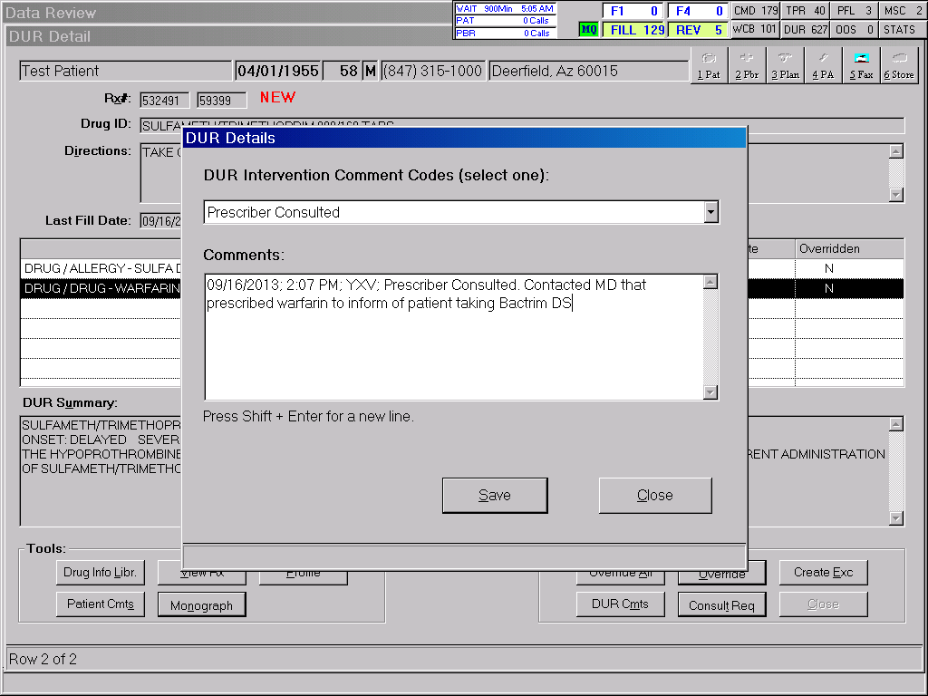
Case #2- Mrs. Patient
F
12/12/2016: 10:16AM: SJH; Prescriber consulted. Dr. Intercom knows that patient is taking warfarin and wants him to take Bactrim. Per Jane, RN at Cardiologist Dr. Jones ‘s office – MD informed of patient taking Bactrim and will monitor INR at appointment next week.
“Patient Safety Work Product. May not be shared, distributed, or discussed outside of the Walgreen Patient Safety Evaluation System.”
Notes:
For the second DUR, the patient is currently taking prescription for warfarin from his cardiologist, Dr. Jones. Sarah reaches out to the cardiologist to alert him that the patient was prescribed Bactrim DS. The MD was not available to speak to Sarah but his nurse, Jane, said that the doctor was aware that the patient needed antibiotics and that she will monitor Mrs. Patient’s INR at the appointment already scheduled for next week.
Sarah documents under the “DUR Cmts” button, select “Prescriber Consulted” from the drop down and provide the information relayed by the nurse in the comments field.

Slide 16
Case #2- Mrs. Patient
F
Add a CAP block to the Rx in order to ensure patient is informed of potential interaction by an RPh.
“Patient Safety Work Product. May not be shared, distributed, or discussed outside of the Walgreen Patient Safety Evaluation System.”
Notes:
Even though all doctor involved in this patient’s care are comfortable with these medications being dispensed, Sarah knows that some patient consultation will be required in order to safely dispense these medications to Mrs. Patient. Before overriding the DURs, Sarah wants to mark the prescription for a mandatory consultation to make sure Mrs. Patient is aware this contains sulfa and that she knows the signs/symptoms to look out for in case she has a reaction. Sarah also wants to make sure that Mrs. Patient knows about the drug/drug interaction. She wants to ensure that she knows how to look for signs and symptoms of bleeding and that they know how important it is to keep her doctor appointments to test their INR.
Comments should be placed under the “Consult Req” button under the “Actions” section.

Slide 17
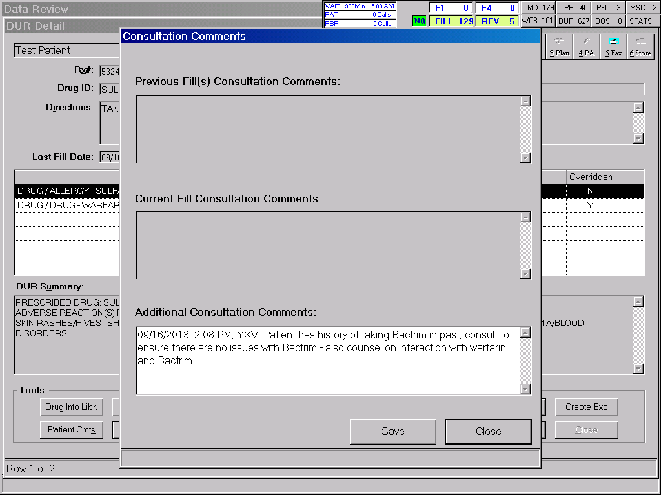
Case #2- Mrs. Patient
“Patient Safety Work Product. May not be shared, distributed, or discussed outside of the Walgreen Patient Safety Evaluation System.”
Notes:
Here Sarah documents what counseling needs to occur when Mrs. Patient picks up the medication.
Once this is saved, this will trigger a CAP block at the register to ensure mandatory counseling by a pharmacist prior to selling the medication.

Slide 18
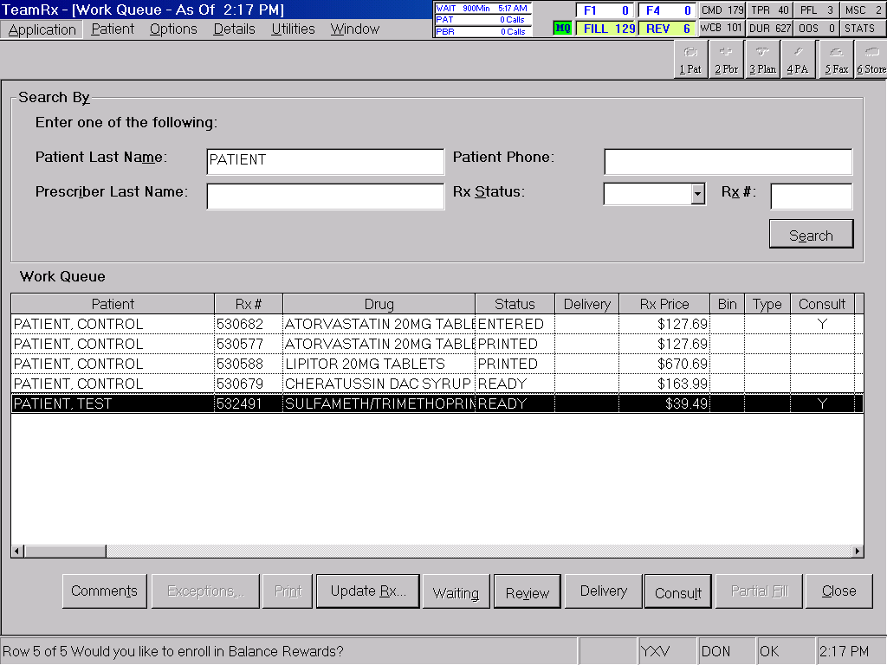
Case #2- Mrs. Patient
The prescription is ready with a “Y” under the “Consult” column, which indicates that counseling will be mandatory prior to selling the medication.
The pharmacist can access the CAP block by clicking on the “Consult” button.
“Patient Safety Work Product. May not be shared, distributed, or discussed outside of the Walgreen Patient Safety Evaluation System.”
Notes:
When Mrs. Patient comes to pick up her prescription later that afternoon, the technician pulls up the work queue to find her prescriptions.
The “Consult” column in the work queue will alert the technician that a pharmacist consultation is requires prior to picking the medication up.
Just in case the technician misses the consultation requirement in the work queue, if the prescription is scanned at the register a CAP block will pop up to alert the employee that a mandatory consultation must be done by the pharmacist for the prescription to be sold.

Slide 19
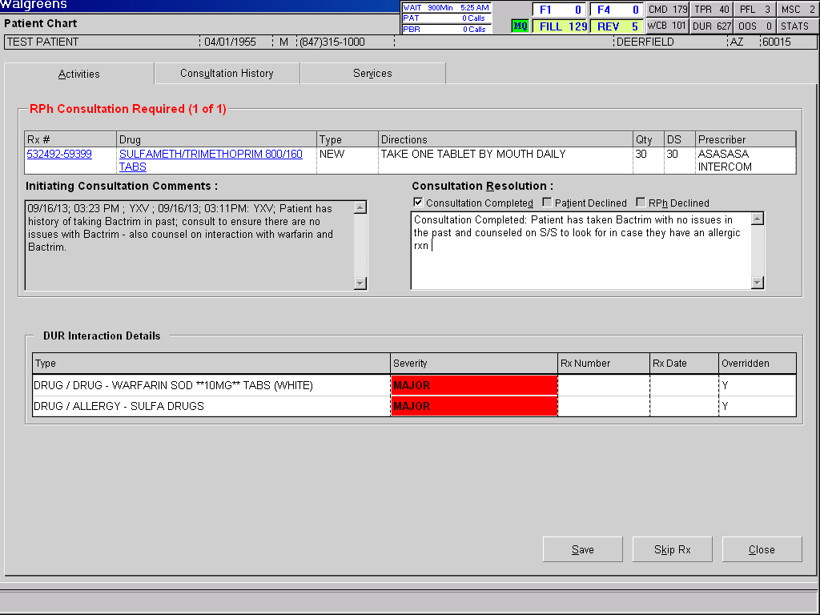
Case #2- Mrs. Patient
F
12/12/2016: 10:25AM: SJH; Patient has history of taking Bactrim per MD. Consult with patient to make sure there are no issues. Consult on signs and symptoms of allergy. Consult on warfarin allergy and signs and symptoms of bleeding, follow up with appointment for INR next week with Dr. jones.
12/12/2016; 3:25PM; MSS; Patient confirmed that they have had Bactrim in the past with no issues. Educated on signs and symptoms of allergic reaction. Counseled on Warfarin interaction, signs of bleeding and follow up next week at MD Jones for INR check.
The pharmacist would input the outcome of the counseling session under the “Consultation Resolution” section.
This field will detail what exactly needs to be counseled on as instructed by the comments that the verifying pharmacist has documented.
“Patient Safety Work Product. May not be shared, distributed, or discussed outside of the Walgreen Patient Safety Evaluation System.”
Notes:
Our pharmacist. Bob is now on duty and he needs to get up to speed quickly on what kind of consultation Mrs. Patient will need to safely take her medications.
This is what Bob sees when he pulls up the consultation application by selecting the “Consult” button. Patient and specific prescription information can be found towards the top of the screen. The interaction(s) can be found towards the bottom and the notes left by the DUR pharmacist are in the middle. Luckily, in this case Sarah, who left the clinical notes, did a great job documenting what the consultation pharmacist needs to cover with Mrs. Patient.
Bob confirms that Mrs. Patient had never had any issues taking Bactrim in the past by asking open ended questions. He educates Mrs. Patient on the signs and symptoms of an allergic reaction and tells her what to do in the case of an allergic reaction. He also tells Mrs. Patient about the drug interaction between warfarin and Bactrim and reminds her to keep all appointments with her cardiologist, Dr. Jones, for her INR checks.

Slide 20
DUR Resolution Patient Safety Tips and Tricks
Ask for updated patient information at in-window.
Clarify with the prescriber if there are any questions.
Be persistent; if you think there is a drug therapy concern, ask to speak with the prescriber.
Be very concise with your information and documentation.
Remember to document the encounter as a DUR comment in a way that anyone reading your notes would be able to pick up where you left off.
Follow all applicable company policies and state guidelines in regards to counseling patients for new or refill prescriptions.
Only dispense prescriptions which you feel, in your professional judgement, are safe to dispense.
“Patient Safety Work Product. May not be shared, distributed, or discussed outside of the Walgreen Patient Safety Evaluation System.”
Notes:
Talking Points:
Ask for updated patient information at in-window:
Ensure that the in-window employee that receives the prescription always asks for updated patient information in order for you, the pharmacist, to be able to do an accurate review (i.e. Allergy and Health Conditions)
Clarify with the prescriber if there are any questions:
Be professional and respectful. Remember that everyone makes mistakes, including prescribers. If there is something that does not seem correct, please question the prescriber. It is better to put in your due diligence and trust your instincts rather than putting the patient at risk for something that could be prevented. Remember this is about patient safety
Be persistent; if you think there is an issue, ask to speak with the MD:
If there is clarification that was confirmed by a prescriber’s agent even though there is a clear discrepancy, request to speak with the prescriber. Reading the prescription from a chart for confirmation does not indicate that the prescriber was correct. Explain the urgency of the matter and insist on speaking with the prescriber if a resolution cannot be made with the agent.
Be very concise with your information:
Avoid back and forth in communication. If the issue is not explained well, an error may still occur.’
Follow all company policies and state guidelines in regards to your obligation to counsel for new or refill prescriptions.
And finally,. Only dispense prescriptions which you feel, in your professional judgement, safe to dispense.

Slide 21
Thank You
Notes:
Thank you for joining us today for a refresher on Prospective Drug Utilization Review and Patient Consultation in the Retail setting

