Slide 1
Prescriber Sanction Pilot
December 12, 2012

Slide 2
Prescriber Evaluation Process
Data analysis
Analyze Rx activity relative to other pbr in chain
DLPM Site Visits
Visited all 13 sites in November 2012
Field feedback
Determine previous disciplinary actions
Search for other pertinent information
Internet Research
DLPMs visited local stores to gather Rph feedback
Used template questionnaire to enable consistent analysis across sites
Documented in feedback template
Team Review
Cross-functional team reviewed/discussed collective information
Determined final recommendations
Team comprised of legal, loss prevention and pharmacy integrity
Subset for office in NJ or PA – resulted in list of 13 pbr
Filter pbr with composite rank in Top 100
Develop a forced ranking based upon Oxycodone activity
A pilot program to identify and sanction selected prescribers has been initiated in New Jersey and Pennsylvania. The process to identify and analyze prescribers was as follows:
For this pilot program, a recommendation to sanction was made only if there was a clear consensus. In cases where the decision warranted significant discussion the decision was made to not sanction the prescriber.

Slide 3
Data Provided by LP Site Visits by DLPM for Dr Alan Burke
Composite Rank (Sep / Oct) | 12 / 114
Prescriber Name | Alan Burke
State of Prescriber License | PA - Pennsylvania
License Number | MD020937E
License Status | Active
Other Status
Specialty | Orthopedic; Pain Management
Disciplinary | Yes; disciplinary document is not accessible
License - Additional State(s) | No
License - Additional State(s) Information
Store # | 7544
Store Visit Date | 11/13/12
Pharmacist Name | Saumil Patel
ICP Address Same as Spreadsheet | Yes
If No, Prescriber Address in ICP
Has RPh Spoken with Prescriber? | Yes
RPh Comments | Pharmacist recalls discussing large amount of pain prescriptions with prescriber; large number of patients paying cash for their pain prescriptions that prescriber had written; At one point, pharmacist witnessed stranger giving cash to multiple patients to pay for their pain medication which prescriptions were written by the prescriber; RxM and staff stopped taking prescriptions from prescriber since early this year
Has RPh Visited Prescriber? | No
Date of Prescriber Visit
RPh Comments
Facility Name | Bustleton Podiatry and Vein Center
Facility Address | 1923 Welsh Road, Philadelphia, PA
Type of facility | Free Standing
Other
Date of Facility Visit | 11/13/12
Arrival Time | 10:45 AM
Departure Time | 11:10 AM
Are Hours of Operations Posted? | No
Hours of Operation
Building Run Down or Unkempt | No
Loitering or Lines Outside Office | No
Security Guard Present | No
Indications of Security Measures | Yes
Patients Arrive in Large Groups | No
Location Identified with Signage | Yes
Signs Suggesting a Specialty | No
Multiple Cars in Lot with Out of State Plates | No
Easy Access to Highway or Major Road | Yes
Number of Patients Entering/Exiting in 30 Minutes | 0 - 5
Safe to Enter Prescriber Office | Yes
Describe any Safety Concerns
Immediately Greeted by Staff | Yes
Interior Office Run Down or Unkempt | No
Signs Mention Walgreens or Specific Pharmacy | No
Signs Indicating Insurance(s) Accepted | No
"Cash Only" Signs or Office Visit Charge(s) | No
Signs Suggesting No Appointment Required | No
Number of People Present in Waiting Area | 0 - 5
Additional Comments

Slide 4
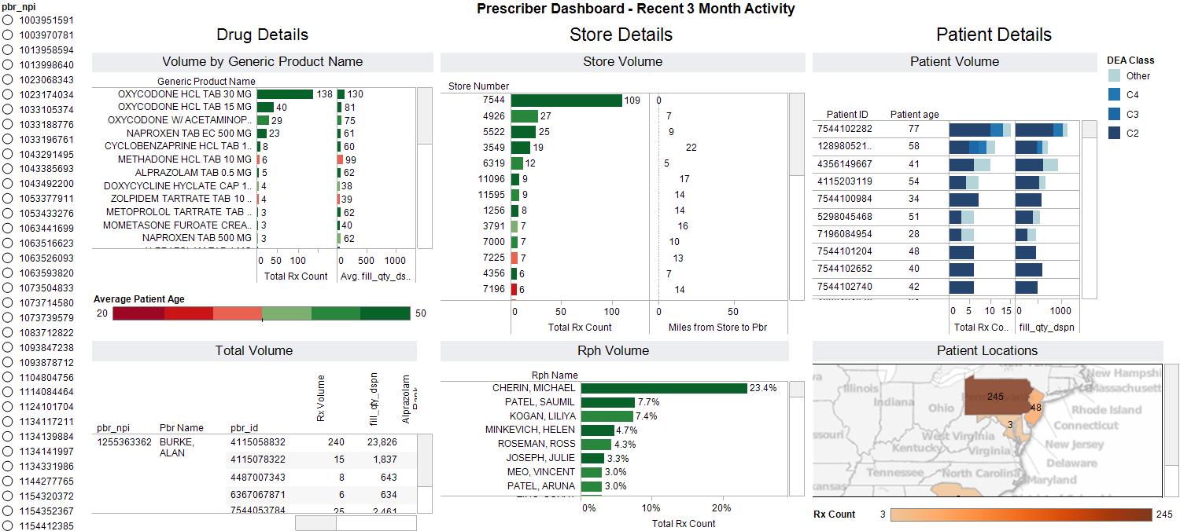
Data Provided by LP Analytics for Dr Alan Burke

Slide 5
Data Analysis Used

Slide 6
Prescriber Scorecard
These Prescribers are Recommended for Sanctioning
The scorecard below describes the factors that were evaluated to determine that controlled substance prescriptions should not be filled by Walgreens for selected prescribers.
Pbr Name | Disciplinary Action | Field Comments | DLPM Site Visit | Data Analysis | Avg. Rx/day filled at Walgreens
Burke | 5 year license revocation in ’95 | Witnessed stranger giving cash to multiple patients Store has stopped taking Rx | Neutral | Oxy – comprises 71% of total Rx, 62% paid in Cash/PSC 80% of Rx are controlled substance | 2.5 Controlled 0.6 Non-controlled
Wert | $100 penalty for failure to provide records - 2006 | None | 15+ patients in 30 minutes Only open 8 hours per week | Oxy – comprises 51% of total Rx 90% of Rx are controlled substance | 5.0 Controlled 0.7 Non-controlled
Bado | None | None | 6-15 patients in 30 minutes Pain Management Center | 90% of Rx are controlled substance Methadone – avg. 283 pills/Rx Oxy 30– avg. 204 pills/Rx | 4.0 Controlled 0.3 Non-controlled
Ouano | Yes | Viewed as suspicious - Doctor not certified in pain mgmt. but all Rx are for pain meds | Neutral | Oxy – 33% paid in cash, 97% of Rx are Oxy 15/30 92% of Rx are controlled substance | 3.1 Controlled 0.3 Non-controlled
Adin | None | Cash only prescriber Nearly all patients say ‘back pain from car accident’ | Neutral | Oxy – comprise 65% of Rx 92% of Rx are controlled substance | 5.4 Controlled 0.5 Non-controlled

Slide 7
Prescriber Scorecard - continued
Pbr Name | Disciplinary Action | Field Comments | DLPM Site Visit | Data Analysis | Avg. Rx/day filled at Walgreens
Siddiqui | None | Pbr office is confrontational when called | Neutral | Oxy 30 – avg. 217 pills/Rx, Oxy – avg. 14K pills/month over 12 months 83% of Rx are controlled substance | 4.0 Controlled 0.7 Non-controlled
Kessler | None | Not comfortable filling Rx for this pbr | Limited office hours Friday afternoon and weekend | Oxy 30 - avg. 170 pills/Rx Oxy – 49% paid in Cash/PSC | 4.4 Controlled 0.9 Non-controlled
Schneider | None | Seven addresses in IC+ | 6-15 patients in 30 minutes Patients arrive in large groups High security location | Oxy – comprise 62% of Rx, 31% paid in Cash/PSC 84% of Rx are controlled substance | 1.3 Controlled 0.3 Non-controlled
Miller | None | Doctor won’t provide treatment plan over phone RxS – ‘no longer filling for this pbr | Neutral | Oxy – composite ranking in top 3% across chain and avg. 10k pills/month over 12 months Methadone– avg. 413 pills/Rx | 5.1 Controlled 5.3 Non-controlled

