Slide 1
LeanSixsigma
Project Kick Off Meeting
TDGFD Process Time Reduction
2/28/17

Slide 2
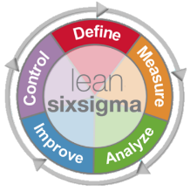
Agenda
What is WLSS and the Define Phase deliverables
Team structure, ground rules and norms
Begin working on a few early project deliverables
Charter
SIPOC
Process Map
Discuss how to collect the “voice of our customers”
Tailor a Communication Plan for our needs
Next Steps

Slide 3
WLSS is a Transformational Approach
WLSS is a customer-focused process improvement approach that drives better business results.

Slide 4
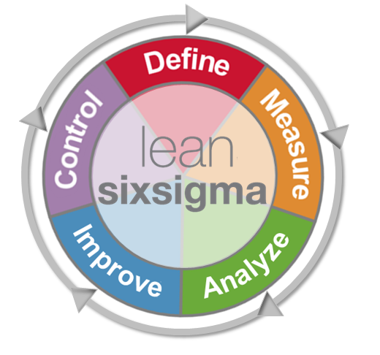
LSS - Proven Methodology for Executing Projects
Define
Define the customer, the problem & why you need to fix it
Control
Hold the gains through ongoing measuring & monitoring
Measure
Quantify baseline performance & document the process
Improve
Identify, select, test & implement solutions
Analyze
Validate the root causes of the problem
Notes:
Lean six sigma uses a D-M-A-I-C project flow. The flow from define to control is a building approach—each phase prepares the team for the next phase. The phased approach also gives the project champion a sense of how well the team is moving forward. There are reviews at the end of each phase to ensure the project is staying on track. These may be formal or informal, but should include a review of the phase deliverables and the insights they generated. They will also include discussion around next steps and anticipated timing.

Slide 5
Steps in Define
Project Charter
SIPOC Analysis (Supplier, Input, Process, Output, Customer) and Process Map
Voice of the Customer (VOC)
Stakeholder Analysis & Management
Develop Project Charter
Map the Current Process
(SIPOC)
Listen to the Voice of the Customer
Stakeholder Analysis & Management
Notes:
The first step in define is creating the project charter. This helps us zero in on our area of focus. Today we will complete a SIPOC analysis which really just maps out who our Supplier

Slide 6
Define Deliverables
By the end of Define, we should be able to:
Define why the project is important
Determine what business goals our project must achieve to be successful
Identify the key players for the project
Identify the boundaries (budget, time, resources) that have been placed on your project
Understand the key process that you will focus on (including its Suppliers, Input, Outputs, and Customers)
Know your customer requirements (i.e. what is critical to quality for them)

Slide 7
Team Structure and Norms

Slide 8
Our Team
Role
Champions | Tom Pietrini
Process Owner | Tasha Polster
Coach | Dave Luebbe
Green Belt | Matt Calvey
Finance Advisor | Bhavin Amin
Team Members | Dave Stauffer – Mgr Pharmacy Process Optimization Ed Bratton – Mgr Pharmaceutical Integrity Patty Daugherty – Mgr Pharmaceutical Integrity Eric Stahmann – Mgr Pharmaceutical Integrity
Other ad-hoc members | Patty Zagami, pharmacy team members

Slide 9
Team Ground Rules
Start and end on time
100% participation
Communication devices limited
Respect each other by practicing good listening
Spelling doesn’t count
What else?
Notes:
Notes:
Ask for agreement with each
Write on flip chart
Add others from participants if agreement
Try to ensure that the following get added:
Have fun
No “dumb” questions
“Process check” for when anyone is getting off track
Post Groundrules

Slide 10
Team Norms - Discussion
Key norm setting areas | Our team norms
What is our desired problem solving approach? | Regularly scheduled meetings Use problem solving tools for team meetings
How should we interact and communicate? | Weekly status meeting Other key stakeholders that need to be informed – as needed
Client interaction and/or meeting norms? | Team members on time and fully present during meetings and conference calls Send agenda prior to meeting start
What lifestyle aspirations do we have? | Meetings should end on time Are there certain days that are better for meetings than others? Are there days we should avoid?
How will we address absences? | Team members to provide explanation if declining meetings

Slide 11
Define Phase Deliverables
Project Charter
SIPOC
Process map

Slide 12
Project Charter: What are we trying to accomplish?
Bob Schaeffer
Project Details
Project Description | Increase capacity for our store Pharmacists by reducing the time it takes them to complete each Target Drug Good Faith Dispensing (TDGFD) checklist by reallocating work to technicians and/or decreases in overall process time.
Problem Statement | Pharmacists and Technicians must comply to completing our (TDGFD) checklist when dispensing prescriptions for Target Drugs. Currently Pharmacists spend approximately 5 minutes completing each checklist equating to an average of 150 hours/store per year. For every 10% reduction in this time commitment, the organization could save between $1.5 million and $8 million per year across approximately 7900 stores.
Business Case (Estimated Project Benefits): | Reducing Pharmacist process time to complete the TDGFD checklist by 10% would save the organization between $1.5 million and $8 million per year by reallocating Rph work to Technicians and/or decreasing overall process time.
 | Benefit Category |  |  | Benefit Sub-type
 | Direct |  |  | EBIT
Project Scope | First Process step in SIPOC | Technician indicates the prescription is a target drug |  | Last Process step in SIPOC | Pharmacist files the TDGFD checklist
 | Includes: | All pharmacies, Target Drug Good Faith Dispensing Checklist, Target Drugs - Oxycodone, Hydromorphone, Methadone, District Specific Drugs (Tablets/Capsules only).
 | Excludes: | Changes to the drugs currently on the TDGFD list and changes to the requirements to check the PDMP. Changes to customer interaction and prescriber call portions of the checklist
Project Goals | Metric |  | Baseline |  | Goal
Primary | Process time to complete a single TDGFD checklist |  | 7.2 minutes |  | 6.5 minutes (10% reduction)
Secondary (if applicable) | - Correct follow-up decisions |  | Needs to be measured |  | - No negative affect on decisions

Slide 13
SIPOC
Target Drug Good Faith Dispensing Process Time Reduction
Supplier
Input
Process
Output
Customer
Customer
Pharmacists
Technicians
Compliance Execution Team
Prescription from customer
IC+ Information
Visual appearance of customer
PDMP Database information
Blank TDGFD Checklist
TDGFD Policy
Completed TDGFD Checklist
Decision to dispense
Customer
Pharmacy Team Members
Compliance Execution Team
Technician identifies prescription as a Target Drug
Pharmacist retrieves TDGFD Checklist
Pharmacist and technician fill out form
Pharmacist decides if Rx should be dispensed
Pharmacist files the TDGFD Checklist

Slide 14
Voice of the Customer

Slide 15
What is the Voice of the Customer?
Voice of the Customer (VOC):
What the customer needs and how well the product/process meets those needs from the point of view of the customer
VOC Process
Identify Customers.
Collect and analyze customer data.
State customer needs in their own words.
Outcomes
Defined Critical to Quality requirements (CTQ)
Specifications for each CTQ

Slide 16
VOC Data Collection Plan Who is the customer and what data is needed?
VOC Data Collection Plan
Who?
How?
Pharmacy Team Members
Compliance Execution Team
Customers
Phone calls to stores, in person interviews, and a survey if necessary
Will call stores of varying volumes from various regions
I will handle the VOC data collection
What?
When?
What can we improve about the TDGFD Checklist?
Are there any changes that you would be opposed to?
What parts do you like about the checklist and/or are easy for you to use?
In Define Phase, Feb/March

Slide 17
Communication Plan

Slide 18
Communication plan: How are we ensuring stakeholder alignment?
Audience | Media | Purpose | Topics of Discussion / Key Messages | Owner | Frequency | Notes / Status
Core Team | 50 min in person or virtual meeting (for those not in Deerfield) | Keep team up to date and move project forward | Current status Decision making Next Steps Timeline | Matt | Weekly
Champion Meetings | In person 30 min meeting | Update champion on project status | Key milestones | Matt | Weekly
Tollgate Meetings | In person – via phone when necessary | Ensure alignment after each phase of the DMAIC process | Phase specific | Matt | ~ Once per month or as we move through the phases
SME engagement | In person meetings or via phone if remote | Gather information needed for the project | Data | Matt | As needed

Slide 19
Process Map

Slide 20
Developing a process map
Brainstorm process steps
Write on self-stick notes or a flipchart
Capture what really happens rather than what is supposed to happen
Arrange the steps in sequence
Check for missing steps or decisions
Number the steps
Identify inputs and outputs for each step
Identify key metrics for each step
Notes:
PG

Slide 21
Let’s choose between these formats
Activity Process Map
Deployment Process Map
Start
Step 1
Step 2
Step 3
Person or Function
Person or Function
Person or Function
Person or Function
Activity
Decision 1
Activity
Yes
Step 4
End
Activity
No
Decision 2
Yes
Activity
Step
Step
No
Activity
Activity
Notes:
PG

Slide 22
Next Steps
Update the charter
Update the SIPOC
Start drawing the Process Map
May take additional team meetings to complete this
Put our VOC plan into action
Put together a CTQ diagram from this
Plan our next meeting agenda

Slide 23
Thank You
Think Lean!

