Slide 1
DEA Update Market Leadership Meeting
Tasha Polster
Director, Pharmaceutical Integrity
January 2012

Slide 2
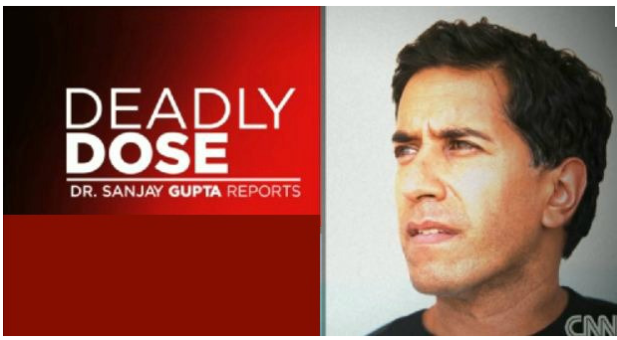
The New HOT Topic
Notes:
The new hot topic in the news is the epidemic America has: Prescription Pain Drug Abuse

Slide 3
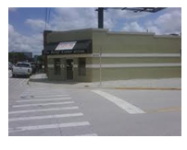
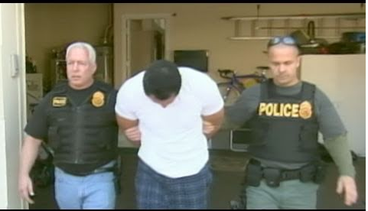
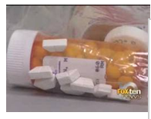
Florida Pill Mill Busts

Slide 4
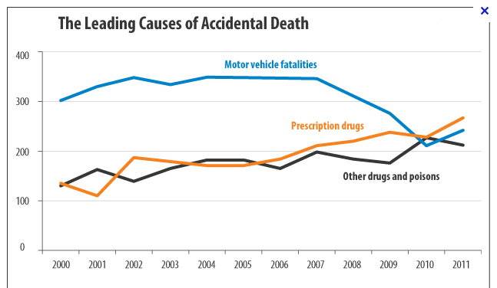
Leading Cause of Death - Prescription Drugs
Notes:
This particular stat came out of California, but there were multiple examples across the country where the leading cause of accidental death is prescription pain medications (opioid use). This national problem has brought increased scrutiny to physicians, pharmacists and drugs wholesalers from regulators, policy makers and law enforcement.

Slide 5
Title 21 Code of Federal Regulations
Section 1306.04 Purpose of issue of prescription.
(a) A prescription for a controlled substance to be effective must be issued for a legitimate medical purpose by an individual practitioner acting in the usual course of his professional practice. The responsibility for the proper prescribing and dispensing of controlled substances is upon the prescribing practitioner, but a corresponding responsibility rests with the pharmacist who fills the prescription. An order purporting to be a prescription issued not in the usual course of professional treatment or in legitimate and authorized research is not a prescription within the meaning and intent of section 309 of the Act (21 U.S.C. 829) and the person knowingly filling such a purported prescription, as well as the person issuing it, shall be subject to the penalties provided for violations of the provisions of law relating to controlled substances.
Notes:
Pharmacists are required by DEA regulations to ensure that prescriptions for controlled substances are dispensed for a legitimate medical purpose. This legal responsibility is pursuant to Title 21 code of Federal regulations. The important point of this regulation is “the corresponding responsibility rests with the pharmacist who fills the prescription”

Slide 6
Timeline of Events
Pre-August 2010
Steady increase in FL pill mills
Prescribers dispensing medications
October 2010
Change in Florida legislation restricts prescriber dispensing to only 72 hour supply of pain medications
October 10- March 11
Dramatic increase in the number of opioid pain medications prescriptions seen at retail stores
July 2011
Florida law amended to prohibit practitioners from dispensing C2-3, except in very limited instances

Slide 7
Timeline 2012
April 2012
Administrative Inspection Warrants were served on 6 stores and the Jupiter DC
May –June 2012
8 stores voluntarily removed all C-II products, Xanax and Soma
Re-launch of Good Faith Dispensing Policy
September 2012
ISO was issued for the Jupiter DC
November 2012
Order to Show Cause issued to 3 of the
original Florida pharmacies
Notes:
The key to note is that this isn’t just a Florida problem.

Slide 8
Timeline
December 2012
Target Drug GFD pilot begins in FL and Vegas
January
2013
Sanction prescriber pilot begins NJ and PA
February
2013
DEA administrative hearing begins

Slide 9
Operational Steps Taken
In June, we re-launched our Good Faith Dispensing Policy across the Chain
Pilots
Target Drug Good Faith Dispensing in FL and NV
Prescriber Sanctioning in NJ and PA
8 prescribers total
Invalid Prescriber DEA removal from IC+
Notes:
We had a COMPASS Communication last week announcing that we are removing Invalid DEAs
What is it?
A new IC+ enhancement is being released this week that will flag and remove Invalid DEA #’s
How will I know the DEA number was removed because it was invalid?
When the prescriber’s DEA # is removed, a message will be put in the comment field of the Prescriber Inquiry window that says:
WARNING INVALID DEA #. DO NOT ADD DEA #. DO NOT FILL C2-5 Rxs FOR THIS PRESCRIBER.
What do I need to know?
Pharmacy staff must look in the prescriber inquiry window for the message above before adding a DEA #.
If the message above is in the profile, do not register the prescriber again and do not add the DEA # back into IC+.
Pharmacy staff must verify that the prescriber’s DEA number is valid from the DEA website before registering any prescriber.
SNet -> RxOps-> Filling Prescriptions -> Good Faith Dispensing -> DEA Diversion Website -> Registration Validation or click link below
(https://www.deadiversion.usdoj.gov/webforms/validateLogin.jsp)
What do I do if this is a refill?
Speak with the patient to ask if they have a new prescriber they would like you to contact for a new prescription. If they do not have a new prescriber, they need to contact their existing prescriber for next steps, as Walgreens cannot fill this prescription under the current prescriber.
What if this is a new prescription?
Return the prescription to the patient and let them know they need to contact the prescriber for next steps.

Slide 10
Reporting Tools

Slide 11
Expired DEA CAP Override
Rx # | Store | Sold Date | Campaign ID | DEA # | Prescriber First Name | Prescriber Last Name | Drug | RPH | Consult Completed Date | Comments | Sold?
1491441 | Xxxx | 12/28/2012 | Doctor Suspension | XX1234567 | First | Last | OXYCODONE 30MG IMMEDIATE REL TABS | EXW | 12/28/12 7:20 PM | Consultation Completed: | YES
1900255 | Xxxx | 12/26/2012 | Doctor Suspension | XX1234567 | First | Last | CONTOUR TEST STRIPS 100'S | NAH | 12/26/12 1:33 PM | Consultation Completed: | YES
3002349 | Xxxx | 12/26/2012 | Doctor Suspension | XX1234567 | First | Last | VIT D 50,000 IU D2 (ERGO) CAPS (RX) | ERL | 12/26/12 12:01 PM | Consultation Completed: | YES
3017623 | xxxx | 12/26/2012 | Doctor Suspension | XX1234567 | First | Last | OMEPRAZOLE 20MG CAPSULES | ERL | 12/26/12 12:01 PM | Consultation Completed: | YES
Each week RxIntegrity gets a report showing CAP overrides
We need documentation back from the RXS that they discussed with
the pharmacist
We should not be dispensing any controls and for the example of Dr Pogue
his medical license was revoked, so non-control rx’s are not valid either

Slide 12
Customer Service in Regard to GFD Policy
Intentionally written with grey areas
Intended to be used as a guideline
Does not replace sound professional judgment

Slide 13
Suspicious Order Monitoring

Slide 14
Suspicious Order Monitoring
How normal and expected transactions are identified:
Accumulation of Receipts over time period - The system accumulates the amount of each controlled substance over the last six weeks.
Ceiling Limit - Data mining is done across Walgreens retail pharmacies to determine the maximum amount that a pharmacy should be allowed to receive in a rolling six week time period, based on statistical linear regression. The analysis compares like pharmacies across the country based on script volume and determines by drug what would represent unusual quantities.
Notes:
DEA regulations require that distributors (i.e.; the Walgreen distribution centers) must take reasonable measures to identify its customers, understand the normal and expected transactions conducted by those customers, and identify transactions that are suspicious in nature. Orders must be assessed to ensure that quantities for controlled substances at a specific location are reasonable. In making such assessments, a wholesale distributor may consider the purchasing entity's clinical business needs, location, and population served. In addition, Walgreens must report to the DEA any order that is deemed suspicious.
So the system takes into account normal accumulation for the store over the last 6 weeks and the maximum (a.k.a. ceiling) they should have over a rolling 6 weeks.

Slide 15
SOM as it Applies to Cardinal
Cardinal will limit the entire family of a drug based on monthly purchases
example: HC/APAP, Hydromet, Tussionex is all grouped into one
Orders they flag (ie; your invoice says “Restricted Due to DEA Regulations”) are reported immediately to the DEA
Cardinal has our sales history by store for the past year, so they can monitor any orders that deviate from the norm
Anything they deem as suspicious gets cut

Slide 16
All Receipts Count Toward Rolling 6-weeks
Warehouse
Interstore – should not be doing this
Vendor
Notes:
All receipts count toward the store’s rolling six week volume.

Slide 17
Best Practices For Ordering
Review all Controlled Substance receipts before posting
Adjust the shipped quantity to “0” if you did not receive
Post as short when appropriate
On-hands
Do not falsely increase/decrease on-hands
Do not increase/decrease suggested orders
- Do not manually inflate your orders

Slide 18
Industry Efforts

Slide 19
Industry Work
American Pharmaceutical Association (APhA)
American Academy of Pain Medicine (AAPM)
American Medical Association (AMA)
National Association of Chain Drug Stores (NACDS)
National Association of Boards of Pharmacy (NABP)
Notes:
This is not just a Walgreen issue, this is an industry wide issue. We have been working with or are in conversations with various organizations
Talk to some of the meetings/conversations……
As we further advance our pharmacy practices to meet these new challenges, we continue to believe that addressing prescription drug abuse will require all parties – including leaders in the community, physicians, pharmacies, distributors and regulators – to play a role in finding practical solutions to combatting abuse while balancing patient access to critical medication
Our goal is to lead the industry to a solution for this problem that affects all areas of healthcare.

Slide 20
Task Forces and Committee Meetings
If you or your Supervisors are asked to participate
- Yes, we need your help!
Contact us before agreeing to participate
Tasha Polster or Al Cater
We will ensure that you are fully versed or have additional corporate support
This team work will ensure we continue to build relationships with state agencies and remain a leader in the industry
Notes:
Many state regulators or agencies will ask for your participation in different task forces or committees because of the national presence Walgreens brings. We do need your help, but we also want to make sure that the person participating is fully versed on the national issue and not just seeing it from a district, state, or local level. Contact me or Al Carter and we will ensure that you have what you need from corporate before agreeing to participate.
This is an opportunity to make sure that laws and regulations that are created don’t hinder us from continuing in expanding our pharmacy practice to the highest level.

