Slide 1
Florida Visit
February 9, 2015

Slide 2
Industry Update
Global Purchasing Consolidation (Top 4 ~80% of US business)
        Mckesson/WBAD/Econdisc bidding traditionally direct customers
        Retailers analyzing potential change to how and where they procure product
Generic TRx penetration > 86% and growing
PBM’s changing philosophies
      Higher price generics being disadvantaged with higher tiered copays
Supply Chain Disruptions continue
        FDA increased scrutiny of both API and FD facilities
  Pricing Environment
  Marketplace dynamics dictating price erosion and appreciation
  Increases more prevalent on a small group of select products
Government Impact
      Delayed new product approvals double edged sword

Slide 3
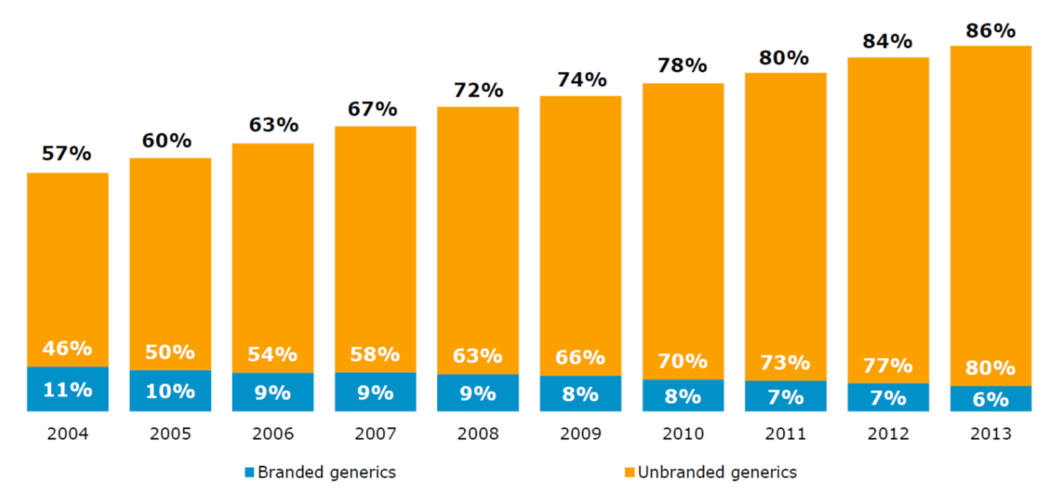
Generics Share of Prescriptions
Generics now account for 86% of all dispensed retail prescriptions
(Source: IMS Health, National Prescription Audit, Jan 2014)

Slide 4
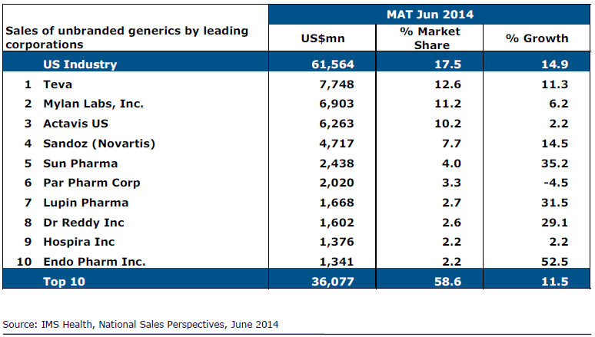
Sales of Leading Manufacturers in Generics:
Actavis is 3rd Largest

Slide 5



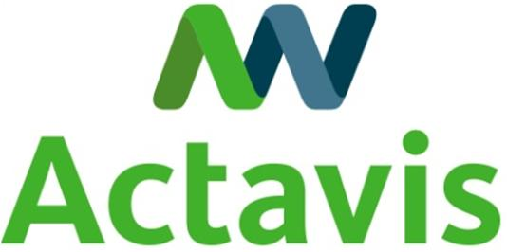


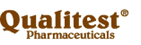

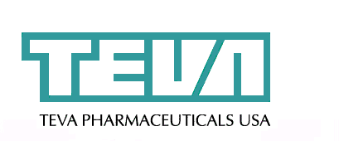
Actavis is the 3rd largest US Generics Company
Total Rx Dispensed (MM’s)
1
2
3
4
5
6
7
8
9
10
501
189
330
150
306
117
277
106
251
101
Source: IMS Health, MAT Dec. 2014

Slide 6

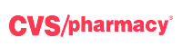


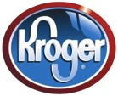
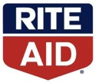

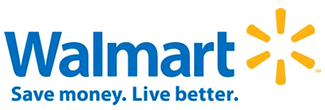
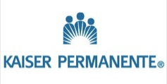
US Purchasing Power
Estimated Market Share Excluding Government

Slide 7
US and International Generics Pipeline
Continues to Expand
US Market | 228 ANDAs pending review; 60 FTF 19 FTFs (14 exclusive FTF, 5 shared FTF) 7 generic product approvals
International Markets | Approx. 1,200 MAAs pending 570 MAAs approved YTD – INN/Strength/Country in Int´l markets - 100 INNs in 53 countries
* MAA = Marketing Application Authorization
Notes:
This is complemented by our best-in-class generic product development organization, which led the industry with more than 750 filings across the globe in 2013 and our best-in-class generics pipeline, which is expanding to include injectable, inhalation, complex-modified release and other dosage forms.

Slide 8
Diversifying Portfolio with Higher Barrier Technologies
In Development
In Market
Filed at FDA
< 25%
~33%
~50%
IR Oral Solid
Topical/Patch
Ophthalmic & Optic
Inhalation
MR Oral Solid
Injectable
Oral Solution
Other
Chart: % of development projects based on # of products in each dosage form
8

Slide 9
# FTFs by Company – 2013 & 2014
43
As of January 8, 2015
Exclusive FTF
Shared FTF
Exclusive + Shared FTF
22
17
14
11
11
2
2
9
8
8
8
7
7
7
7
2
1
≤6
2
Actavis
Sandoz
Mylan
Amneal
Apotex
Teva
Dr. Reddy’s
Hetero
Lupin
Glenmark
Par
Roxane
Sun
*Others (29)
**Un-
known
*Others: Accord, Agila, Akorn, Alembic, Alkem, Alvogen, Amerigen, Arbor, Aurobindo, BPI Labs, Breckenridge, First Time US Generics, Fresenius, Hikma, Hospira, Impax, InnoPharma, Lannett, Mayne, Micro Labs, Panacea, Perrigo, Prinston, Ranbaxy, Sawai, SigmaPharm, Unimark, Wockhardt, Zydus
**Unknown: Generic filer not yet identified (not sued)
Note: Total is greater than 120 (44 FTFs posted in 2013 + 76 FTFs posted YTD 2014) due to shared FTFs
Source: FDA Paragraph IV Certifications Website, IPD Analytics and internal analysis

Slide 10
2015 Top 20 Products

Slide 11
2014 Top 15 Customers

Slide 12
Conclusion
Actavis is the best positioned US generic company to navigate the rapidly changing market place
Diversified product line
#1 pipeline
Great supply chain
Excellent cross functional collaboration
Best understanding & market intelligence in the industry
Long standing relationships

Slide 13
>> As the largest supplier of product to the US market, We are proud to work with such a great team
>> Your success is our success
>> We cannot succeed without you!
>> We Thank You for All your hard work
THANK YOU!

Slide 14
Q & A

