Slide 1
Actavis – A Global Leader in Specialty Pharmaceuticals

Slide 2
US Generic Industry Update
Purchasing Power Consolidation
Emergence of large GPO’s (WBAD, Econdisc, CVS/Cardinal)
McKesson/Rite Aid combined procurement
Walmart evaluating options
Some price erosion offset by marketplace dynamics
Price increases more prevalent due to supply shortages or low margin
Supply Chain Disruption
Teva, Mylan, Sandoz improving
Smaller companies (Ranbaxy, Wockhardt, Sun, Qualitest) declining
FDA increased scrutiny of facilities
FDA/Healthcare Reform
ANDA application fees (GDUFA) implemented
    Addressing global facility compliance & ANDA backlog
REM’s program requirements more numerous
Pedigree/Serialization requirements still under development

Slide 3
Manufacturer Consolidation
Top 10~57% US$ Generic Share
Market Share
Source: IMS Health, MAT Dec. 2013

Slide 4

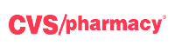


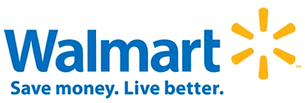


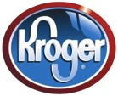
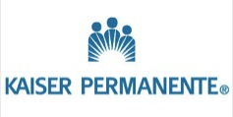
Top Pharmacy Customers in US by estimated Market Share

Slide 5
Actavis Pharma US Update

Slide 6



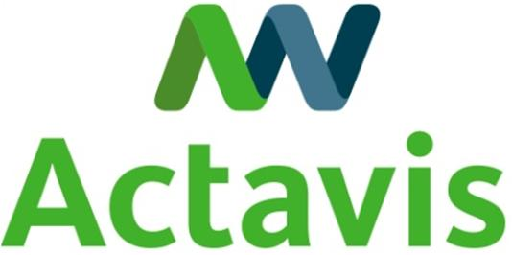





Actavis is the 3rd largest US Generics Company
Total Rx Dispensed
1
2
3
4
5
6
7
8
9
10
561
182
358
129
298
102
209
99
206
96
Source: IMS Health, MAT Dec. 2013

Slide 7
Overall US Generic Strategy
Maximize value of product portfolio
  Leverage supply chain and relationships
  Execute strategic pricing/volume matrix opportunities
Grow Rx leadership position in market
  Breadth of product portfolio
  Pipeline (through R&D , BD)
First to market, last to exit
  R&D FTF opportunities
  Global Supply Chain Initiative to reduce COG’s
#1 in Customer Satisfaction
  Reputation of quality
  Value added & cost saving project implementation (ie using Anda as a 3PL)
  Superior supply chain/Service levels
  Service through cross functional customer relationships
Expand offerings into injectables, creams/ ointments, inhalations, & liquids
7

Slide 8
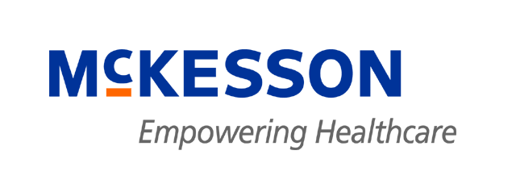
US Pharma
2013 Top 15 Actavis Customers
~91% of Total Generic Business
Customer | $ M | %
Walgreen | $1,070 | 25.1%
CVS | 592 | 13.9
Anda | 364 | 8.6
McKesson | 325 | 7.6
Walmart Stores | 233 | 5.5
Gov’t (incl rpkgrs) | 200 | 4.7
AmerisourceBergen | 196 | 4.6
Econdisc | 180 | 4.2
Rite Aid | 135 | 3.2
Cardinal | 120 | 2.8
Optisource | 86 | 2.0
Kaiser Permanente | 84 | 2.0
Morris & Dickson | 46 | 1.1
Omnicare | 44 | 1.0
HD Smith | 42 | 1.0

Slide 9
Top 15 Watson Generic Products
~51% of Total Generic Revenue*
Product | NS$ | % of Sales | Development Site^
Methylphenidate ER | 791 | 21.5% | Florida
Metoprolol ER | 167 | 4.5% | Florida
Mixed Amphetamines | 132 | 3.6% | Elizabeth
Hydrocodone | 129 | 3.5% | Corona
Enoxaparin | 86 | 2.3% | TPM
Microgestin | 69 | 1.9% | Corona
Fentanyl Patch | 67 | 1.8% | Salt Lake City
Potassium Tabs ER | 64 | 1.7% | Florida
Morphine Sulfate | 58 | 1.6% | Elizabeth
Oxycodone/APAP | 57 | 1.6% | Corona/Elizabeth
Metformin HCl XT | 50 | 1.4% | Florida
Oxycodone HCl | 50 | 1.4% | Elizabeth
Bupropion XL | 49 | 1.3% | Florida/ASA
Next Choice | 47 | 1.3% | Corona
Gabapentin | 42 | 1.1% | Elizabeth
Top 25
~ 61%
* YTD May, 2013 Annualized
^ Development site

Slide 10
Actavis R&D/BD Update

Slide 11
We continue to diversify our pipeline into new dosage forms
Less than 50% of new projects selected for the US last year were
oral solids
US New Projects Selected 2013
Other
13%
IR Oral
Solid
11%
Inhalation
4%
5%
28%
11%
Topical
13%
67%
ER Oral
Solid
26%
Injection
Based on # of new products selected for development in 2013, excludes in-licensing

Slide 12
Portfolio – The good news!
There is no shortage of new product opportunities

Slide 13
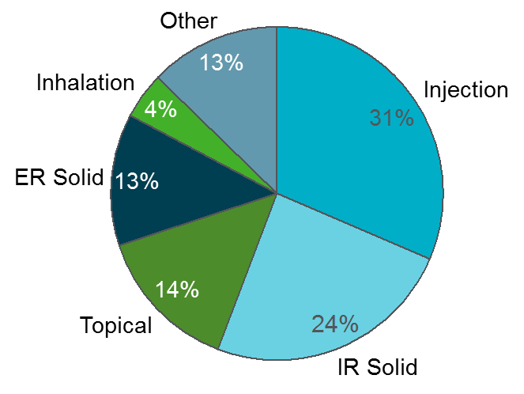
Newly endorsed products for US
85

Slide 14
Injectable products now in our US pipeline
50
Projected Sales of Marketed/Pipeline $US

Slide 15

Actavis won the race on FTFs in 2013!

Slide 16
Actavis Leads US First-to-files
Number of First-to-files in 2013 by Company
18
Exclusive + Shared FTF
Shared FTF
Exclusive FTF
8
5
5
4
4
3
3
3
3
≤2
1
1
1
1
Actavis
Sandoz
Amneal
Mylan
Glenmark
Hetero
Alkem Labs
Lupin
Teva
Zydus
Others* (16)
Source: FDA website, Public lawsuits, Internal Analysis
Note: Total is greater than 44 due to shared FTFs

Slide 17
Actavis achieved 41% of all FTFs and 61% of the FTF $
Competing against 100+ Gx companies
First-to-File # Products in 2013¹
Product Sales of FTFs in 2013²
Shared
Shared
Exclusive
2.5
Exclusive
26
61%
44
41%
6.3
0.9
6
2.9
12
Total
Others
Actavis
Total
Others
Actavis
¹ First-to-Files posted on the FDA website in 2013
² IMS Health Sales MAT Nov. 2013, $ in Billions

Slide 18
How do we win in this extremely competitive market?

Slide 19
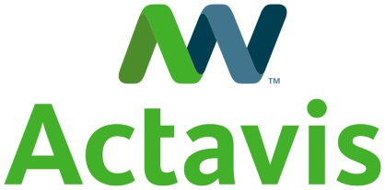
We may have all come on different ships,
But we’re in the same boat now.

Slide 20
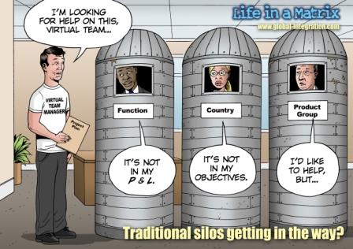

It Starts with Collaboration
Can you supply us Lorazepam?
WAG’s
ial
HR
Finance
Operations
Commercial
We will decide what to Mfg
Just Mfg what we forecast
These are
Only special
numbers
Notes:
Matrix structure has it pros and cons as we all know
But still at the end of the day we all want to be special
WE have few person also wanted to get special…who does not want to be special
But at the end of the day We have to get rid of the silos

Slide 21
Our Strengths
Cross functional collaboration both internal and external
    Relationships
    Integrity
    Communication
    Transparency
Supply Chain execution
    Consistency
    Flexibility
    Find a way to say “Yes” without jeopardizing existing business
Product line
    One of largest breadth in the industry
    Strongest pipeline in the industry
Maximize value of assets

Slide 22
Where does Elizabeth fit in the Puzzle?
Consistent Quality and Supply
Competitive COG’s
Agile to maximize unforeseen opportunities such as Duloxetine
Continued great communication and collaboration across all functional areas
    Commercial
    R&D

Slide 23
Elizabeth Sales by Product

Slide 24
Our success is due to your collaboration and support.
Thanks for all your hard work!!

Slide 26
US Pharma
2014 Commercial Upside Opportunities
Opportunity | Potential GP
Delay in Mylan and/or Endo AG Lidocaine launch | $20M/month
Oxycodone price increase | $10M/month
Lower than expected price erosion | $40M
Reschedule and/or Hydrocodone price increase | $2M- $5M/month
Buprenorphine/Naloxone PBM intervention (30% share) | $3-$4M/month
Lower than anticipated OC unit/price erosion | $20M
Earlier launch on Hydromorphone (Exalgo) | $3M/month
Other Price increases | TBD

Slide 27
US Pharma
2014 Commercial Downside Risks
Risk | Potential GP
Higher than budgeted price erosion (i.e. WBAD/ABC=$60M) | $40-$80M
Additional Mixed Amphetamine competition | $10M-$15M
Additional Methylphenidate competition | $15M-$20M
Additional Buprenorphine/Naloxone competition | $15M
Mckesson combination with retailer for GPO | $60-$80M
Supply chain risk | $10-$20M

