Slide 1
Operations Planning Summit
June, 2 2015

Slide 2
Start with a Thanks!
Thanks for the Collaboration
Thanks for the Communication
Thanks for being Proactive
Thanks for finding a better solution
Thanks for recognizing that we are in this together
Thanks for the tireless hours spent to support the team

Slide 3
Industry Update
Global Purchasing Consolidation (Top 4 ~80% of US Market)
        Mckesson & Cardinal aggressively bidding traditionally direct customers
        Mid size customers analyzing potential change to how and where they procure product
Generic TRx penetration > 86% and growing
PBM’s changing philosophies
      Higher priced generics being blocked or disadvantaged with higher tiered copays
Supply Chain Disruptions continue with less frequency
        FDA increased scrutiny of both API and FD facilities
  Pricing Environment
  Proactive & aggressive bid cycle for all major customers
  Marketplace dynamics dictating price erosion and appreciation
  T’s & C’s of large GPO’s delaying or discouraging some price increases
Government Impact
      Delayed new product approvals double edged sword

Slide 4
Products Facing LOE in the Next 4 Years
Valued at $78.4 Billion
Nexium, Abilify and Namenda face generic competition in 2015

Slide 5
US Generic Sales were $65 Billion & YoY Growth of 14.2%

Slide 6
US Generic TRx’s were 3.5 Billion & YoY Growth of 4.2%

Slide 7


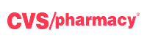




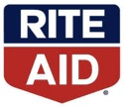

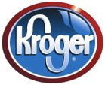



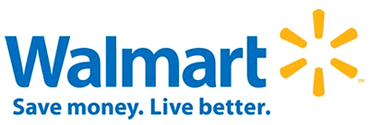


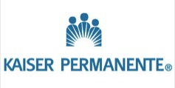
US Purchasing Power Excluding Government

Slide 8



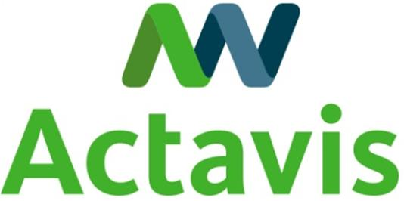


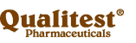


Actavis is the 3rd largest US Generics Company
Total Rx Dispensed (MM’s)
1
2
3
4
5
6
7
8
9
10
501
189
330
150
306
117
277
106
251
101
Source: IMS Health, MAT Dec. 2014

Slide 9
Top 20 Customers (Does not include full Anda sales)
Company | OTC | Rx | 2014 Generic Total
WBA (Walgreens/ABC) | 22.2 | 1,698.8 | 1,721.0
McKesson (incl RiteAid & Omnicare) | 1.8 | 621.5 | 623.3
Red Oak (incl CVS/Caremark & Cardinal) | 18.1 | 530.1 | 548.2
Wal-Mart | 14.3 | 295.0 | 309.3
Econdisc (incl ESI, Kroger & SuperValu) | 0.4 | 198.9 | 199.3
Government (incl PL Distributors & Apexus) | 0.5 | 176.9 | 177.4
Anda | 1.6 | 100.4 | 102.0
Optisource | 0.3 | 95.7 | 96.0
MHA | 1.1 | 55.5 | 56.6
Morris & Dickson | 0.3 | 55.5 | 55.8
Kaiser | 0.0 | 44.4 | 44.4
HD Smith | 0.6 | 40.3 | 40.9
Humana | 0.0 | 37.8 | 37.8
Publix | 0.3 | 32.5 | 32.8
PVA (Premier Value Alliance) | 1.1 | 31.8 | 32.9
HEB | 0.9 | 27.3 | 28.2
Target | 0.0 | 27.1 | 27.1
American Sales Co | 0.0 | 26.6 | 26.6
Meijer Drug | 0.1 | 21.6 | 21.7
Cigna Healthcare | 0.0 | 20.8 | 20.8

Slide 10
Top 15 Products
Products | Actual 2014 Net Sales
Lidocaine Patch | $556.8
Methylphenidate AG | 392.9
Metoprolol ER Andrx | 174.0
Mixed Amphetamine | 145.6
Duloxetine Hydrochloride | 138.0
OTC (incl Nicotine & Next Choice) | 94.8
Oxycodone/APAP | 93.4
Methylphenidate IR | 84.0
Doxycycline Hyclate | 73.2
Buprenorphine/Naloxone | 72.9
Metformin HCL XT AG | 67.8
Hydrocodone/APAP | 63.6
Potassium CHL Andrx | 62.6
Enoxaparin | 62.2
Propranolol ER | 59.7

Slide 11
Methylphenidate ER Weekly TRx (Last 4 Weeks)
IMS RAPID Weekly Audit May 15, 2015

Slide 12
Development Portfolio Well Diversified
Across Dosage Forms
US Products & Development Projects*
Filed at FDA
In Development
26%
8%
36%
15%
17%
24%
26%
17%
IR Oral Solid
Injectable
Inhalation
MR Oral Solid
Ophtho/Otic
Hormones
Topical/Patch
Oral Liquid
Other
*Based on # of products in each dosage form

Slide 13
# FTFs by Company – 2013-2015 YTD
50
As of April 23, 2015
More FTF exclusives than Teva, Mylan & Sandoz Combined
Exclusive FTF
Shared FTF
Exclusive + Shared FTF
24
18
17
14
2
11
10
2
2
9
9
8
8
8
7
7
7
2
2
1
≤ 6
Actavis
Sandoz
Mylan
Apotex
Amneal
Teva
Hetero
Lupin
Dr. Reddy’s
Par
Sun
Accord
Fresen-
ius
Roxane
*Others (31)
**Un-
known
*Others: Akorn, Alembic, Alkem, Alvogen, Amerigen, Arbor, Aurobindo, BPI, Breckenridge, Emcure, Ezra, First Time US Generics, Glenmark, HEC, Hikma, Hospira, Huahai, Impax, InnoPharma, InvaGen, Lannett, Mayne, Micro Labs, Panacea, Perrigo, Praxair, Sawai, SigmaPharm, Unimark, Wockhardt, Zydus
**Unknown: Generic filer not yet identified (not sued)
Note: Total is greater than 137 (44 FTFs posted in 2013, 75 in 2014, & 18 in 2015 YTD) due to shared FTFs
Source: FDA Paragraph IV Certifications Website, IPD Analytics and internal analysis

Slide 14
# FTFs by Company – 2015 YTD
7
As of April 23, 2015
7
Exclusive FTF
Shared FTF
1
1
1
1
1
1
1
1
Actavis
Accord
Alembic
Apotex
InvaGen
Lupin
Par
Praxair
Teva
**Un-
known
**Unknown: Generic filer not yet identified (not sued)
Note: Total is greater than 18 (# FTFs posted YTD 2015) due to shared FTFs
Source: FDA Paragraph IV Certifications Website, IPD Analytics and internal analysis

Slide 15
US Recap
Best positioned generic company to navigate the rapidly changing market place
Diversified product line
#1 pipeline
Best in class supply chain
Service driven streamlined organization
Best understanding & market intelligence in the industry
Long standing relationships
Challenges
Competitors gConcerta studies and outcomes create significant upside or downside
FDA new product approval timing and mix unknown
Ability and timing to leverage price increase opportunities significantly reduced
FTS (failure to supply) penalties dramatically increasing while customer O/H inventories decreasing

Slide 16
How Do We Remain The Best?
Where Does Supply Chain Fit In?
Customers are making decisions based upon a small set of criteria:
Price >> need competitive COG’s
Service Levels >> Can never be out of stock as it leads to lost revenue
Future Innovation >> Pipeline creates future value (volume rebates)
Ease of doing business >> capable of making decisions and resolving issues quickly
Relationships >> Integrity, communication, transparency
Supply Chain impacts all 5 of the key criteria items

Slide 17
Our success is due to our collaboration, communication and your overall support.
Thanks for all your hard work!!

