Slide 1
New Mexico Controlled Substance Trends
Tasha Polster
5/22/2013

Slide 2
Agenda
Brief overview of Pharmaceutical Integrity
Target Drug GFD Policy/Common Misconceptions
New Mexico Data
Questions

Slide 3
Pharmaceutical Integrity
Created to protect and grow Walgreens controlled substance business
Transforming community pharmacy to play a greater role in the Opioid Narcotic Epidemic
Managing, creating, and maintaining controlled substance dispensing, monitoring and reporting programs including the National Target Drug Good Faith Dispensing program
Notes:
Rx Integrity was created to protect and grow Walgreens controlled substance business while transforming community pharmacy to play a greater role in the Opioid Narcotic Epidemic and protect our business against high risk prescribers.
Rx Integrity is responsible for managing, creating, and maintaining controlled substance dispensing, monitoring and reporting programs including the Good Faith Dispensing Policy, and the National Good Faith Dispensing program.

Slide 4
Pharmaceutical Integrity
Review orders that are manipulated by the store in order to determine whether the order meets specific criteria to qualify as suspicious. Suspicious orders are sent to the DEA and State Boards as required
Work closely with various departments including Legal, Government Affairs, Logistics, Inventory, Loss Prevention, IT and others to ensure company wide awareness and adherence to federal, state, and local laws and regulations
Notes:
Walgreens has identified the following orders of interest that appear to be of an unusual size, unusual frequency or deviate substantially from a normal pattern.
Rx Integrity team identifies and minimizes loss of Company assets and ensures the safety, compliance and security of the ordering and dispensing of controlled substances. The Rx Integrity team will investigate and report potential violations of laws, regulations or Company policy internally and suspicious orders externally to the DEA, State Boards, and other agencies as required. Rx Integrity currently owns, makes recommendations, and utilizes the Controlled Substance Order Monitoring System (CSOM) to manage the amount of controlled substance product that is shipped to the stores. The CSOM system was developed to flag orders by store by drug that are above the norm or average units of each controlled substance product that is sent to stores in a 6 week rolling period. The team reviews orders that are manipulated by the store in order to determine whether the order meets specific criteria to qualify as suspicious. Suspicious orders are sent to the DEA and State Boards as required.
The team works with various departments including Legal, Government Affairs, Logistics, Loss Prevention, IT and others to ensure company wide awareness and adhere federal/state/local laws and regulations. Rx Integrity is tasked in developing a collaborative working relationship with government, law enforcement, and industry organizations (e.g., DEA, FDA, State Boards of Pharmacy, National Retail Federation, Retail Industry Leaders Association, National Association of Drug Diversion Investigators) to drive industry leading solutions to pharmaceutical diversion.

Slide 5
Common Misconceptions of the TD GFD Policy
Calls to prescribers are required for all target drugs
There are quantity limits for Target Drugs
Valid ID is required for the person the prescription is written for
It is okay to scan and save a patient’s ID to their IC+ profile
All controlled drugs require a completed checklist
Pharmacists can ask the prescribers for copies of patient medical records (MRIs, X-rays, pain assessment records…etc.)
A ‘refill too soon’ or an ‘early fill’ is an automatic refusal to fill and the prescription should be faxed to the DEA
Notes:
For Hospice and Oncology patients only: If unable to reach the prescriber, RPh may fill the Rx without verification by the prescriber provided the
elements of Good Faith Dispensing are met.

Slide 6
Common Misconceptions of the TD GFD Policy
It is okay to provide prescribers/patients a copy of the checklist/policy
PDMP reports can be given to the patient
When faxing a refused prescription to the DEA, pharmacists should also include the completed checklist and/or the PDMP report
If a patient’s TD prescription is refused, that patient is no longer able to fill another prescription for that medication again at Walgreens
The TD GFD policy is mandated by the DEA and/or Board of Pharmacy
Overnight pharmacists are exempt from TD GFD
Notes:
Refusal message: “Walgreens is working hard to ensure the appropriate dispensing of certain pain medications. Based on my clinical review and professional judgment, this prescription does not meet the requirements we have put in place for dispensing these medications. Therefore, we cannot fill this prescription in good faith at this or any Walgreens. I apologize for any inconvenience.”

Slide 7
New Mexico Overview

Slide 8
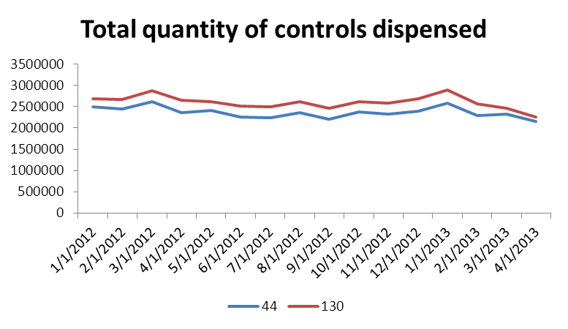
Overall Control Trend
District 44 has seen a 3.6% decrease in the quantity of controls dispensed year over year.
District 130 has seen a 3.5% decrease in the quantity of controls dispensed year over year.
Both districts have had a ~3.5% decrease in the number of Control Rx scripts.

Slide 9
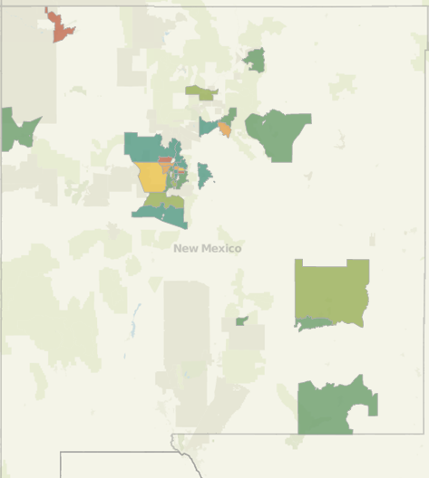
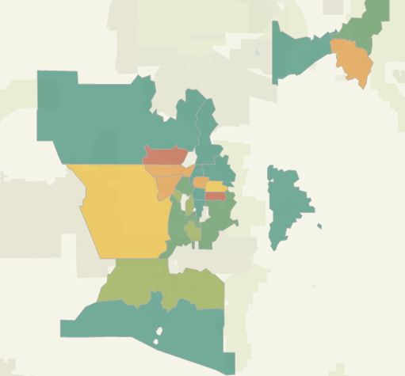
Geographic Distribution of Controlled Scripts
Data for 1/1/2013 to 3/31/2013

Slide 10
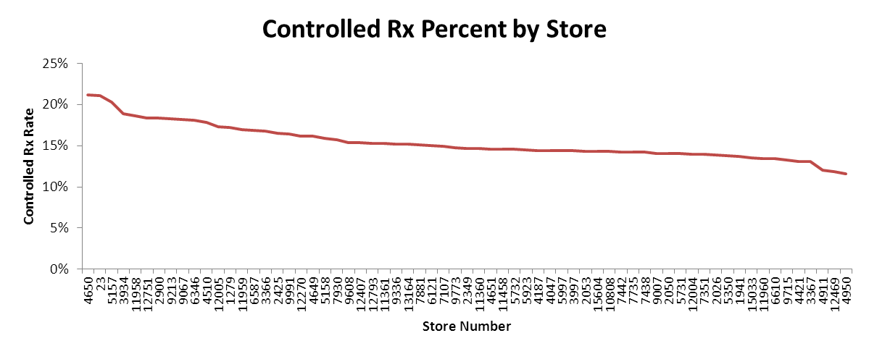
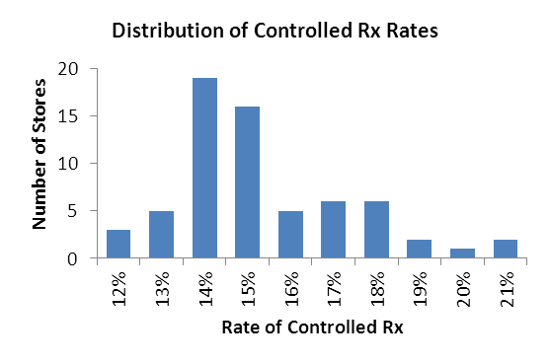
Rate of controlled Rx dispensing
Stores in districts 44 and 130 average a rate of 15.2% controlled substance dispensing. The chain average is 15.3%
Some stores have a controlled dispensing rate as high as 21%
Data for 1/1/2013 to 3/31/2013

Slide 11
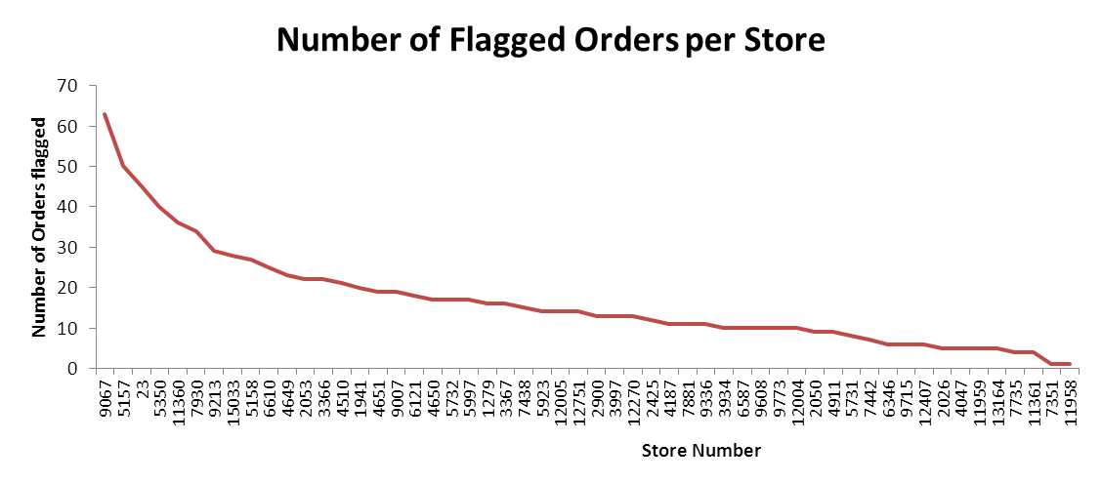
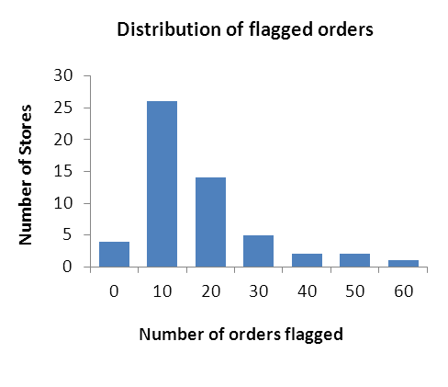
Suspicious Orders per store
Stores in districts 44 and 130 averaged 16 flagged orders in this time period.
Top 10 stores accounted for 42% of all flagged orders.
Highest stores had as many as 63 flagged orders.
Data for 1/1/2013 to 3/31/2013

Slide 12
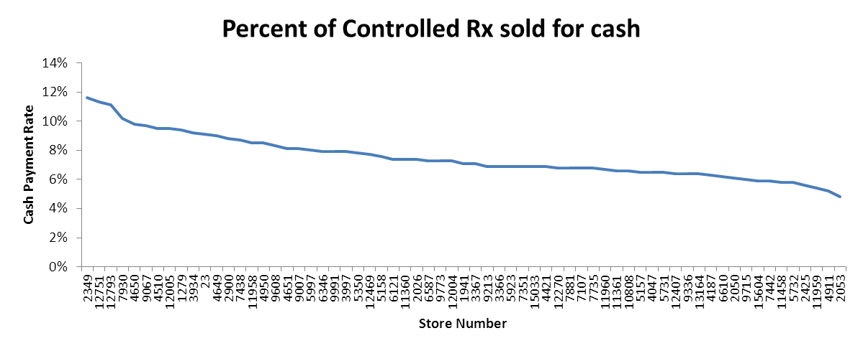
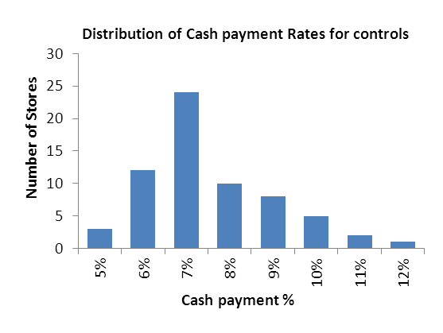
Cash Payment rate for Controlled Rx
Stores in districts 44 and 130 average a rate of 7.5% for cash payments on controlled substances. The chain average is 8.4%
Some stores have a controlled dispensing rate as high as 12%, which is almost twice the average.
Data for 1/1/2013 to 3/31/2013

Slide 13
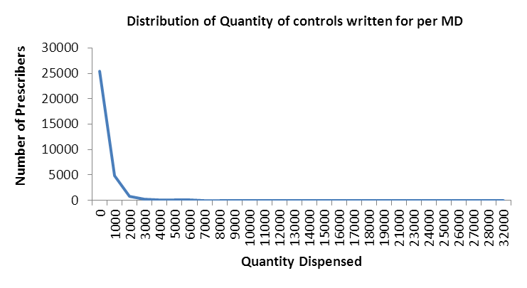
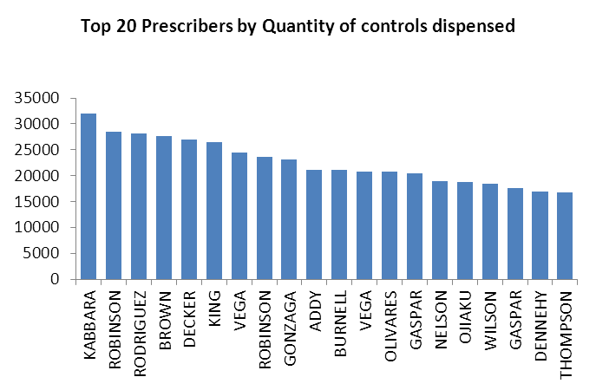
Top Prescribers of Controls
Prescribers serviced by districts 44 and 130 wrote for an average total quantity of 257 units (tabs, caps, etc.) of controls.
The top prescribers exceed this average by as much as 12,400%.
Top 100 prescribers wrote for 9% of all controls dispensed from 58,839 prescribers.
Data for 1/1/2013 to 3/31/2013

Slide 14
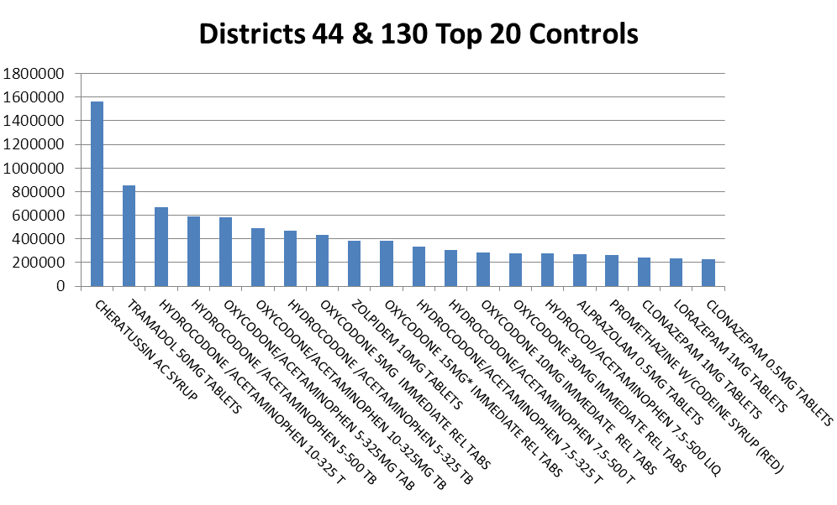
Top 20 Controlled Substances
Top 20 controlled substances accounted for 60% of all controls dispensed.
Hydrocodone alone accounted for almost 22% of all controls dispensed with over 3,302,907 dosage units dispensed across 55,661 scripts.
Data for 1/1/2013 to 3/31/2013

Slide 15
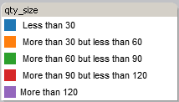
Hydrocodone distribution
Top 10 Hydrocodone distribution by quantity size.
Data for 1/1/2013 to 3/31/2013

Slide 16
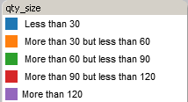
Oxycodone distribution
Top 10 Oxycodone distribution by quantity size.
Data for 1/1/2013 to 3/31/2013

Slide 17
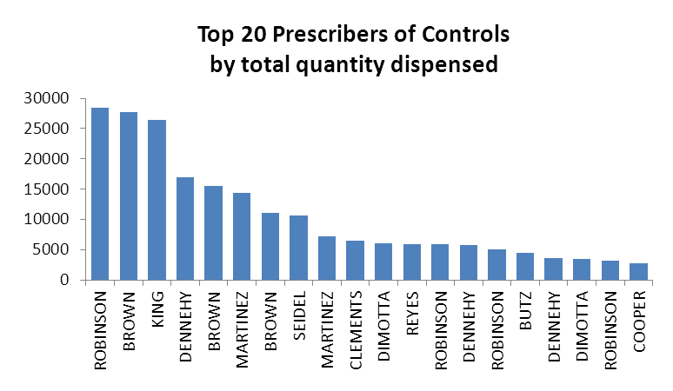
Top Prescribers – 4650
Top 20 prescribers wrote for 60% of all controls dispensed by 591 prescribers.
Data for 1/1/2013 to 3/31/2013

Slide 18
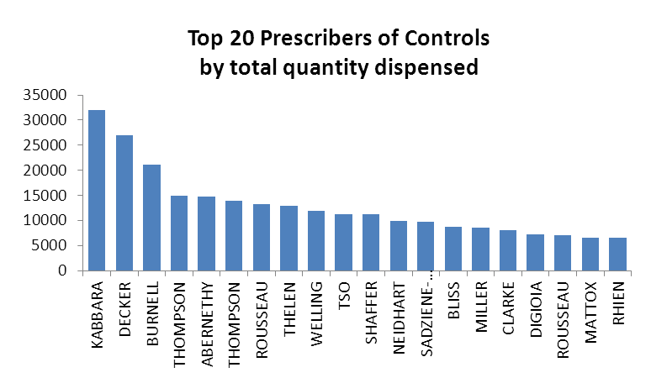
Top Prescribers – 9067
Top 20 prescribers wrote for 41% of all controls dispensed by 621 prescribers.
Data for 1/1/2013 to 3/31/2013

Slide 19
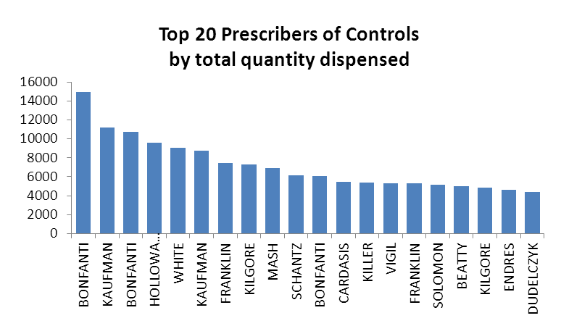
Top Prescribers – 12751
Top 20 prescribers wrote for 44% of all controls dispensed by 645 prescribers.
Data for 1/1/2013 to 3/31/2013

